Slide 1

let your training
journey begin

Slide 2

I’d like to learn about this product myself…

Slide 3
Using this presentation
Navigate to a specific section using the interactive links on the next slide, OR
Follow along slide-by slide
We recommend you view this PowerPoint in Presentation mode for the best experience.

Slide 4
Contents
Introduction to the platform
What is it? What’s in it? Who is it for?
Finding and selecting data
The homepage, browsing, searching
Manipulating the data
Data visualization – chart options
Displaying data values
The Calculator
Exporting the data
Creating permanent links (DOIs)
Exporting data for manipulation
Exporting the data visualization
Exporting to reference managers

Slide 5
Introduction to the platform
Back to Contents
What is it? What’s in it? Who is it for?

Slide 6
Data Planet, acquired by SAGE in 2018, is a statistical data repository and aggregation tool, providing access to over 12.6 billion international datasets, from 80 global sources.
Users can browse and search to obtain incredibly specific and detailed information, compare and contrast variables of interest across multiple datasets through a single point of access, and create customized views in tables, maps, rankings, and charts.
You can access the platform at:
https://statisticaldatasets.data-planet.com

Slide 7

The datasets are...
Sourced from authoritative, credible organisations
Current (where the source is still collecting the data)
Accessible in both table and charts formats
Documented (links back to the original data source)
Citable, with formatted exports and DOIs
  DataCite, APA, MLA, Chicago, RefWorks, EndNote, and Zotero
Easily exportable to other software
  Excel, SAS, SPSS, XML, CSV, PDF, PowerPoint, and SHAPE

Slide 8

What’s in it?
The content you can access through Data Planet will depend on the subscription at your library
It’s possible your library does not subscribe to all of our content
If you aren’t sure which content your institution subscribes to, please check with your library staff

Slide 9


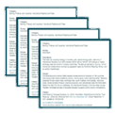
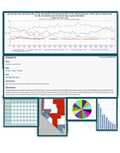
Datasets are ingested from many types of sources
Datasets are standardized into our common structure
+
Datasets are editorialized with 37 fields of metadata
=
The result is over 12.6 billion datasets that can be viewed as…

Slide 10
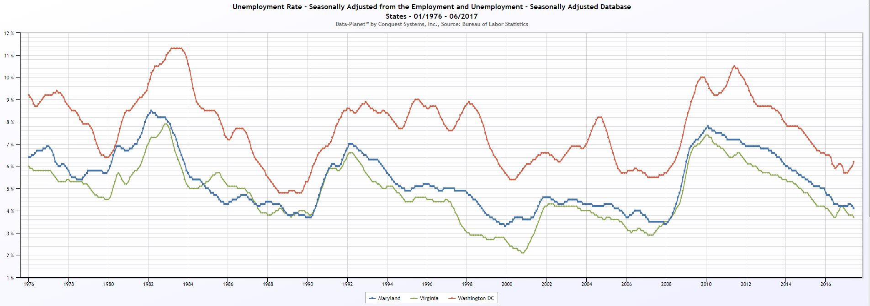
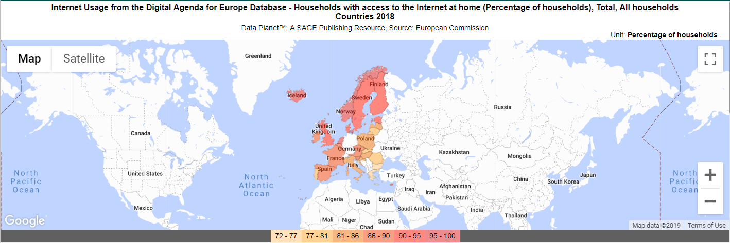
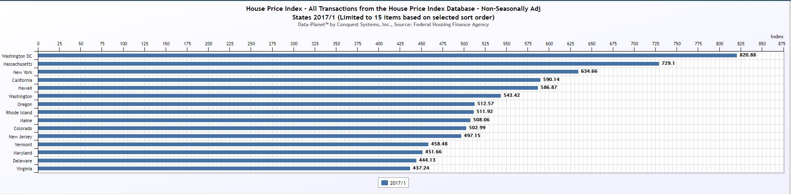
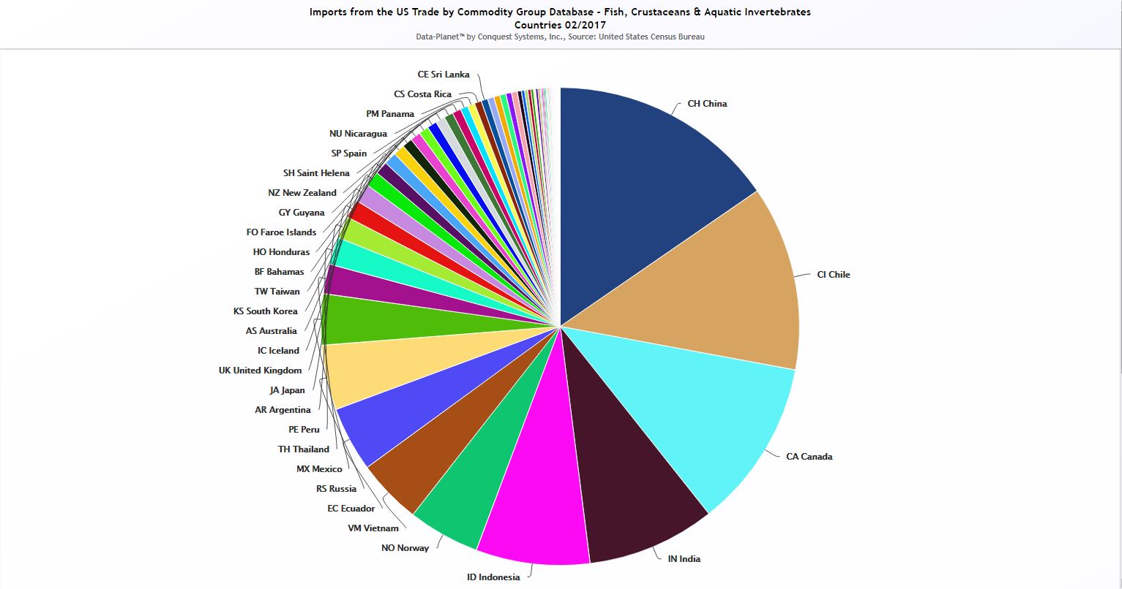
Trend charts
Maps
Rankings
Pie Charts

Slide 11
Data Planet subject coverage
Agriculture & Food
Banking, Finance & Insurance
Criminal Justice & Law Enforcement
Education
Energy Resources & Industries
Government & Politics
Health & Vital Statistics
Housing & Construction
Industry, Business & Commerce
International Relations & Trade
Labor & Employment
Military & Defense
Natural Resources & Environment
Population & Income
Prices, Consumption & Cost of Living
Transportation & Traffic

Slide 12
Data Planet content
Datasets are sourced from a wide variety of authoritative public, private, and commercial sources across national and international organizations. Sources include:
European Commission
World Trade Organization
International Population Statistics Database
United Nations
International Monetary Fund
OECD
China Yearly Statistics (National/Subnational)
Eurostat
World Bank
You can discover more about our source organizations here.

Slide 13
Who is it for?
Students
    Understand the data behind concepts
    Access data whenever, wherever, for course preparation, revision, and self-study at their own pace
    Download citation information for easy referencing
Researchers
    Find, collect and work with raw data from multiple sources, saving time
    Access standardized, credible and vetted data on a single-screen interface
    Use tools for comparison, visualization, and calculation to gain precise insights
    Export data in a number of formats for analysis and manipulation offline
Faculty
    Introduce students to high-quality data
    Allow students to access whenever, wherever, with unlimited simultaneous users
    Access data across multiple subject areas
Librarians
    Teach information and data literacy
    Answer reference questions requiring statistical information
    Recommend credible and current data resource to faculty and students
    Make data discoverable in discovery layers and library catalogue

Slide 14
Finding and selecting data
Back to Contents
The homepage, browsing, searching

Slide 15
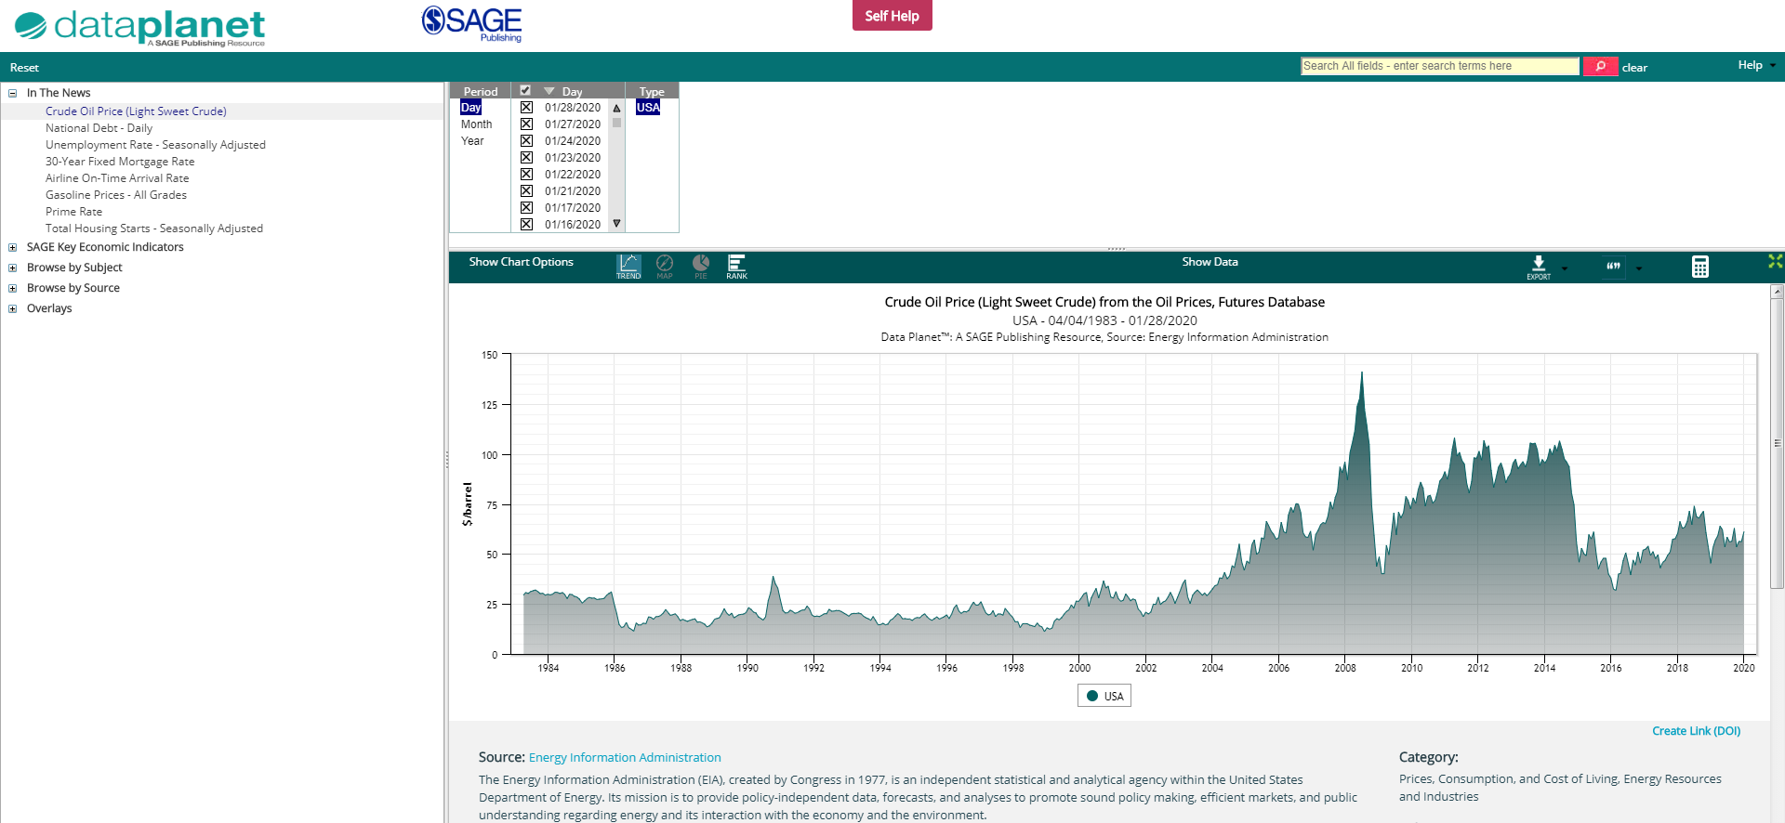
The Data Planet homepage https://statisticaldatasets.data-planet.com
Data Planet content will also be available through your library catalogue, and search engines like Google

Slide 16
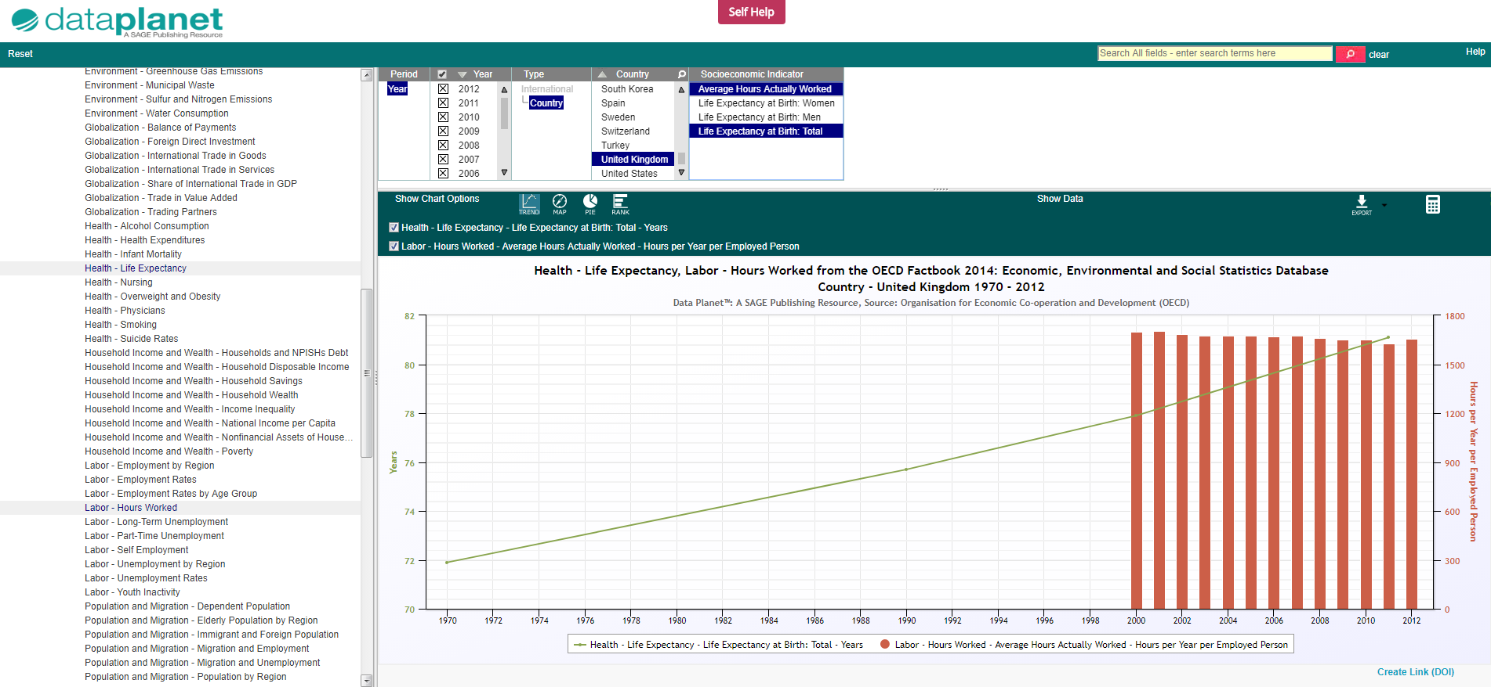
Data Planet homepage overview
Criteria Panel
Results Panel
Indicator Panel

Slide 17
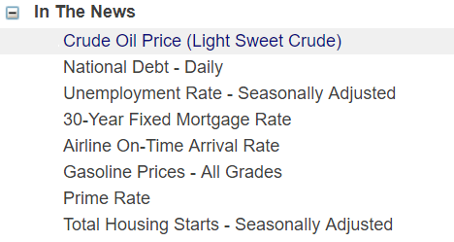
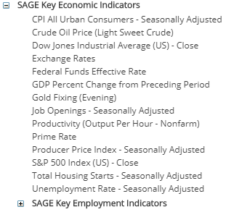
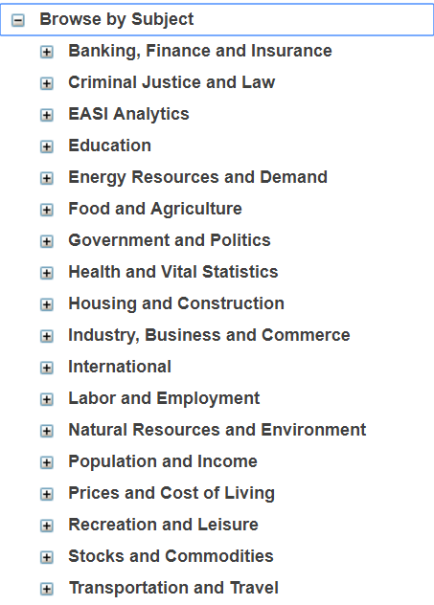
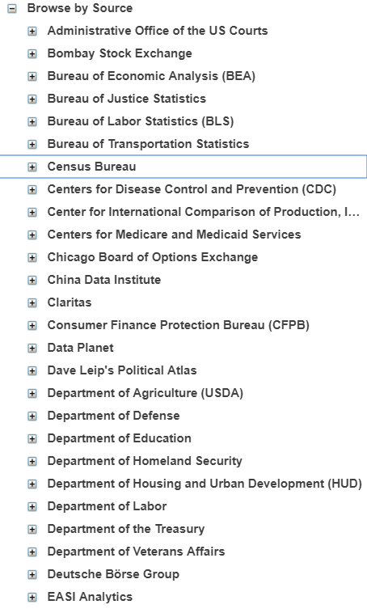
Browsing datasets
Browse the indicator tree in the left-hand Indicator Panel using one of the four folders: In the News, Key Economic Indicators, Browse by Subject, and Browse by Source.
The menus are expandable (+) and collapsible (-) to help you start finding data of interest.
In the News, featured indicators, items of interest in the news
Key Economic Indicators, economic data that users might find particularly useful or of interest
Browse by Subject, our 16 subject areas to discover depth and diversity of coverage
Browse by Source, explore the data from our 80 source organizations

Slide 18
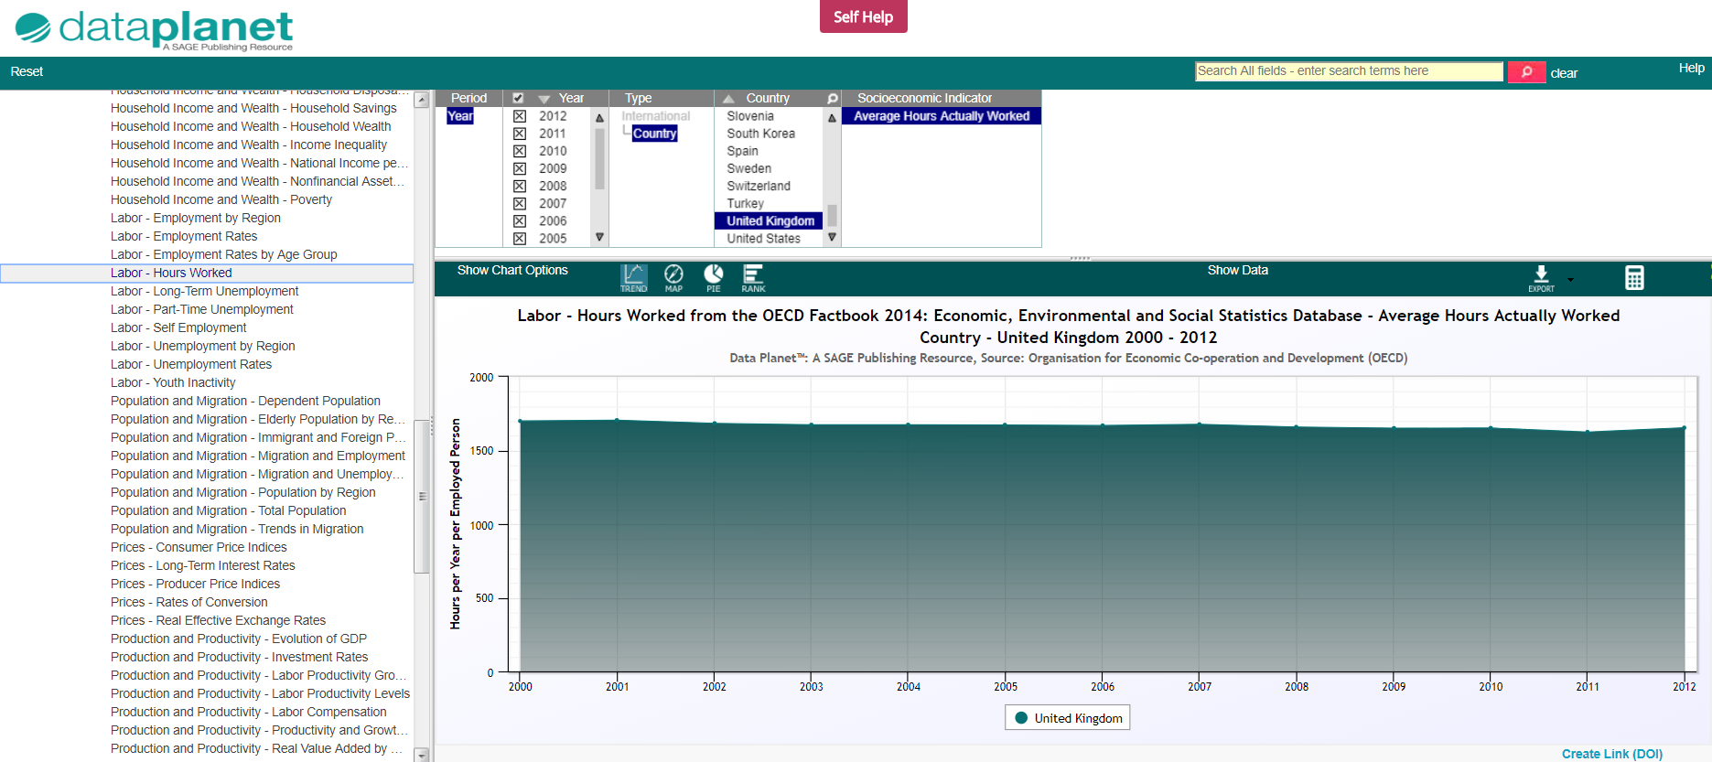
Selecting data
Second, the Criteria Panel has changed to reflect the criteria available for the selected indicators (Period, Year, Type, Country, Socioeconomic indicator).
Select the criteria you are interested in.
First, from the Indicator Panel, select the data you are interested in.
The screenshot example displays data from the OECD Factbook+, and the indicator of ‘Labor – Hours Worked’.
The criteria displayed on the trend chart is data from the UK.
Third, the Results Panel is now displaying a trend chart for the selected criteria

Slide 19
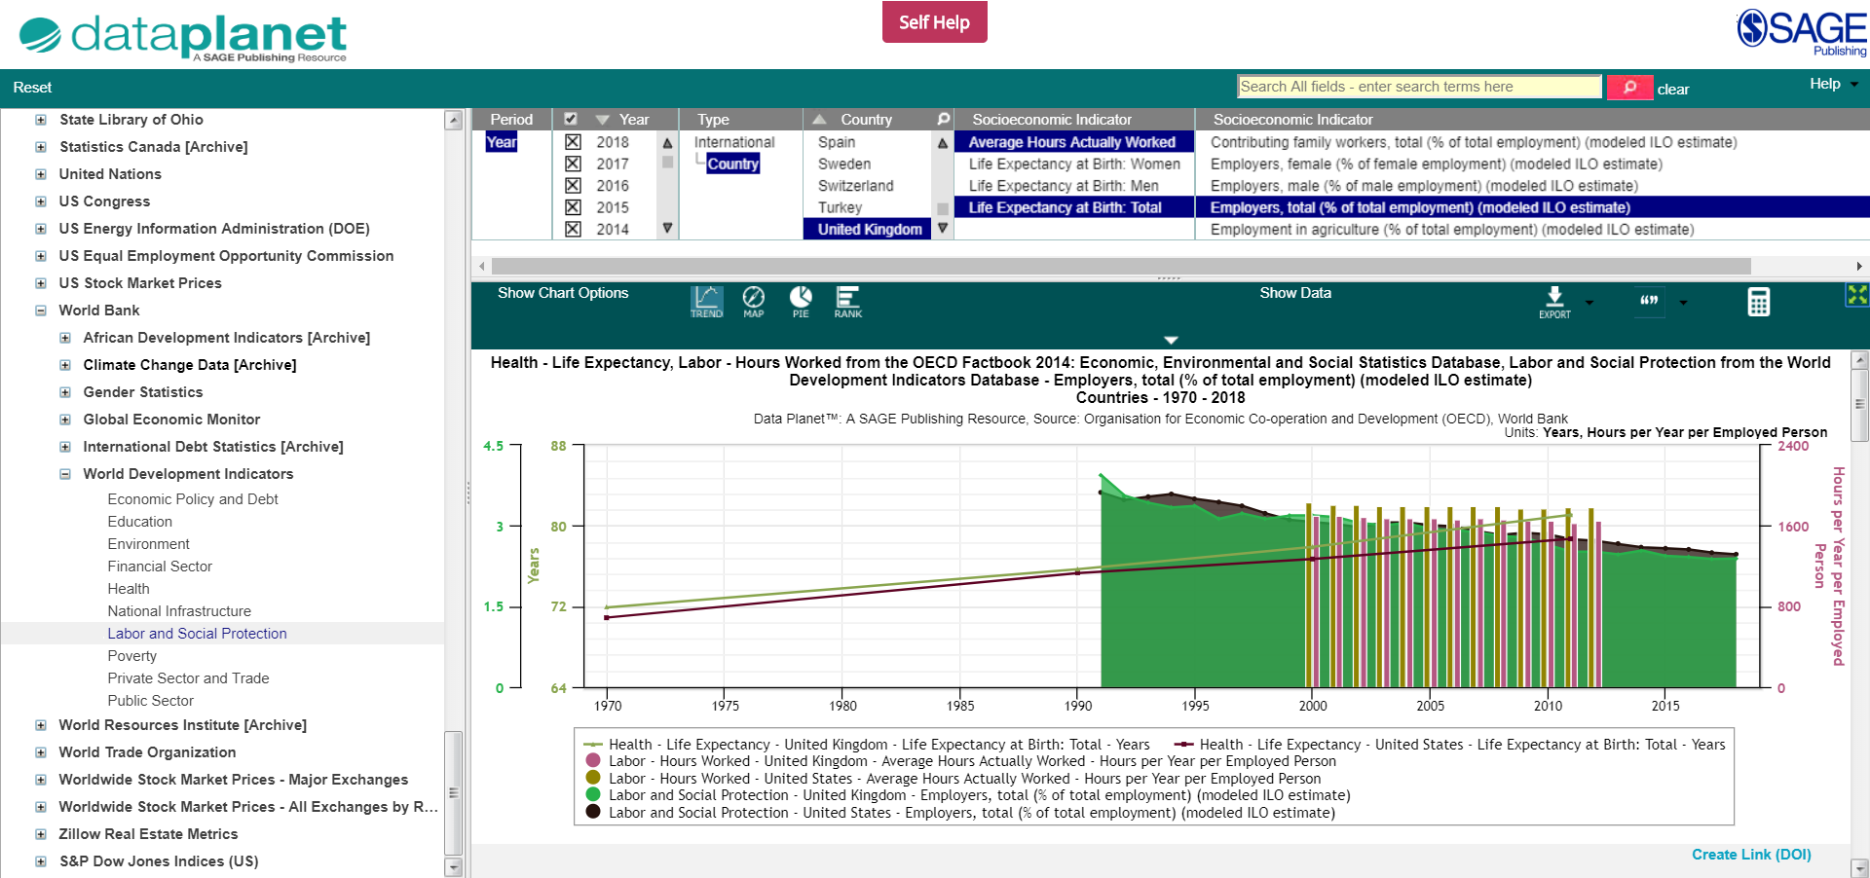
Multi-selecting and overlaying data
Data Planet allows you to overlay, and compare and contrast data across multiple indicators from the same source, as well as data from different source organizations.
TIP: Hold down the (Ctrl) button on Windows, and the (Cmd) button on Macs while you click, in order to select multiple options at the same time
The screenshot example displays data from the OECD Factbook+, and multi-selecting the indicators of ‘Health – Life Expectancy’ and ‘Labor – Hours Worked’, and from the World Bank, World Development Indicators, ‘Labor and Social Protection’
The criteria displayed on the chart is data from the UK and the US, multi-selecting the criteria of ‘Average Hours Actually Worked’ and ‘Life Expectancy at Birth: Total’ (from the OECD Factbook+), and ‘Employers, total (% of total employment) (from the World Bank)

Slide 20
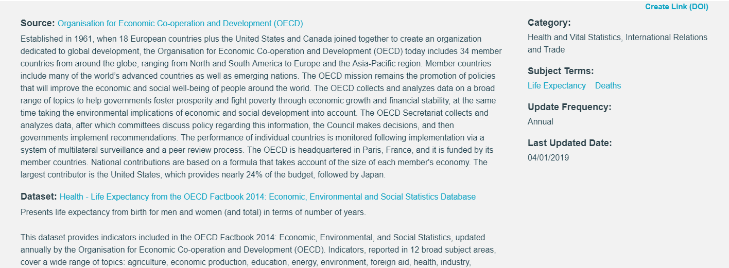
Accessing the descriptive information
Descriptive information about the indicator(s) selected, and the datasets from which they are drawn appear directly below the data chart
The categories that the indicator and dataset are classified in
Find related data by clicking on the Subject Terms links
Update Frequency for how often the data is updated, Last Updated Date for when the data was last updated
Source and Dataset provide information on source organization and indicator(s) selected
Scroll down for citation information, and citation format

Slide 21
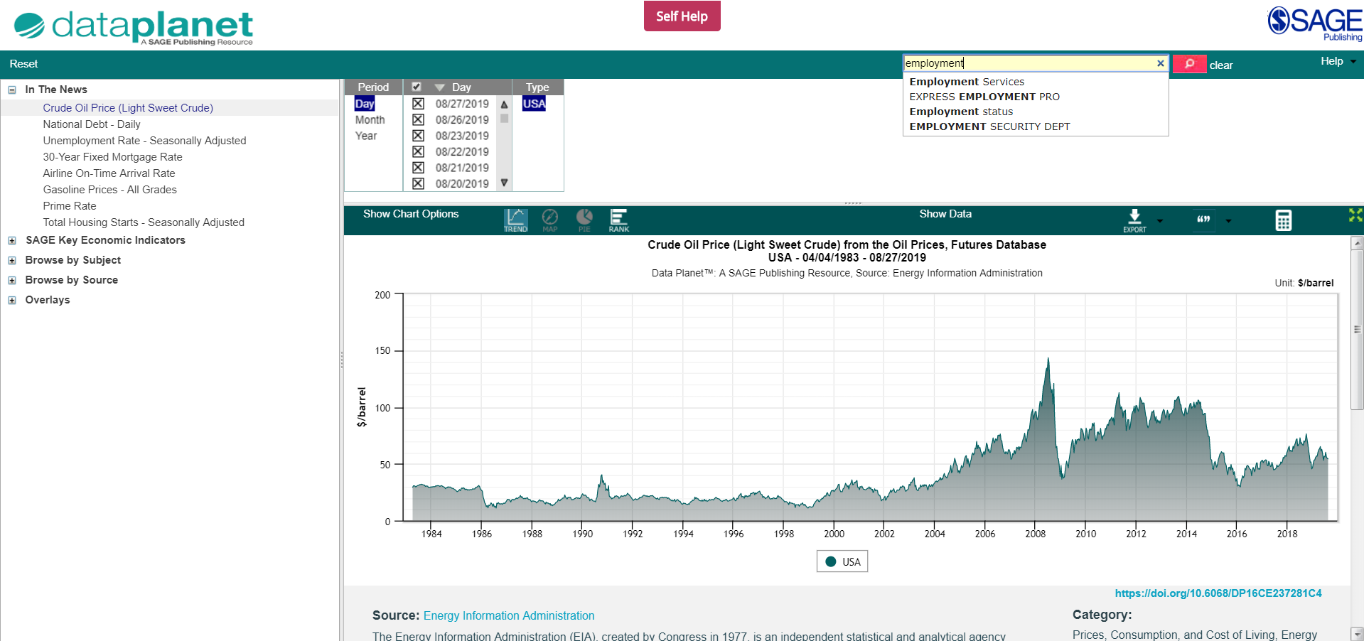
Using the
Quick Search
Use the search box to search the repository for topics of interest.
Run the search for your own terms, or click on one of the suggestions to run a search for that term.

Slide 22
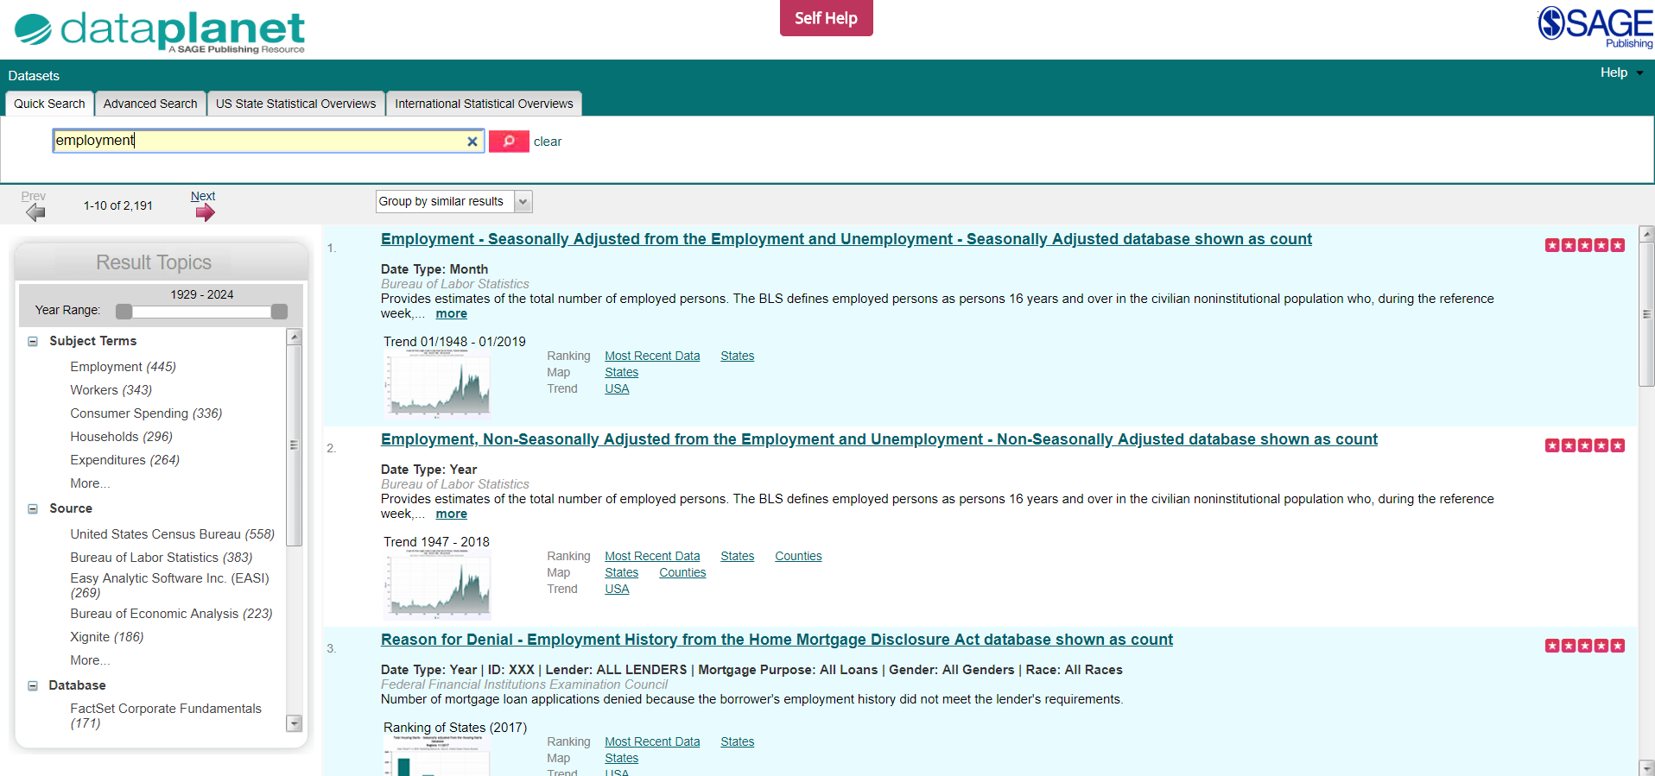
Using the
Quick Search
After running the search, a listing of results appears.
Scroll through the results to select an indicator of interest by clicking on the link.
This will then display the selected data and chart on a new page.
Use the filters on the left-hand side of the search results to refine your results by subject terms, source, database that contains the statistic and geography

Slide 23
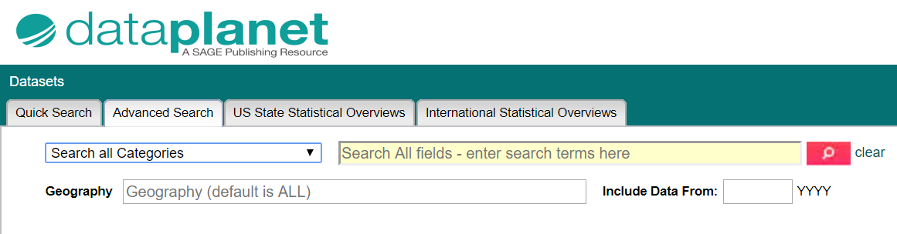
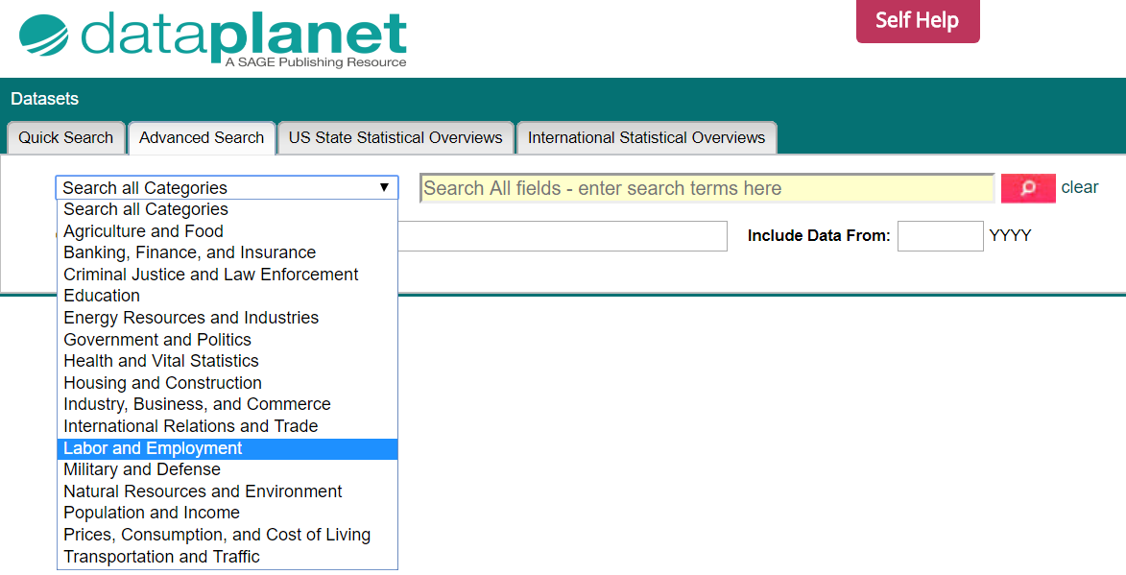
Using the
Advanced search
Select the Advanced Search tab, to search by 16 broad categories, your topic of interest, and geography
TIP: Access the Advanced Search directly from the Data Planet homepage, by clicking on the magnifying glass button in the Quick search bar.
Select one of the categories from the drop-down list to narrow your search

Slide 24
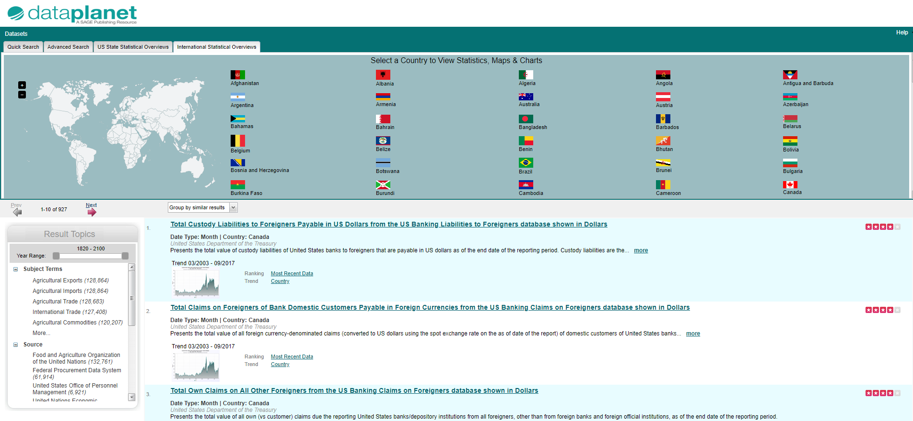
Using the US State and
International Statistical
Overviews
Select the US State Statistical Overviews or International Statistical Overviews tab to find data related to a specific state or nation, by clicking on the flag

Slide 25

Applying your learning
Visit the Data Planet homepage at https://statisticaldatasets.data-planet.com or find it via your library catalogue
Find data on a topic that interests you using Browse by Subject
Run a search for data based on a current assignment or project you are working on
Use the International Statistics Overview to find data on a nation of your choice

Slide 26
Manipulating the data
Back to Contents
Data visualization – chart options
Displaying data values
The Calculator

Slide 27
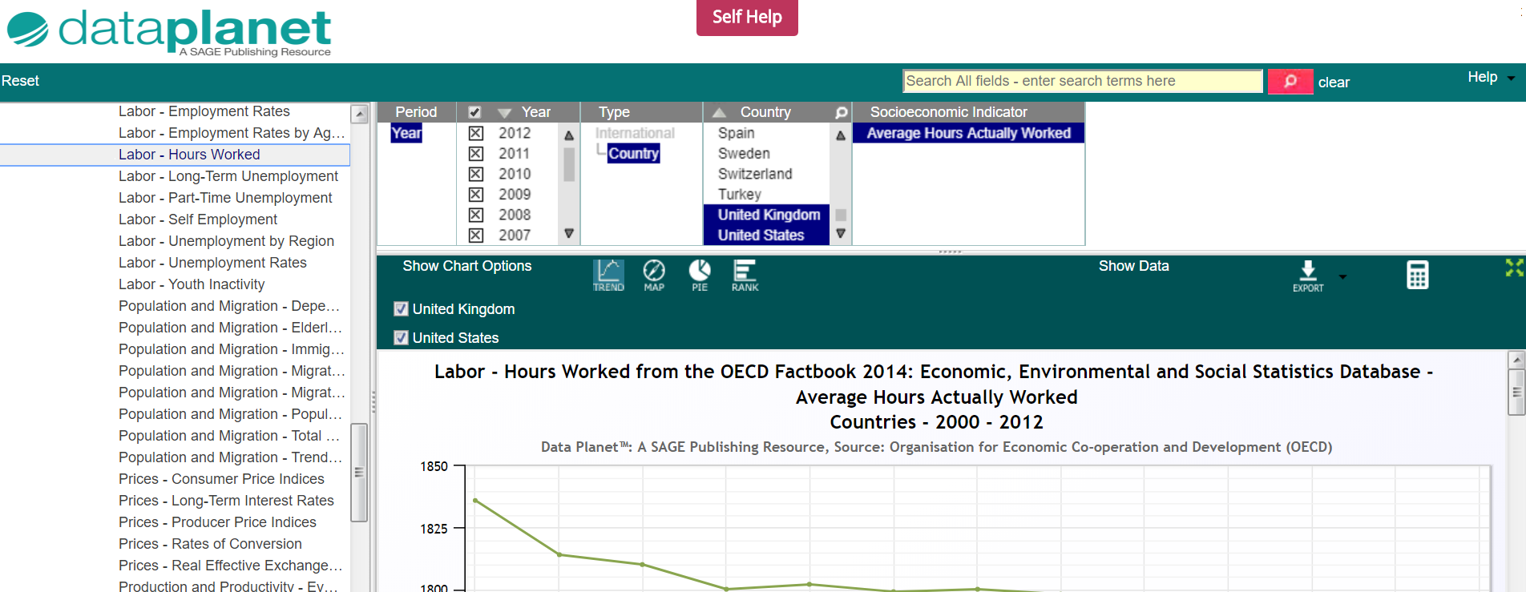
Chart options
After selecting your data, you can display it in a number of ways. By selecting one of the four icons in the menu bar, you can show the data as trends over time, a comparative ranking, a map, or a pie chart.
NOTE: The availability of chart type will vary by dataset.
TIP: Clicking on Show Chart Options will reveal several alternatives for the style of visualization, depending on what type of chart you have selected.

Slide 28
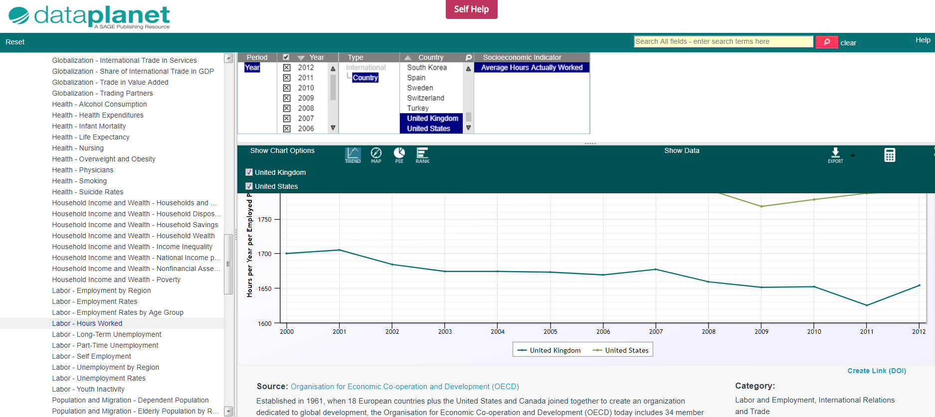
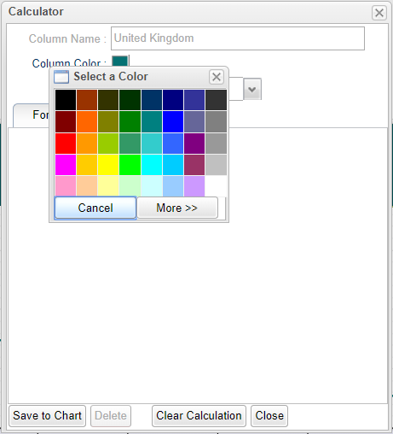
Chart options
Colours for Trend and Rank charts can be customized by clicking on the color box in the chart legend
A new window will open, click on Column Color to open a color palette. Select your choice and Save to Chart.

Slide 29
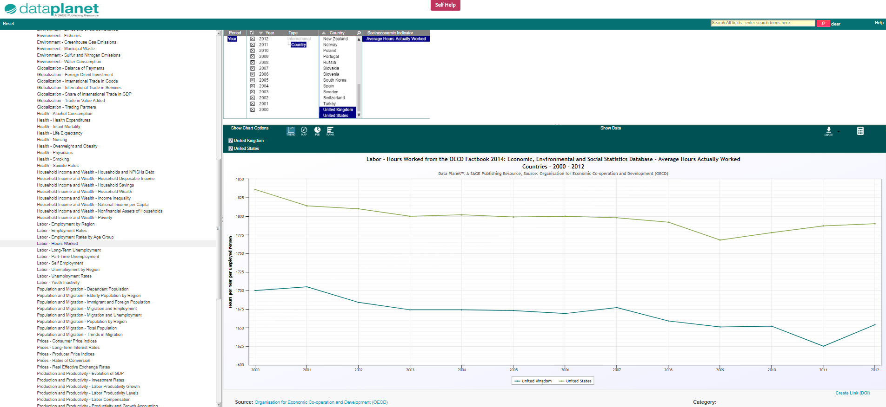
Trend chart
Trend chart displaying, ‘Average Hours Actually Worked’, comparing the UK and the US over time

Slide 30
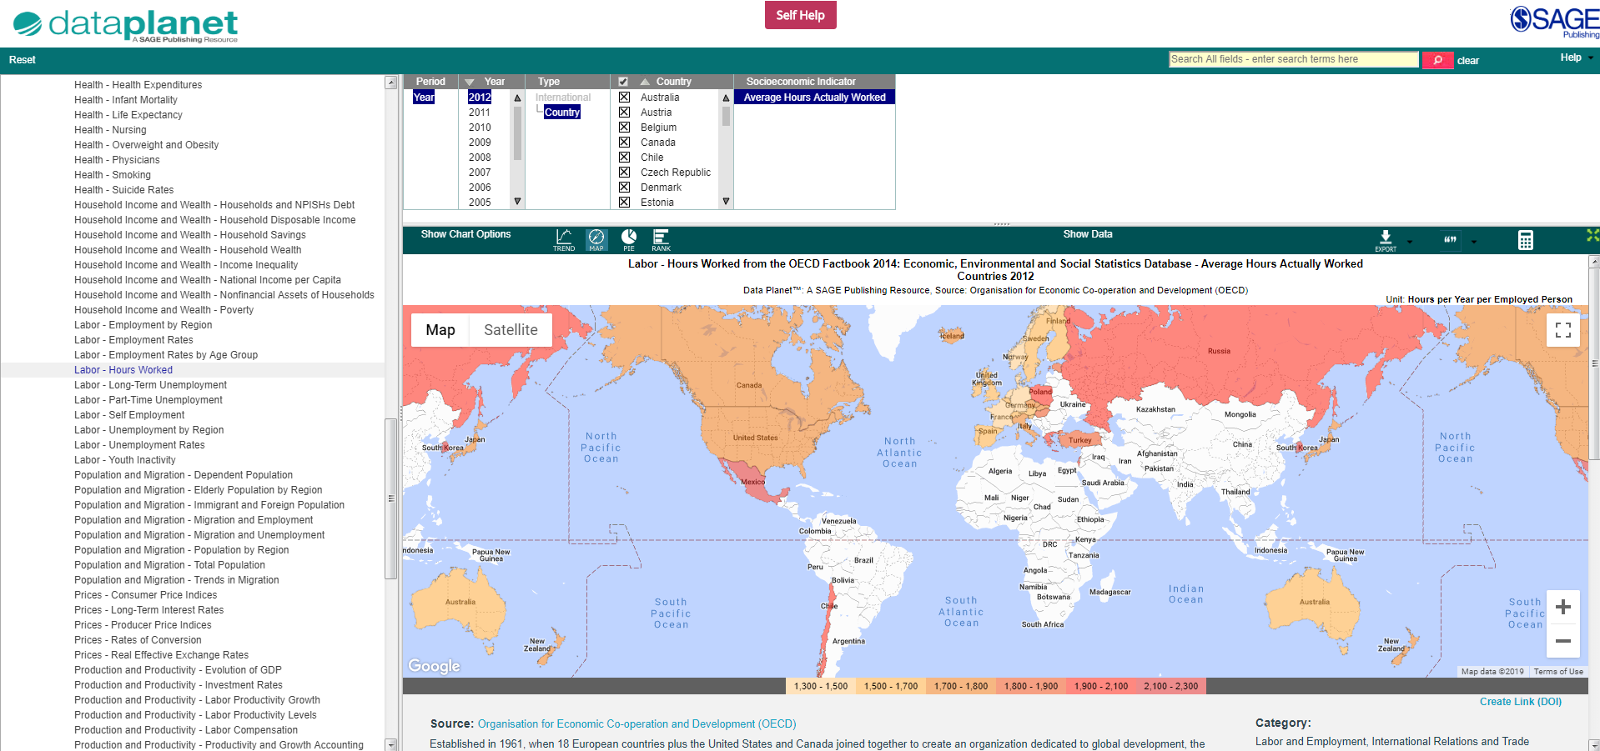
Map
Map displaying, ‘Average Hours Actually Worked’, comparing several countries, from lowest hours worked (blue) to highest hours worked (red)

Slide 31
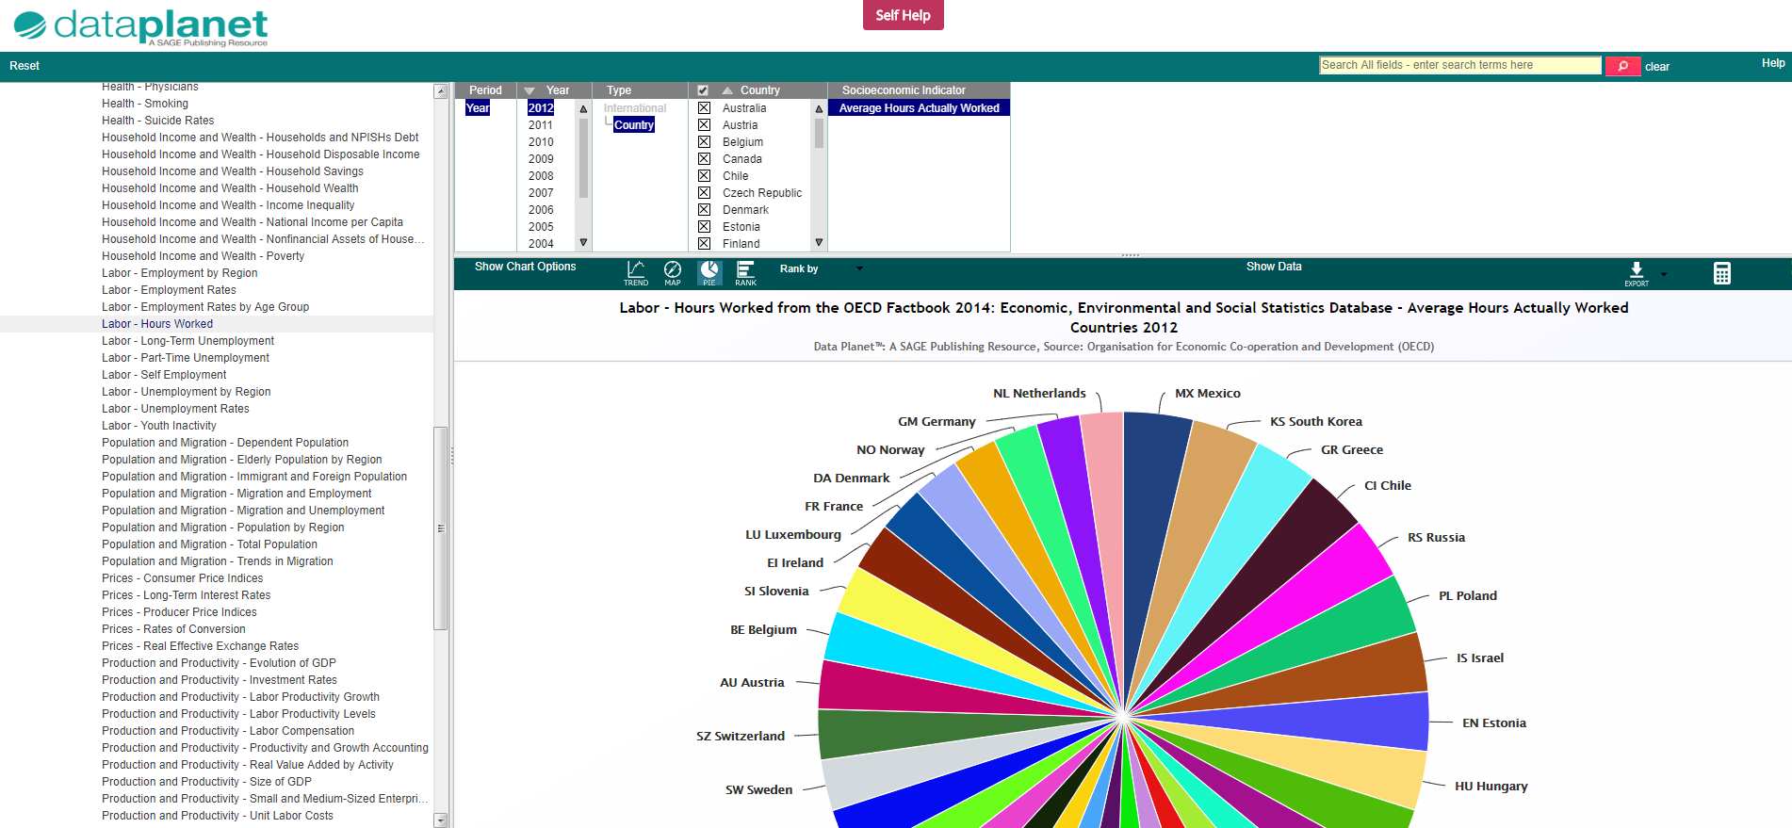
Pie chart
Pie chart displaying, ‘Average Hours Actually Worked’, comparing several countries

Slide 32
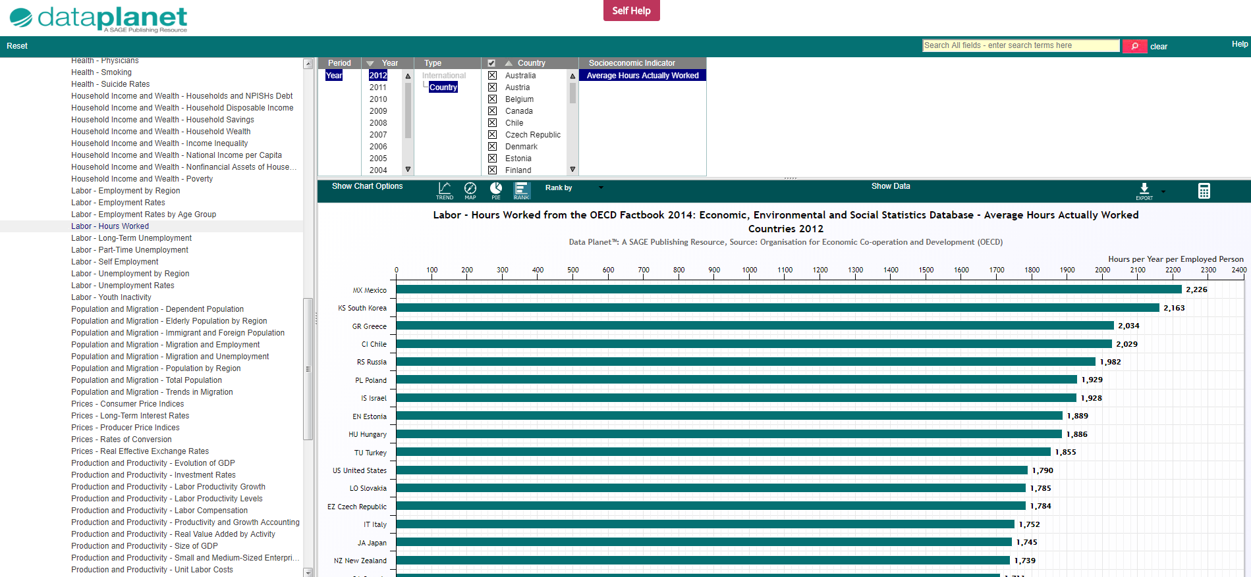
Rank chart
Rank chart displaying, ‘Average Hours Actually Worked’, comparing several countries from highest to lowest

Slide 33
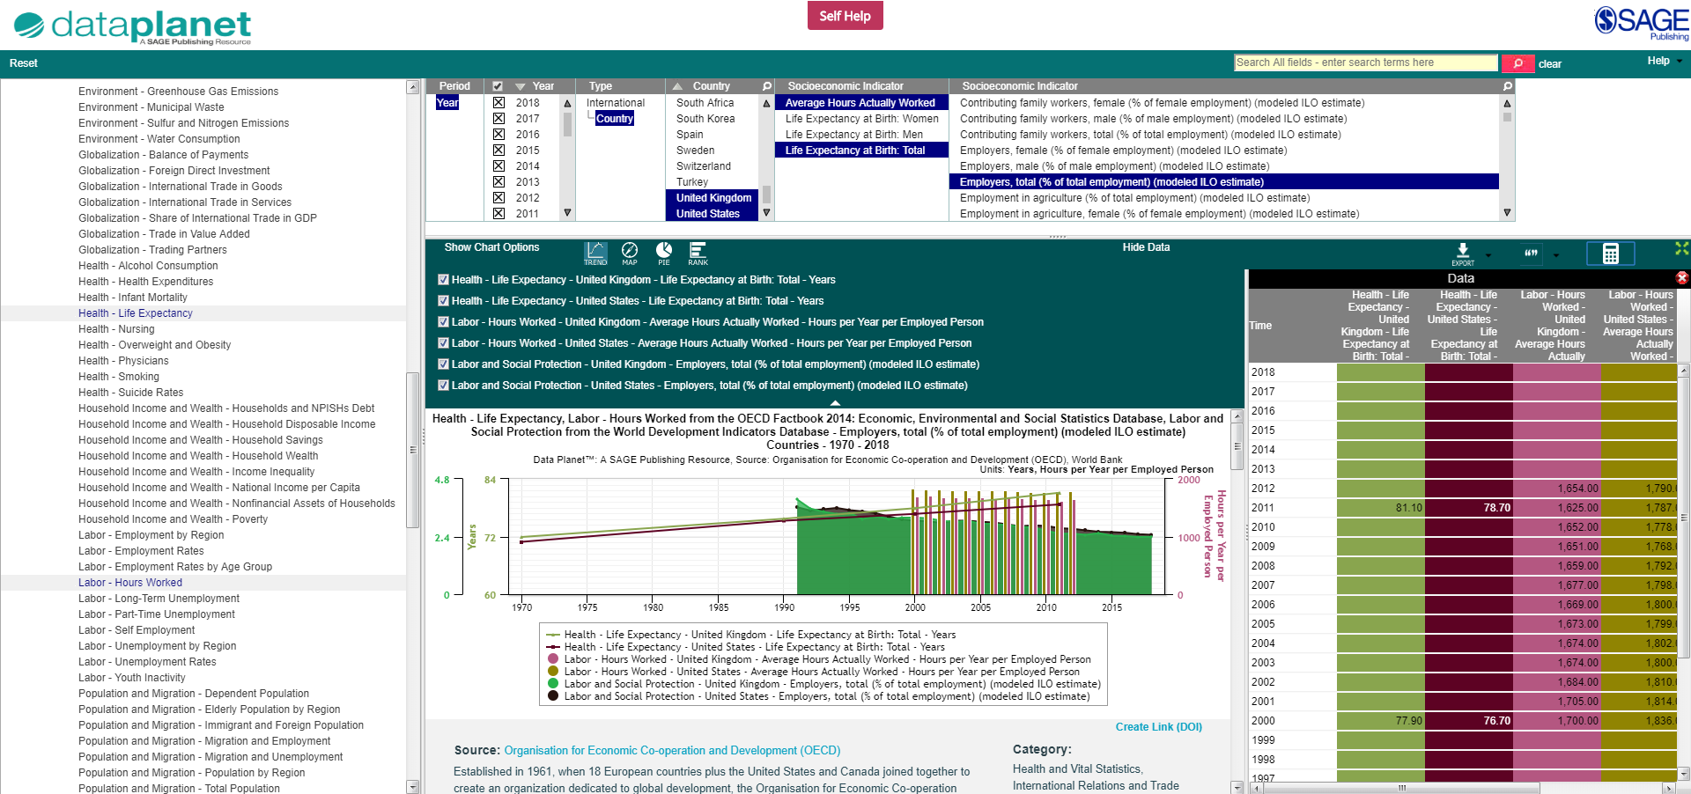
Displaying data values
To see the raw data behind the chart, click on Show Data on the toolbar, to open a table which appears next to your chart.
Clicking Hide Data will close the table.

Slide 34
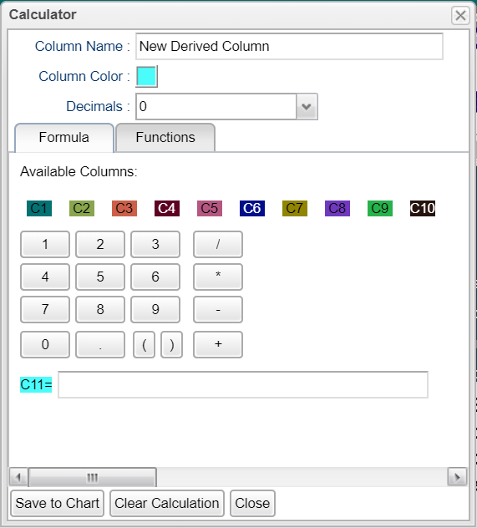
The Calculator
The Calculator button on the toolbar allows you to calculate your own formulas based on the data selected, and do some basic statistical analysis.
You can either type in your own formula or select a preformatted formula (from the Functions tab) in the Calculator window
New values calculated will appear in a new data column in the chart, after clicking Save to Chart

Slide 35
Applying your learning
Find data on a topic that interests you, and create two different charts using the data
Use the Calculator to open the Functions tab and calculate the standard deviation on your data

Slide 36
Exporting the data
Back to Contents
Creating permanent links (DOIs)
Exporting data for manipulation
Exporting the data visualization
Exporting to reference managers

Slide 37
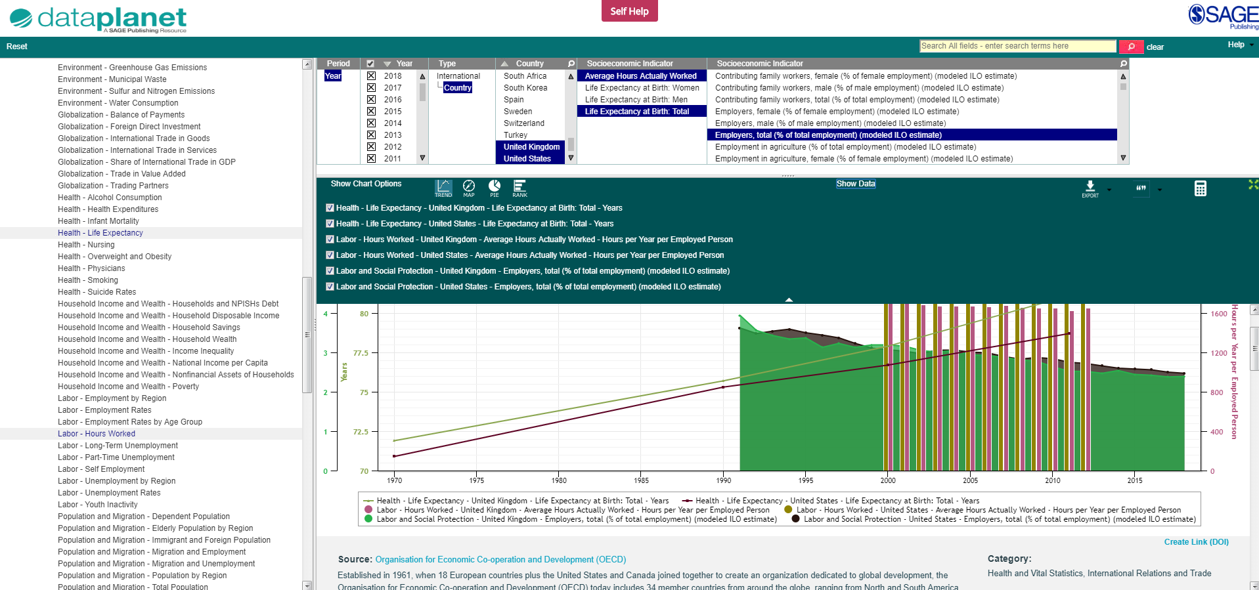
Digital Object Identifiers
(DOIs)
Send your visualizations and data to colleagues, faculty and students by creating permanent links (DOIs) just below the chart, and forwarding that link to a contact.
Clicking Create Link (DOI), will generate the DOI.
This link ensures that the person viewing it will see the exact version of the chart at the time you created it, and allows you to get back to the same data view.

Slide 38
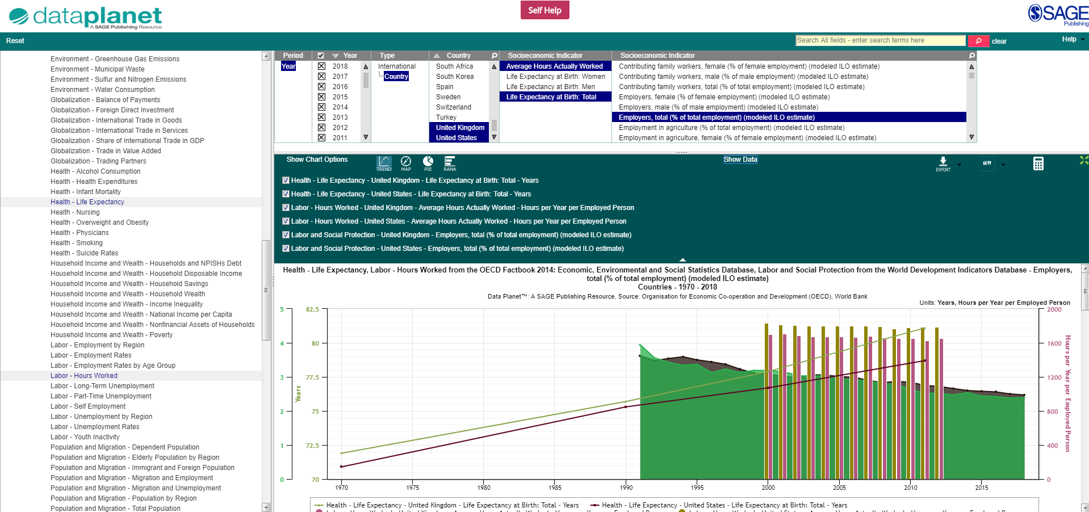
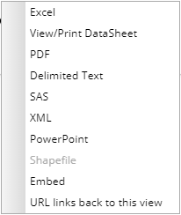
Exporting data for manipulation
From the window, select Excel, Delimited Text, SAS, or XML.
All of these options allow users to download the data for manipulation.
To export the data for manipulation in external software, click on the Export button from the tool bar

Slide 39
Exporting the data visualization
To export the data visualization and descriptive information, click on the Export button from the tool bar
From the window, select PDF or PowerPoint.
Both of these options allow users to download the data visualization and descriptive information
TIP: To learn how to change your chart colours, click here.

Slide 40
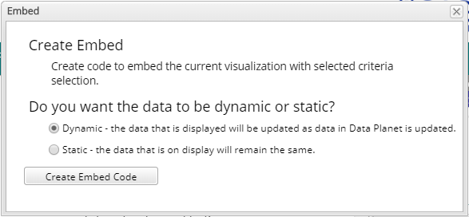
Embedding the data visualization
To embed the data visualization and create interactive embeds of Data Planet content, click on the Export button from the tool bar
From the window, select Embed.
Choose whether you want the data to be dynamic or static to create your embed code
TIP: The Embed feature is available for all non-rights restricted content (for any restricted content, the Embed option will not appear in the Export drop-down menu)

Slide 41
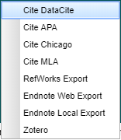
Exporting to reference managers
To export the data citation into a reference manager, click on the quotation mark button from the tool bar.
From the window, select your preferred reference manager.

Slide 42
Applying your learning
Find data on a topic that interests you, and create a permanent link (DOI), or identify what the DOI is if one has already been created
Export your data for manipulation into Excel
Export your chart and data description into a PowerPoint file

Slide 43
Want to learn more?
If you are in Europe, the Middle East, Africa, Asia, or Oceania, you can explore more of our training resources here.
If are in North America, Latin America, or the Caribbean, you can explore more of our training resources here.
Data Planet LibGuides provide information about getting started on the platform, hints and tips, and International Statistics by Country to help you get to data of interest.

Slide 44
Thank you for watching!
Back to Contents

