Slide 1

let your training
journey begin

Slide 2
I’d like to learn about this product myself…

Slide 3
Using this presentation
Navigate to a specific section using the interactive links on the next slide, OR
Follow along slide-by slide
We recommend you view this PowerPoint in Presentation mode for the best experience.

Slide 4
Contents
Introduction to the platform
What is it? What’s in it? Who is it for? Why a library collection of business cases?
Getting started on the platform
The homepage, browsing, searching
The Case page
Case page features and functionality
Creating a Profile
Saving searches, adding cases to lists
Accessing teaching notes

Slide 5
Introduction to the platform
Back to Contents
What is it? What’s in it? Who is it for?
Why a library collection of business cases?

Slide 6
SAGE Business Cases gives you access to a collection of thousands of proprietary, licensed, and commissioned cases that inspire researchers to develop their own best practices and prepare for professional success.
These business cases, tailored to library needs, provide librarians, faculty, and students with cases to support their curriculum and independent research.
You can access the platform at:
http://sk.sagepub.com/cases

Slide 7


What’s in it?
The content you can access through SAGE Business Cases will depend on the subscription at your library
It’s possible your library does not subscribe to all of our content
If you do not have access to particular content, you will see the following icon next to the resource:
If you aren’t sure which content your institution subscribes to, please check with your library staff

Slide 8
What’s in it?
Original cases are exclusive to the platform, and are written by Business & Management faculty who have extensive knowledge of teaching with business cases.
Repurposed SAGE content has been adapted into the case format from resources already published by SAGE, including books and journal articles. Adapting the content in this way can save users time when searching for cases in these formats.
Licensed content from content partners SAGE work with over 20 global content partners (such as Universities, business schools and professional societies), who often produce their own business cases, and then sell them at the library level.

Slide 9
Our Editorial process
An In-house Editorial team dedicated to SAGE Business Cases content development
  Source and develop relationships with prospective content partners
  Identify potential original authors and follow commissioning process
  Curate existing SAGE content
An Editorial Advisory Board oversees the whole collection
  Global Business & Management faculty
  Well known to SAGE
  Highly respected in their fields
  Familiar with teaching with cases
  Suggest top cases we can license
Cases go through full peer-review
  Submissions handled through ManuscriptCentral
  A team of (external) reviewers check each case we publish
    Ensures ‘teachability’ and viability in class
Final publication into the SAGE Business Cases collection
Cases will be updated if they age significantly

Slide 10
Why a library collection of business cases?
SAGE are a well-known Business & Management publisher, with over 100 journals in this subject area, so a library collection was a natural progression.
Business cases as a resource for teaching have commonly been purchased on a pay-per-case basis by faculty,
i.e, in a class of 30 students, this would be 30
individual cases purchased.

Slide 11
Library collection vs. pay-per-case
Campus-wide access to the entire collection.
77% of cases contain faculty-only teaching notes and other supplements, and 84% have discussion questions.
Classroom-tested and peer-reviewed.
Platform-generated PDFs for printing and sharing within the institution.
No financial burden for students, and faculty.
For librarians, there can be frustration that student and faculty requests for resources are unobtainable under a site-wide model. In addition, the extra time taken to gain additional permission to issue cases to more than one user at a time.

Slide 12
Who is it for?
Faculty
    Reduce costs by circumventing the pay-per-case model
    Remove access barriers for students
    Easily access wide variety of cases from a number of different sources
    Publish cases with SAGE
Students
    Access cases whenever, wherever, for course prep, revision, and self-study
    Become more self-sufficient by going beyond assigned cases
    Find related study resources such as books, reference works and journal articles
Researchers
    Examine real-life business decisions and strategies for personal research
Librarians
    Enhance relationships with Business faculty
    Save faculty money
    Inform collection development; obtain data on usage and engagement of case
    content

Slide 13
Getting started on the platform
Back to Contents
The homepage, browsing, searching

Slide 14
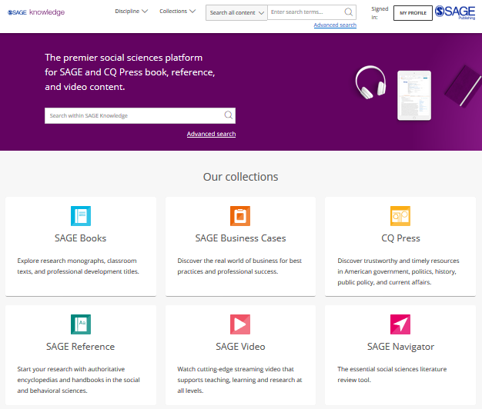
The SAGE Knowledge homepage
SAGE Knowledge hosts a number of SAGE’s digital library products, including SAGE Business Cases.
You can access SAGE Knowledge by going to http://sk.sagepub.com
Please note, it is possible that some of these content options will appear in grey on your screen, if your institution does not subscribe to a particular collection.

Slide 15
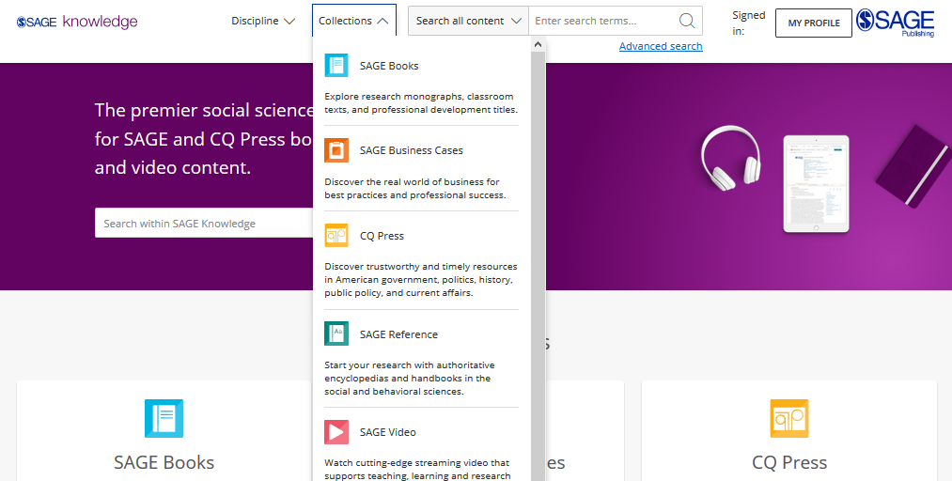
Browsing by
Collection
Click to open the Collections menu to explore all content within a particular collection, for example, if you want to see all of our cases.
You can also Browse by Collection using the tiles on the homepage.
Please note, it is possible that some of these content options will appear in grey on your screen, if your institution does not subscribe to a particular collection.

Slide 16
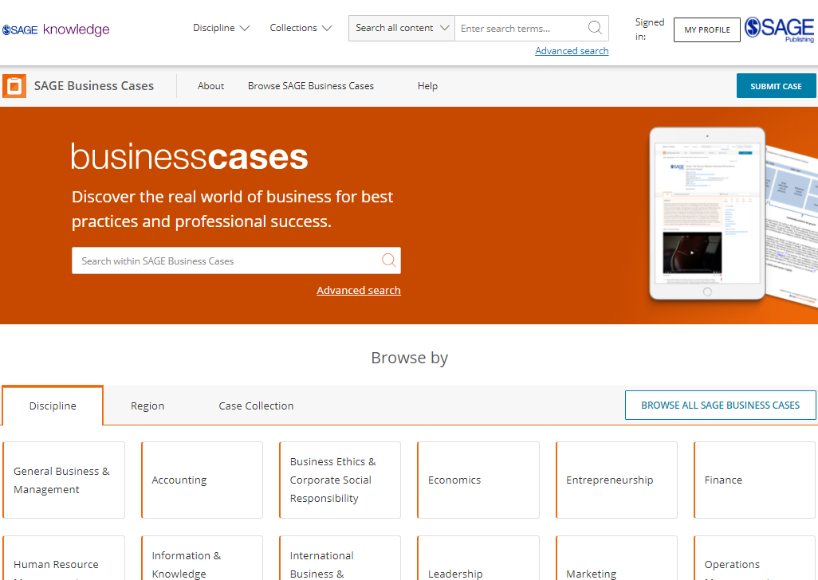
The SAGE Business Cases homepage
You can access SAGE Business Cases directly by going to http://sk.sagepub.com/cases
SAGE Business Cases content will also be available through your library catalogue, and search engines like Google.

Slide 17
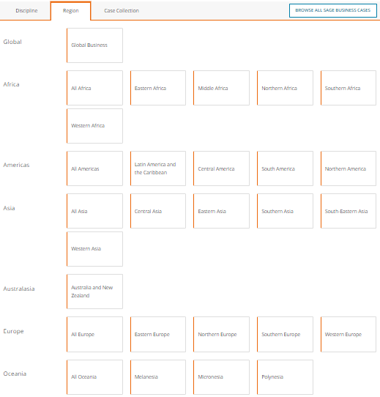
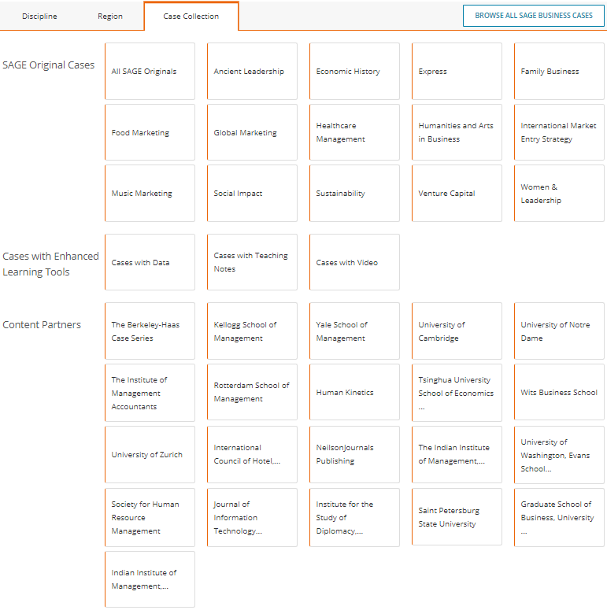
Browsing from the SAGE Business Cases homepage
Browse by Region to see cases related to business in particular regions, or by Case Collection to see cases from SAGE’s original case series, enhanced cases, and cases from a particular content partner.

Slide 18
Browsing from the SAGE Business Cases homepage
Browse by Discipline to access the subject taxonomy to get a more granular breakdown of the Discipline.

Slide 19
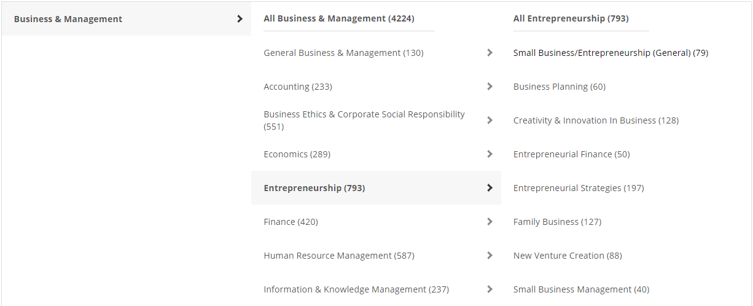
Browsing by Discipline
The subject taxonomy allows you to discover cases on your chosen topic or research area. It is also a great way of seeing what is covered in the case collection, especially if you’re not sure of your key word search terms.
Please note, some discipline or topic areas will show zero results (0) depending on your institution’s collection status.

Slide 20
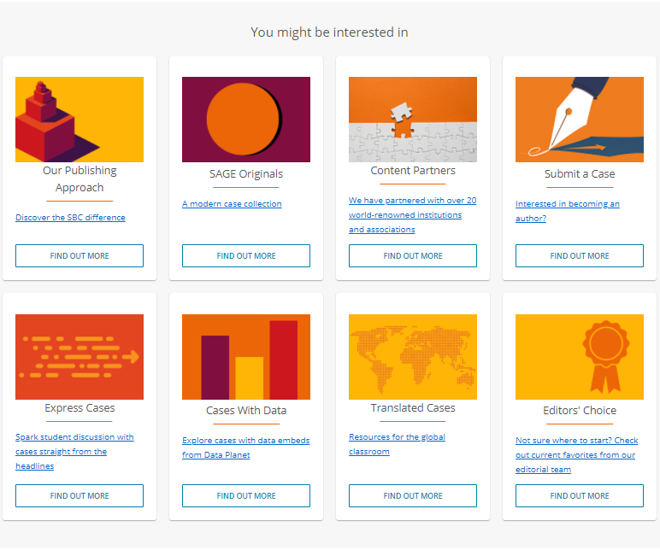
Browsing from the SAGE Business Cases homepage
Explore the You might be interested in links towards the bottom of the SAGE Business Cases homepage to find out more about the case collection.

Slide 21
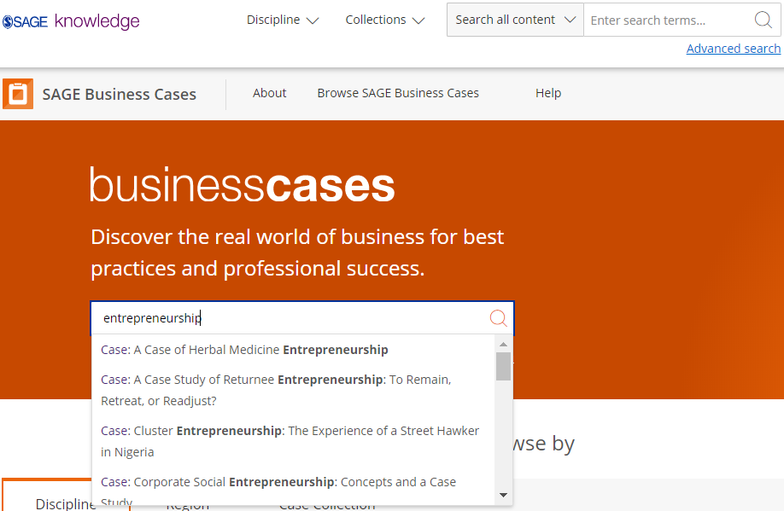
Using the Quick search
You can run a search from any page using the search bar at the top of the screen.
Use the quick search to look for cases related to key words and phrases.
Run the search for your own terms, or click on one of the auto-suggestions to go directly to that case or keyword result.

Slide 22
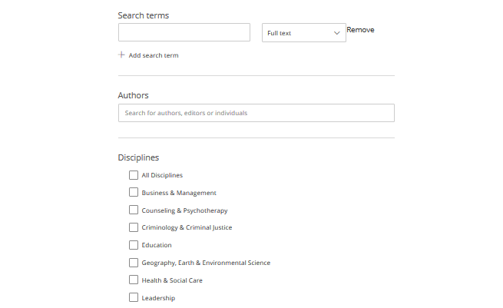
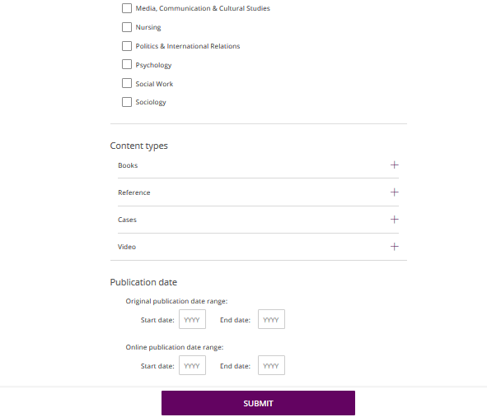
Using the Advanced search
Enter your search criteria
Add new rows for more criteria
Search specifically for people, e.g. authors
Choose the disciplines you want to search across
Choose the collections you want to search across
Select your publication date ranges
Click Submit when you’re ready

Slide 23
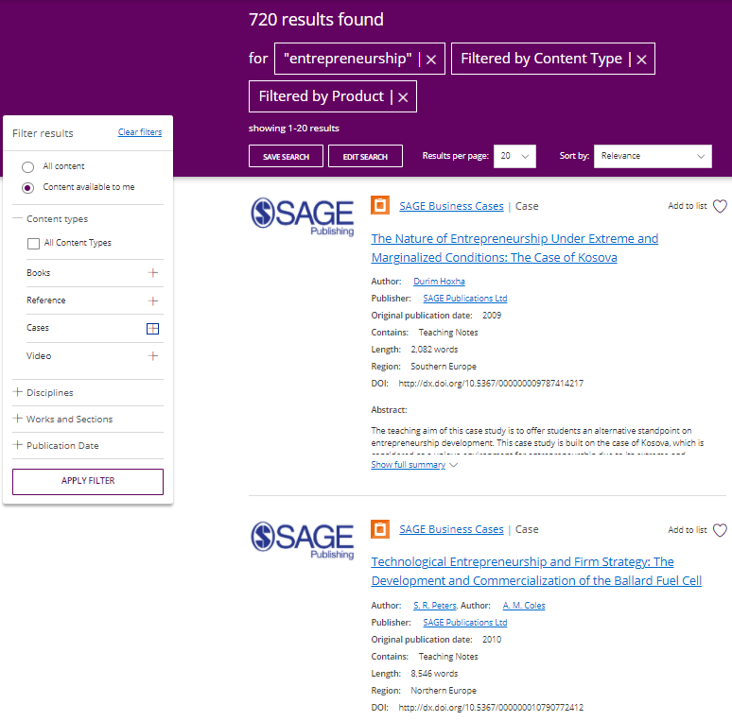
Viewing your results
Use the filters on the left-hand side of the search results page to refine your search; you can filter by content type and discipline, and use the publication date slider to find older or newer content.
Click the image or title to open the case.
You must click the Apply filter button to apply your changes.
Item is not available at your institution

Slide 24

Applying your learning
Visit the SAGE Business Cases homepage at http://sk.sagepub.com/cases or find it via your library catalogue
Find a case on a Business and Management topic that interests you using Browse by Discipline
Run a search based on a current assignment or project you are working on
Use the filters to look at cases from the last 2 years

Slide 25
The Case page
Back to Contents
Case page features and functionality

Slide 26
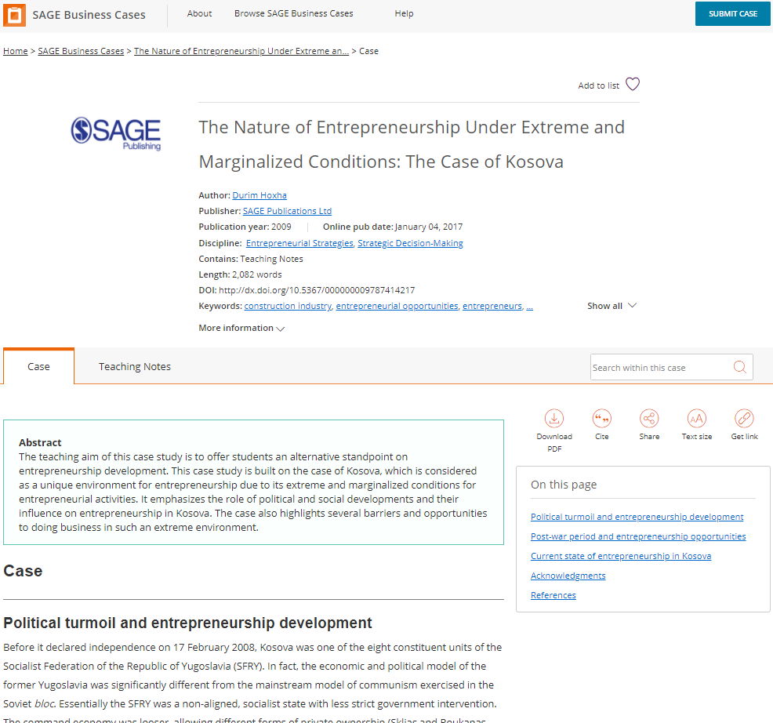
Case page
Add the case to a list using the heart icon
View more publication information about the case
Search for a term or phrase within the case
Switch between different tabs; the main tab you will want to use is the Case view
Download, cite and share the case
Move through different sections in the case
Full text of case continues down the page

Slide 27
Case page
77% of cases contain faculty-only teaching notes, tried and tested by the case authors.
Teaching notes contain discussion questions and suggested activities to use inside and outside of the classroom.
To access these you will need to get a Verification Code from your library staff.
TIP: To learn how to access teaching notes, click here.

Slide 28
Applying your learning
Open More information about your case, and use the hyperlinks to explore other cases that might be of interest to you
Download the citation for your chosen case
Open a case and download the full-text PDF

Slide 29
Creating a Profile
Back to Contents
Saving searches, adding cases to lists

Slide 30
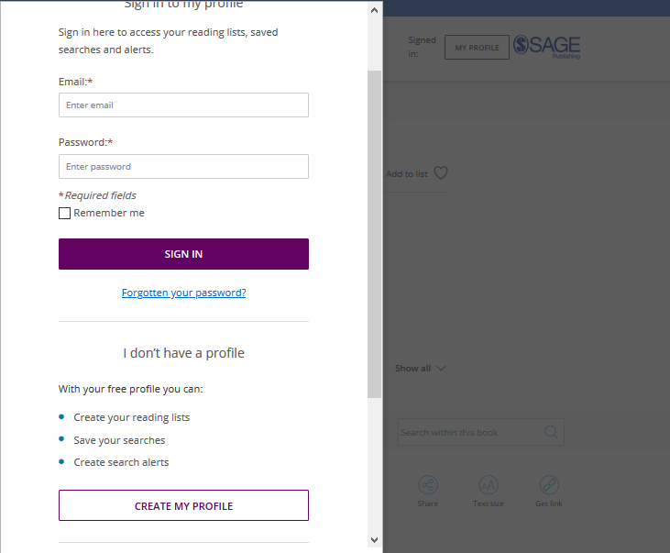
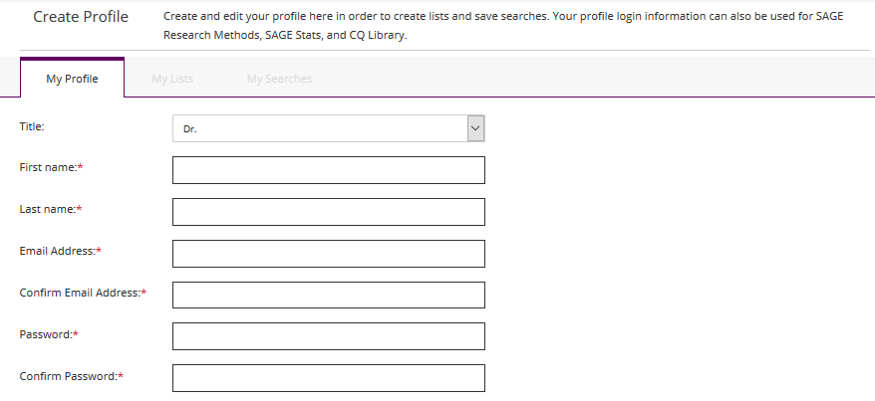
Creating a Profile
Click the My Profile button, then select Create my profile towards the bottom of the pop-up window that appears.
Once you’ve created your free profile, you can sign in here at any time.

Slide 31
Saving searches
When you’re logged into your Profile and you are viewing your search results, click the Save Search button to save your search criteria, so that you can quickly re-run the same search again later.

Slide 32
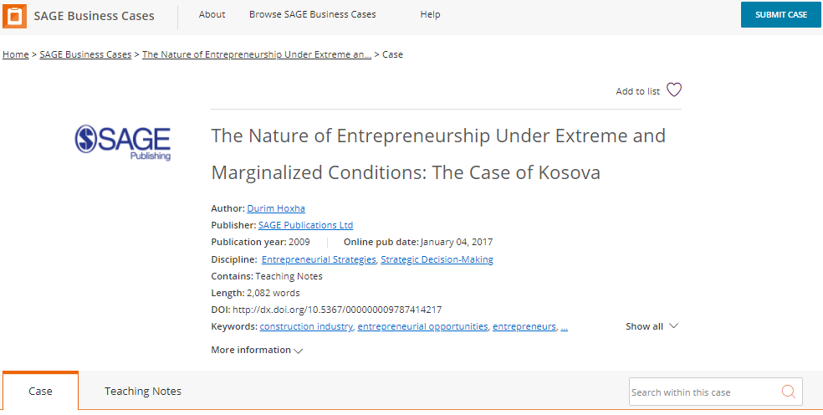
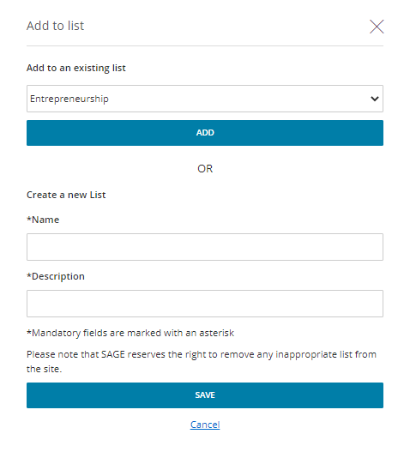
Managing lists
When logged in to your Profile, you can add cases to My Lists in order to save items of interest for later.
On any case page, click the Add to list button.
When the pop-up window appears, choose an existing list to add your case to, or create a new list.

Slide 33
Managing lists
When logged in to your Profile, you can add cases to My Lists in order to save items of interest for later.
You can also add a case to a list from your search results page.

Slide 34
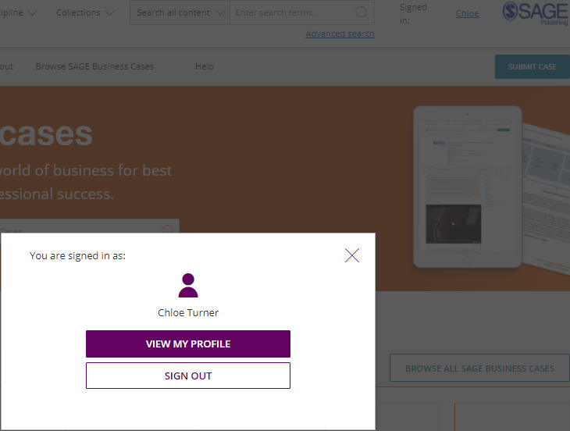
Managing your Profile
When you are signed in, you can access your lists and saved searches by clicking on your name at the top-right of any page.
Select View my profile to edit your profile details, and view and edit your saved searches and lists.

Slide 35
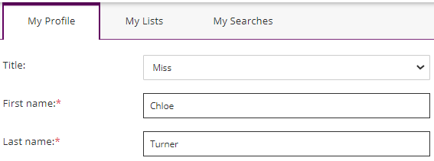
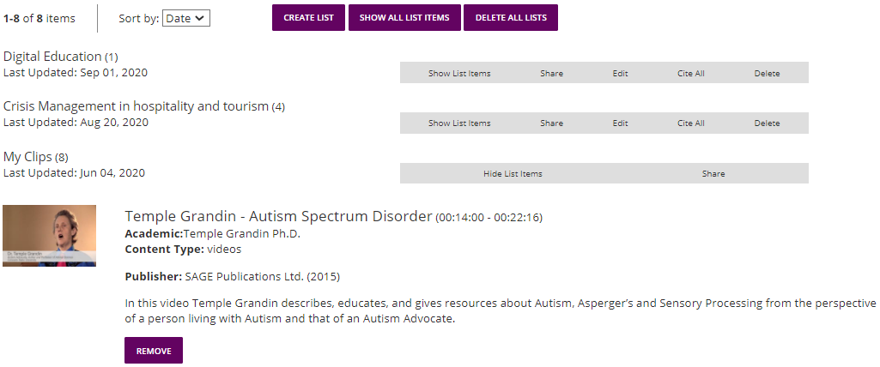
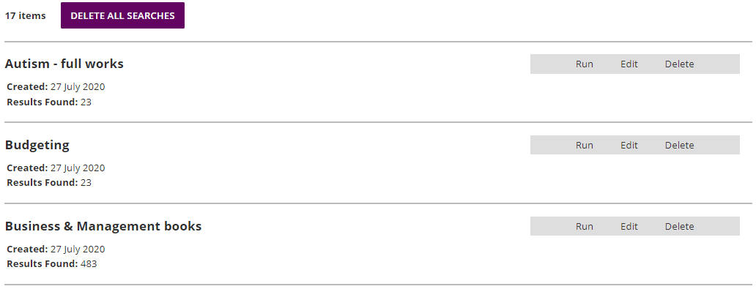
Managing your Profile
Toggle between your profile areas
My Lists
My Searches

Slide 36
Applying your learning
Create a free profile on SAGE Business Cases from any page of the platform
Save a search based upon a current assignment or research project
Save one case to My Lists

Slide 37
Accessing teaching notes
Back to Contents

Slide 38
Accessing teaching notes
To access the teaching notes, teachers will need to create a profile, if they haven’t already, on the SAGE Business Cases platform.

Slide 39
Accessing teaching notes
When you are signed in, you can access your profile information by clicking on your name at the top-right of any page.
Select View my profile to edit your profile details

Slide 40
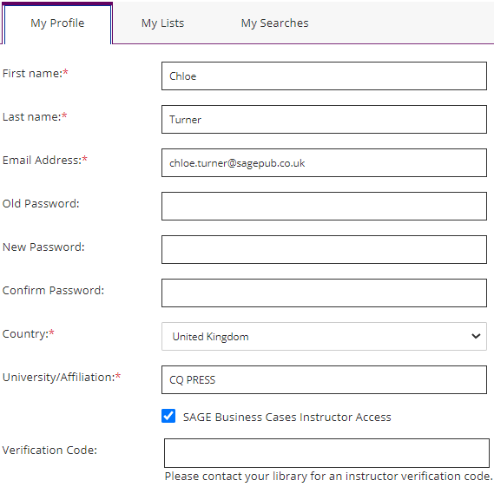
Accessing teaching notes
At the bottom of the My Profile section, tick the box called SAGE Business Cases Instructor Access.
A new box will appear called Verification Code. This Verification Code is a password set up by your library staff, so should be available if you contact them. Enter the code, and click Save.

Slide 41
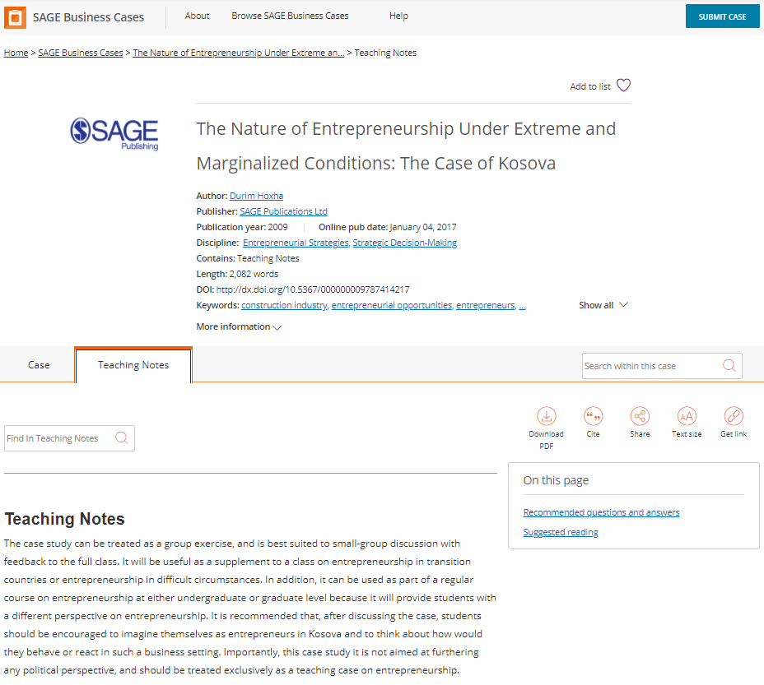
Accessing teaching notes
Go back to the case page, and you will now be able to access the teaching notes for your case by clicking on the Teaching Notes tab.

Slide 42
Want to learn more?
Explore more of our training resources here.

Slide 43
Thank you for watching!
Back to Contents

