Slide 1

let your training
journey begin

Slide 2

I’d like to learn about this product myself…

Slide 3
Using this presentation
Navigate to a specific section using the interactive links on the next slide, OR
Follow along slide-by slide
We recommend you view this PowerPoint in Presentation mode for the best experience.

Slide 4
Contents
Introduction to the product
What is it? What’s in it? Who is it for?
Getting started on the platform
The homepage, browsing and searching, and the results page
The resource page
Entire works and chapters and entries
Creating a Profile
Saving searches and managing lists

Slide 5
Introduction to the product
Back to Contents
What is it? What’s in it? Who is it for?

Slide 6
SAGE Knowledge is where we host all our online book and reference content, ideal for learning new theories, concepts, debates and applications in your subject area.
SAGE Knowledge content covers the following subject areas:
http://sk.sagepub.com
Leadership
Media, Communication & Cultural Studies
Nursing
Politics & International Relations
Psychology
Social Work
Sociology
Business & Management
Counseling & Psychotherapy
Criminology & Criminal Justice
Education
Geography, Earth & Environmental Science
Health & Social Care

Slide 7


What’s in it?
Full access to SAGE Knowledge includes over 4,600 books and over 600 reference items
However, the content you can access through SAGE Knowledge will depend on the subscription at your library; it’s possible your library does not subscribe to all the content
If you do not have access to a particular item, you will see the following icon next to it in the search results:
If you aren’t sure which content you have access to at your institution, please check with your library staff

Slide 8
Who is it for?
Students and researchers
    Learn more about key topics in your subject area, at all levels of study
    Get multiple perspectives on topics from SAGE authors all around the world
    Save items to lists to keep track of useful information for your projects
    Download citation information for easy referencing
    Discover new resources with ‘More like this’ recommendations
Faculty
    Introduce students to high-quality content from well-known experts
    Create engaging reading lists for your classes
    Ensure students get easy access to full-text titles on- and off-campus
    Allow all students to access whenever, wherever, with unlimited simultaneous users and a mobile-responsive design

Slide 9
Getting started on the platform
Back to Contents
The homepage, browsing, searching

Slide 10
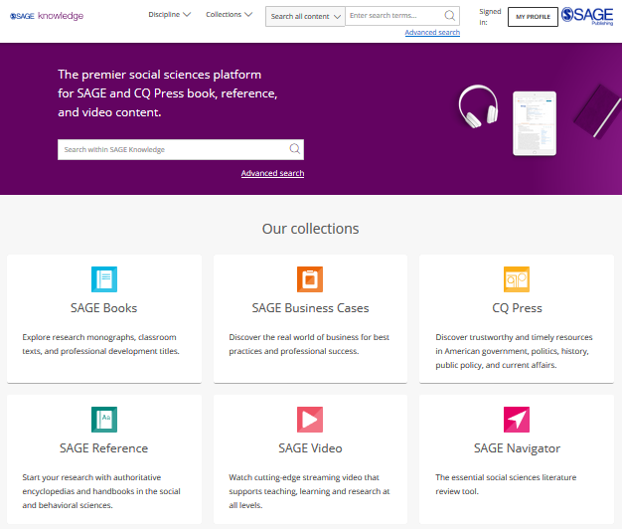
The SAGE Knowledge homepage
You can access SAGE Knowledge by going to https://sk.sagepub.com
SAGE books and reference items will also be available through your library catalogue, and search engines like Google.

Slide 11
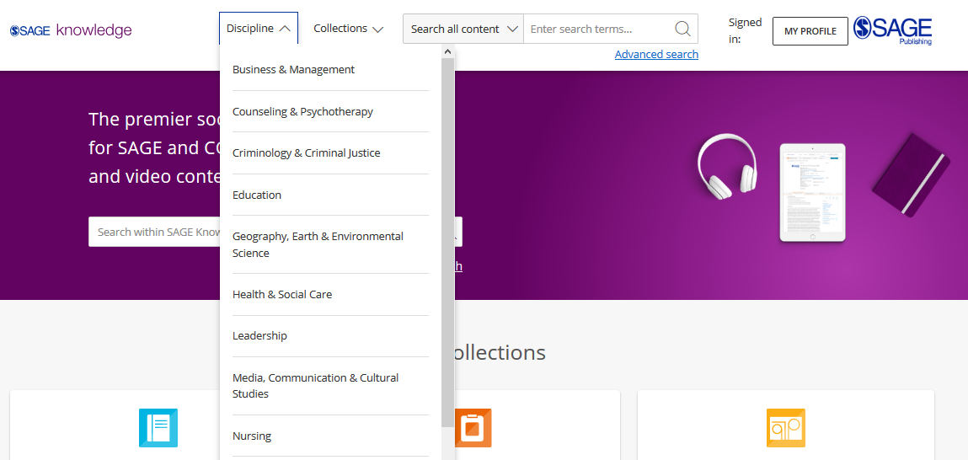
Browsing by Discipline
Click the Discipline menu at the top of the screen on any page to see all content for your subject area.
Please note, it is possible that some of these content options will appear in grey on your screen, if your institution does not subscribe to a particular collection.

Slide 12
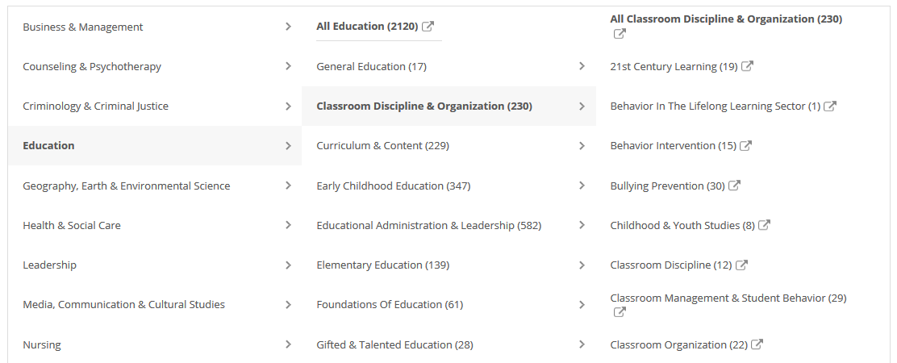
Browsing by Discipline
Browse through the taxonomy for your discipline to explore available subject areas and study themes.
Please note, some discipline or topic areas will show zero results (0) depending on your institution’s collection status.

Slide 13
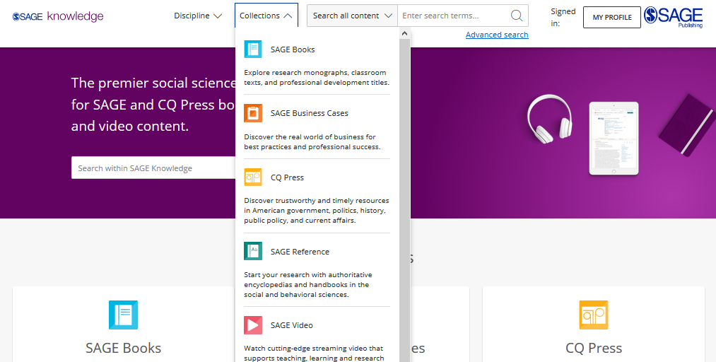
Browsing by
Collection
Click to open the Collections menu to explore all content within a particular collection, for example, if you want to see all of our Books.
You can also Browse by Collection using the tiles on the homepage.
Please note, it is possible that some of these content options will appear in grey on your screen, if your institution does not subscribe to a particular collection.

Slide 14
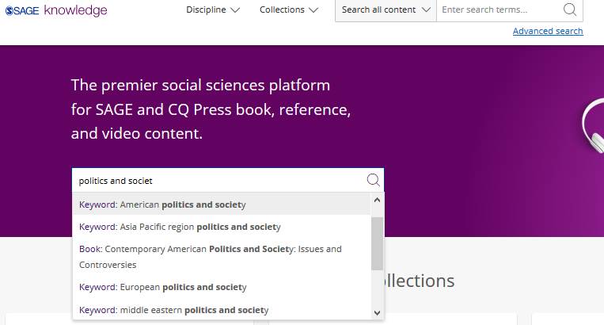
Using the Quick search
You can run a search from any page using the search bar at the top of the screen.
Use the quick search to look for content related to key words and phrases.
Run the search for your own terms, or click on one of the auto-suggestions to go directly to that resource or keyword result.

Slide 15
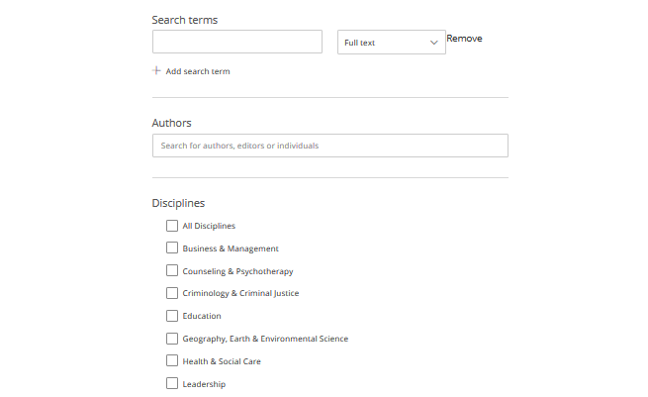
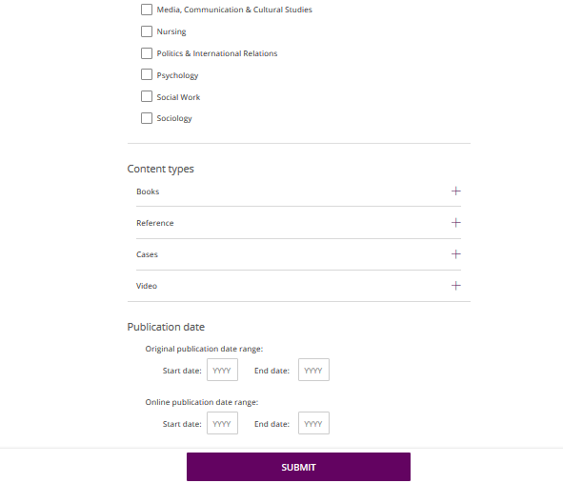
Using the Advanced search
Enter your search criteria
Add new rows for more criteria
Search specifically for people, e.g. authors
Choose the disciplines you want to search across
Choose the collections you want to search across
Select your publication date ranges
Click Submit when you’re ready

Slide 16
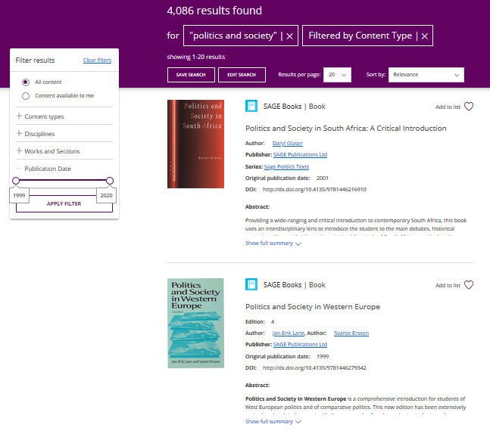
Viewing your results
Use the filters on the left-hand side of the search results page to refine your search; you can search within your results, filter by content type and subject, and use the publication date slider to find older or newer content.
Click the image or title to open the item.
You must click the Apply filter button to apply your changes.
Item is not available at your institution

Slide 17

Applying your learning
Visit the SAGE Knowledge homepage at https://sk.sagepub.com or find it via your library catalogue
Browse your discipline or run a search based on a current assignment or project you are working on
Use the filters to find content from 2010 onwards

Slide 18
The resource page
Back to Contents
Entire works and chapters and entries

Slide 19
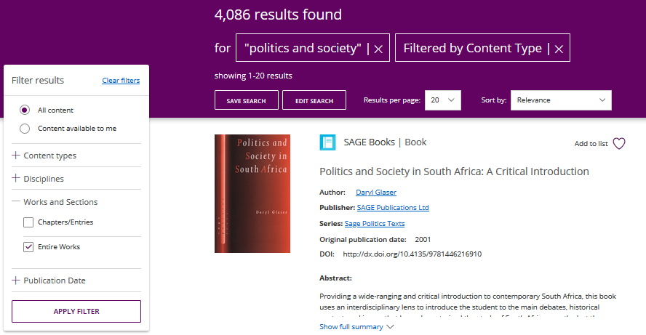
Entire Works
Entire Work refers to the complete version of a text, e.g. a whole Book or a complete Encyclopedia
When you are viewing your search results, if you leave only Entire Works selected, each complete work will only appear in the search results once.

Slide 20
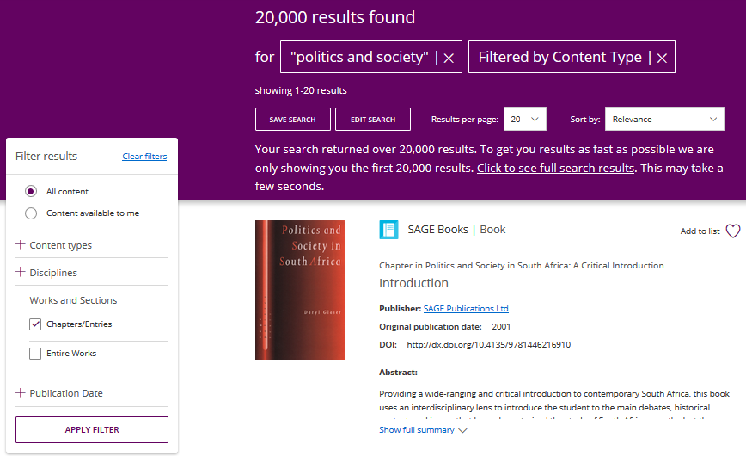
Chapters and Entries
Chapters and Entries refers to the individual component of a text, e.g. a chapter within a Book or an entry in an Encyclopedia
When you are viewing your search results, if you leave only Chapters/Entries selected, you will often see multiple results from the same Entire Work, with a larger number of results returned.

Slide 21

Entire Work page
Add the work to one of your lists
View publication information about the work
Switch between different tabs; the main tab you will want to use is the Contents view
Expand the Chapters view
Download, cite and share the item

Slide 22
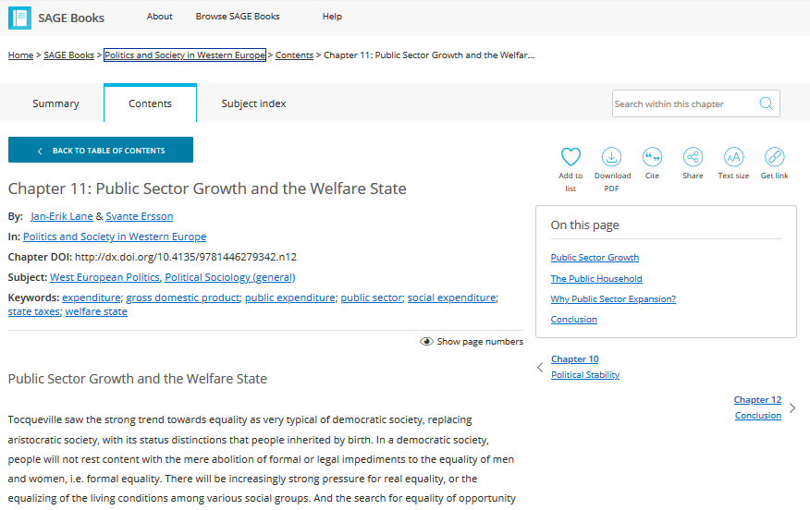
Chapter and Entry page
Search for a term or phrase within the chapter you’re viewing
Return to Entire Work
Download, cite and share the item, or save it to one of your lists using the heart icon
Full text of chapter or entry continues down the page
Browse through other chapters and entries in this work

Slide 23
Applying your learning
Apply the Entire Works or Chapters/Entries filter to your previous search or browse results
Open a relevant resource
Open the citation for your chosen item
Navigate to the chapter level and download the PDF

Slide 24
Creating a Profile
Back to Contents
Saving searches and managing lists

Slide 25
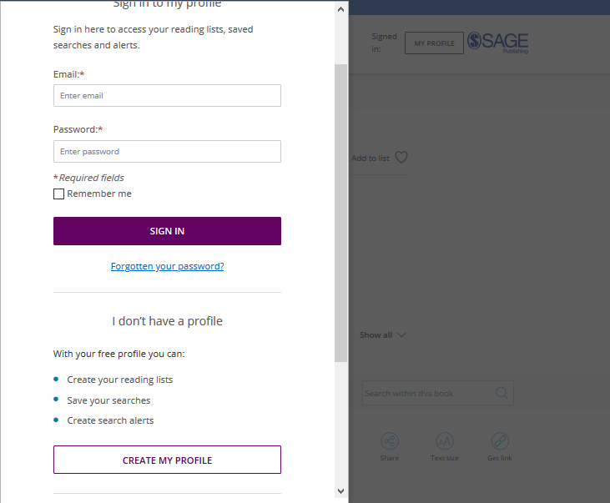
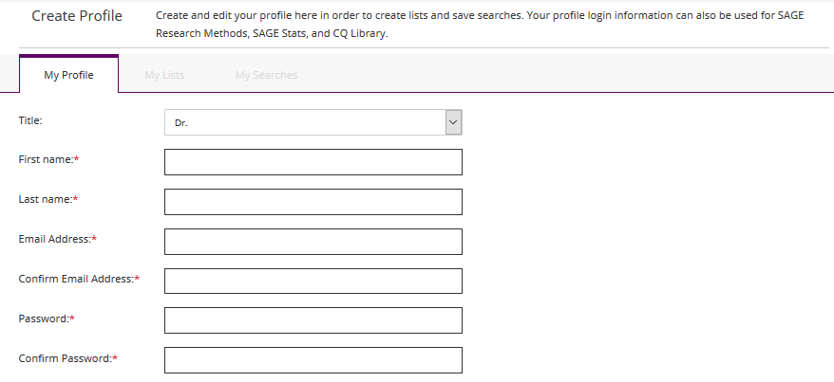
Creating a Profile
Click the My Profile button, then select Create my profile towards the bottom of the pop-up window that appears.
Once you’ve created your free profile, you can sign in here at any time.

Slide 26
Saving searches
When you’re logged into your Profile and you are viewing your search results, click the Save Search button to save your search criteria, so that you can quickly re-run the same search again later.

Slide 27

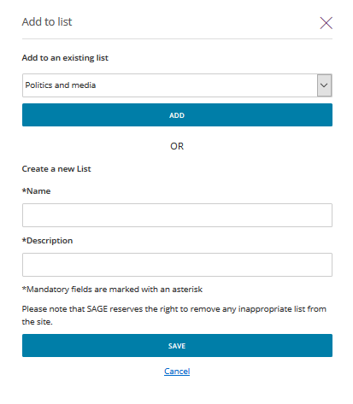
Managing lists
When logged in to your Profile, you can add resources to My Lists in order to save items of interest for later.
On any resource page, click the Add to list button.
When the pop-up window appears, choose an existing list to add your resource to, or create a new list.

Slide 28
Managing lists
When logged in to your Profile, you can add resources to My Lists in order to save items of interest for later.
You can also add an item to a list from your search results page.

Slide 29
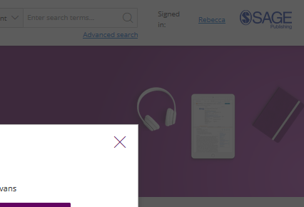
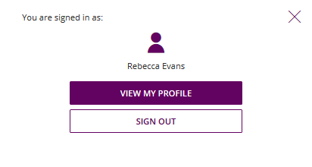
Managing your Profile
When you are signed in, you can access your lists and saved searches by clicking on your name at the top-right of any page.
Select View my profile to edit your profile details, and view and edit your saved searches and lists.

Slide 30
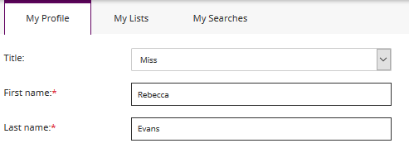
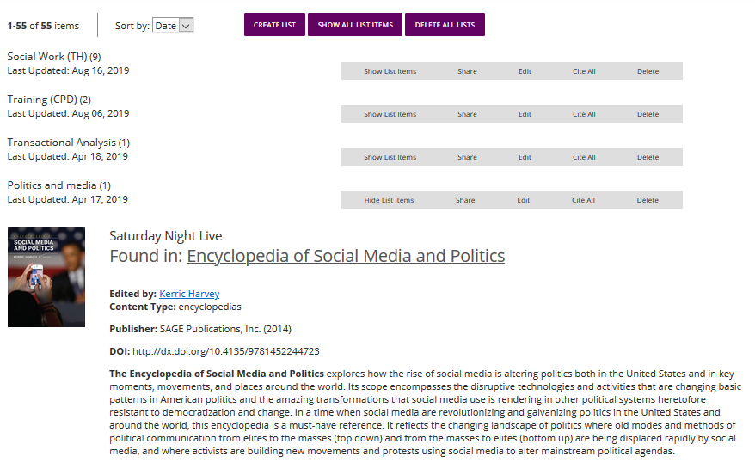
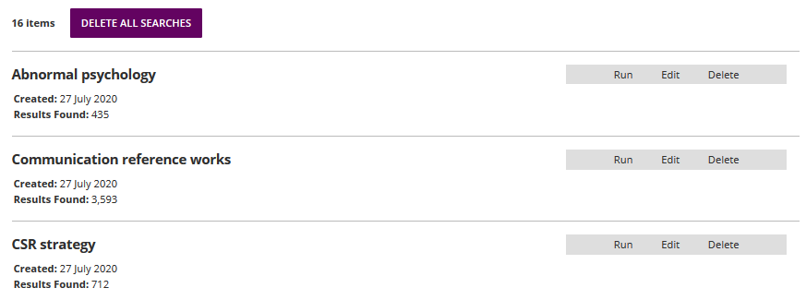
Managing your Profile
Toggle between your profile areas
My Lists
My Searches

Slide 31
Applying your learning
Create your free profile from any page of the SAGE Knowledge platform
Save a search based upon a current assignment or project
Save one resource to My Lists
Find your new list and saved item via My Profile

Slide 32
Want to learn more?
Explore more of our training resources here.

Slide 33
Thank you for watching!
Back to Contents

