Slide 1

let your training
journey begin

Slide 2

I’d like to learn about this product myself…

Slide 3
Using this presentation
Navigate to a specific section using the interactive links on the next slide, OR
Follow along slide-by slide
We recommend you view this PowerPoint in Presentation mode for the best experience.

Slide 4
Contents
Introduction to the platform
Why watch educational video? What is it? What’s in it? Who is it for?
Getting started on the platform
The homepage, browsing, searching
The Video page
Video page features and functionality
Creating a Profile
Saving searches, adding videos to lists, and creating video clips

Slide 5
Introduction to the platform
Back to Contents
Why watch educational video?
What is it? What’s in it? Who is it for?

Slide 6
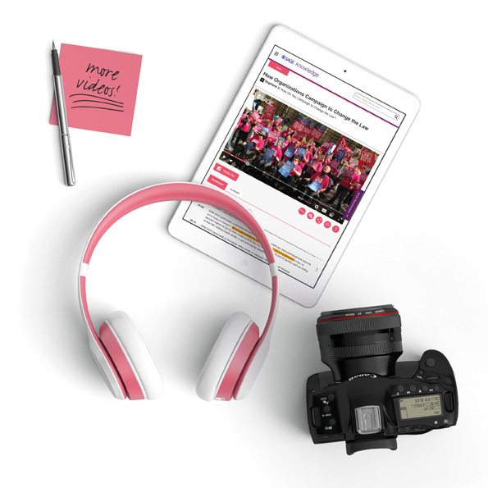
Why watch educational video?
We conducted market research in the 2014/15 academic year, White paper study conducted by SAGE
We surveyed 1673 students
  49% undergraduate
  33% graduate/post-graduate
  18% unspecified
Respondents came from North America, Asia Pacific, Europe and South America

Slide 7
Why watch educational video?
According to our respondents, these are the reasons people watch educational video:
63.4% Professor plays it during class
59.3% For help in understanding course material
43.2% Assigned as homework prior to class
41.4% Assigned as supplemental material
34.3% To see the steps necessary to do something successfully
31.8% To see a practical example of a theoretical concept
29.4% To get another perspective
25.1% As part of a research assignment
17.7% To illustrate a point in a presentation you are making

Slide 8
SAGE Video is a series of streaming video collections developed in partnership with leading academics, societies and practitioners, to deliver pedagogical and research-oriented video mapped to disciplinary curricular needs.
You can access the platform at:
http://sk.sagepub.com/video

Slide 9

What’s in it?
SAGE Video is currently made up of eleven subject collections:
  Business & Management Political Science & International Relations
  Psychology Counseling & Psychotherapy
  Education Media, Communication, & Cultural Studies
  Sociology Criminology & Criminal Justice
  Social Work Nursing
  Leadership
The content you can access through SAGE Video will depend on the subscription at your library
If you do not have access to particular content, you will see the following icon next to the resource:
If you aren’t sure which video subject collections your institution subscribes to, please check with your library staff

Slide 10
2015
Education, Counseling and Psychotherapy, and Media, Communication & Cultural Studies
2016
Business & Management, Political Science & International Relations, and Psychology
2017
Sociology, and Criminology & Criminal Justice
2019
Social Work
2020
Nursing, and Leadership

Slide 11
SAGE Video collections
Created to support pedagogical needs across higher education, from undergraduate teaching and learning, student reference, research projects, through to higher level academic interest material
Developed with our author and editor networks to meet pedagogical needs; overseen by an Editorial Advisory Board
All videos available globally
About 60% of content exclusive to SAGE
New and original productions, plus licensed material

Slide 12
Video types
There are 17 video types, designed to help with different objectives in teaching or learning situations – each type has a different use.
The six most common are:
Video cases shed light on a key course topic, examining a certain context or problem
Documentaries to explore a particular theme or topic in-depth
In Practice to make connections between theory and practice with a real-life context
Interviews with leading academics
Tutorials explaining the principles of a key course topic; how to understand it; how to do it; key points
Definitions of key terms and concepts

Slide 13
Who is it for?
Faculty
    Keep students engaged with exciting video content
    Embed directly into Learning Management Systems for convenient access
    Rely on high-quality, stable videos that won’t disappear
    Choose from curriculum-mapped content, direct from the experts
Students
    Study and self-serve at their own pace
    Understand how concepts are really applied, beyond the book
    See academics and practitioners in the flesh
    Feel confident referencing reliable, credible content from an academic publisher
Researchers conducting independent projects
    Refer to real-life examples for deeper understanding
    Get inspired for new research topics
    Engage critically with multiple perspectives
Librarians providing research support, information workshops
    Bring valuable video resources to the academic community
    Meet changing expectations of the learning landscape
    Ensure patrons are using quality, citable resources

Slide 14
Getting started on the platform
Back to Contents
The homepage, browsing, searching

Slide 15
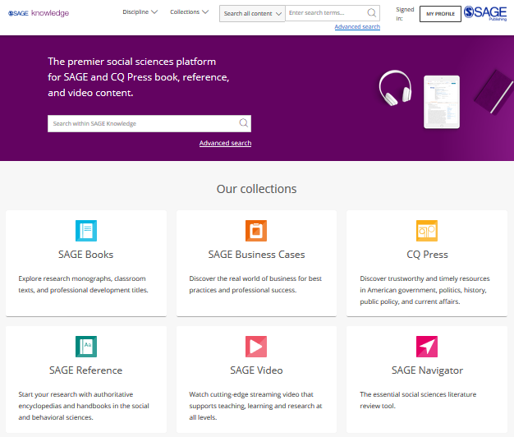
The SAGE Knowledge homepage
SAGE Knowledge hosts a number of SAGE’s digital library products, including SAGE Video.
You can access SAGE Knowledge by going to http://sk.sagepub.com
Please note, it is possible that some of these content options will appear in grey on your screen, if your institution does not subscribe to a particular collection.

Slide 16
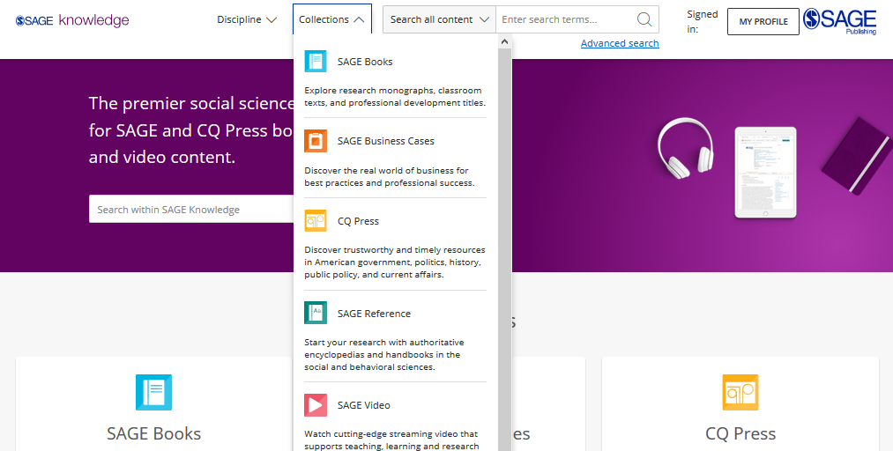
Browsing by
Collection
Click to open the Collections menu to explore all content within a particular collection, for example, if you want to see all of our videos.
You can also Browse by Collection using the tiles on the homepage.
Please note, it is possible that some of these content options will appear in grey on your screen, if your institution does not subscribe to a particular collection.

Slide 17
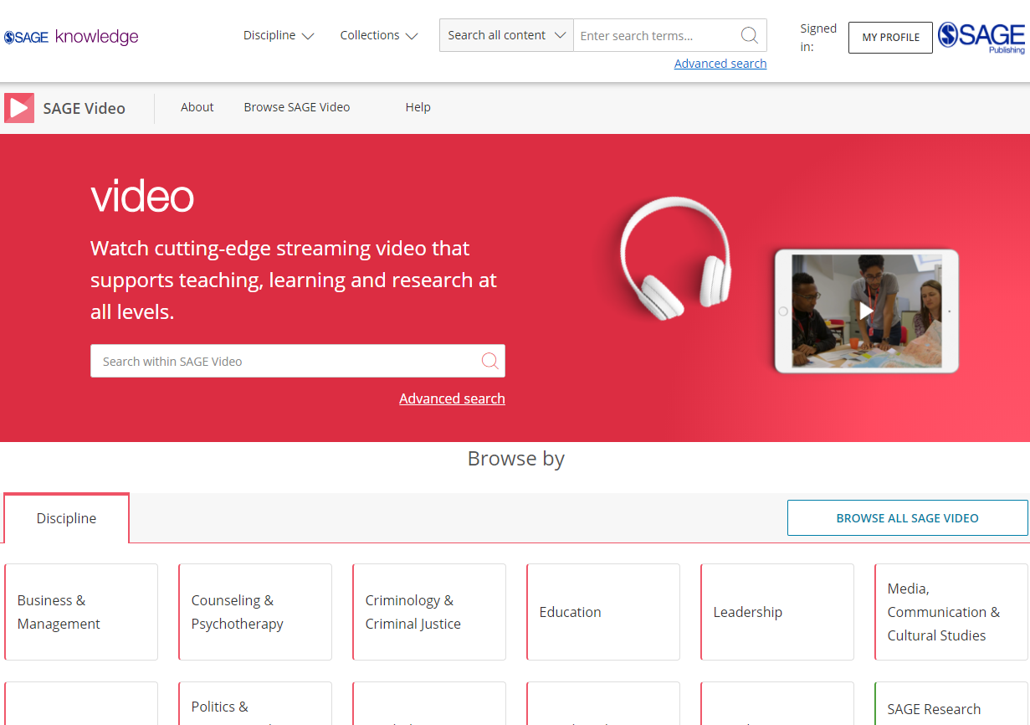
The SAGE Video homepage
You can access SAGE Video directly by going to http://sk.sagepub.com/video
SAGE Video content will also be available through your library catalogue, and search engines like Google.

Slide 18
Browsing from the SAGE Video homepage
Browse by Discipline to access the subject taxonomy to get a more granular breakdown of the Discipline.
Please note, it is possible that some of these content options will appear in grey on your screen, if your institution does not subscribe to a particular collection.

Slide 19
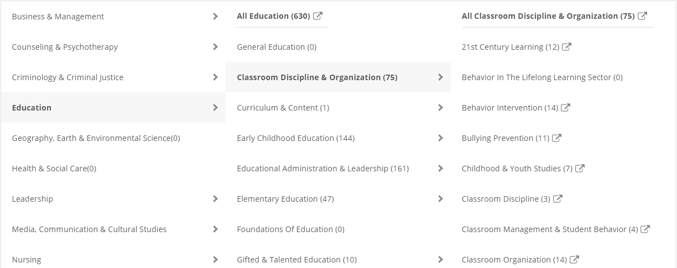
Browsing by Discipline
The subject taxonomy allows you to discover videos on your chosen topic or research area. It is also a great way of seeing what is covered in the video discipline collection, especially if you’re not sure of your key word search terms.
Please note, some discipline or topic areas will show zero results (0) depending on your institution’s collection status.

Slide 20
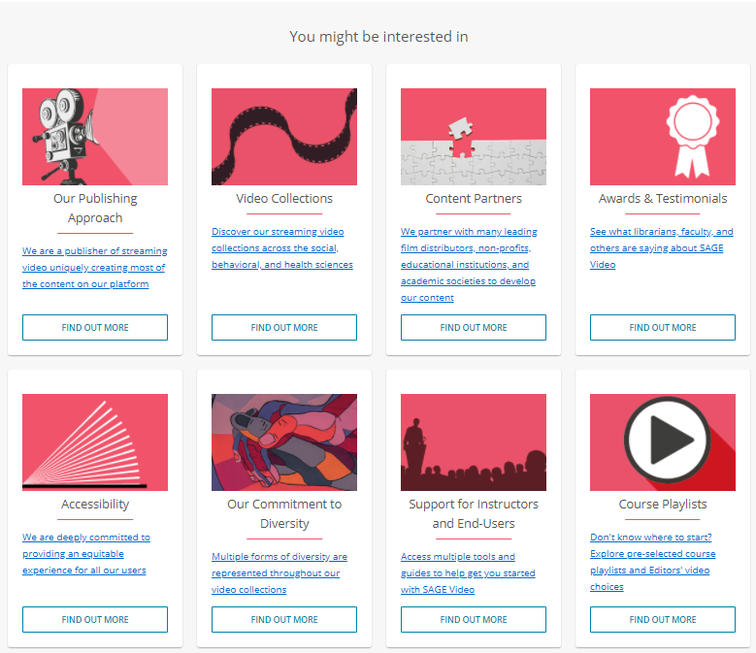
Browsing from the SAGE Video homepage
Explore the You might be interested in links towards the bottom of the SAGE Video homepage to find out more about the video collections.

Slide 21
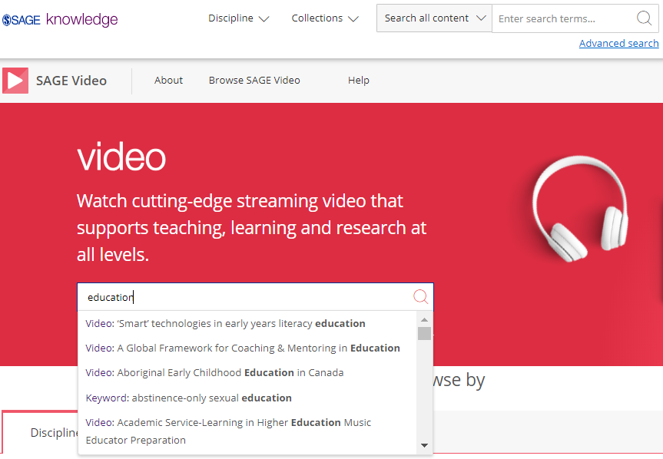
Using the Quick search
You can run a search from any page using the search bar at the top of the screen.
Use the quick search to look for videos related to key words and phrases.
Run the search for your own terms, or click on one of the auto-suggestions to go directly to that video or keyword result.

Slide 22
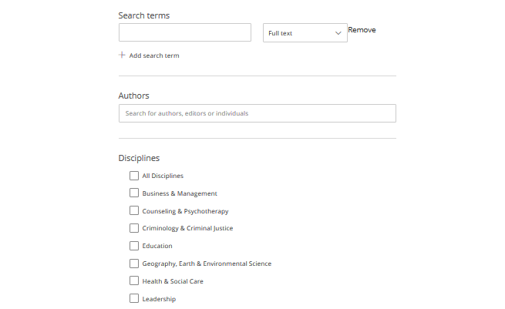
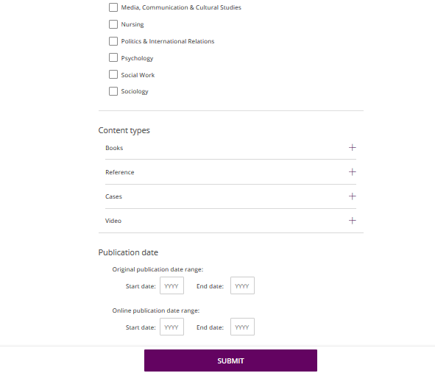
Using the Advanced search
Enter your search criteria
Add new rows for more criteria
Search specifically for people, e.g. authors
Choose the disciplines you want to search across
Choose the collections you want to search across
Select your publication date ranges
Click Submit when you’re ready

Slide 23
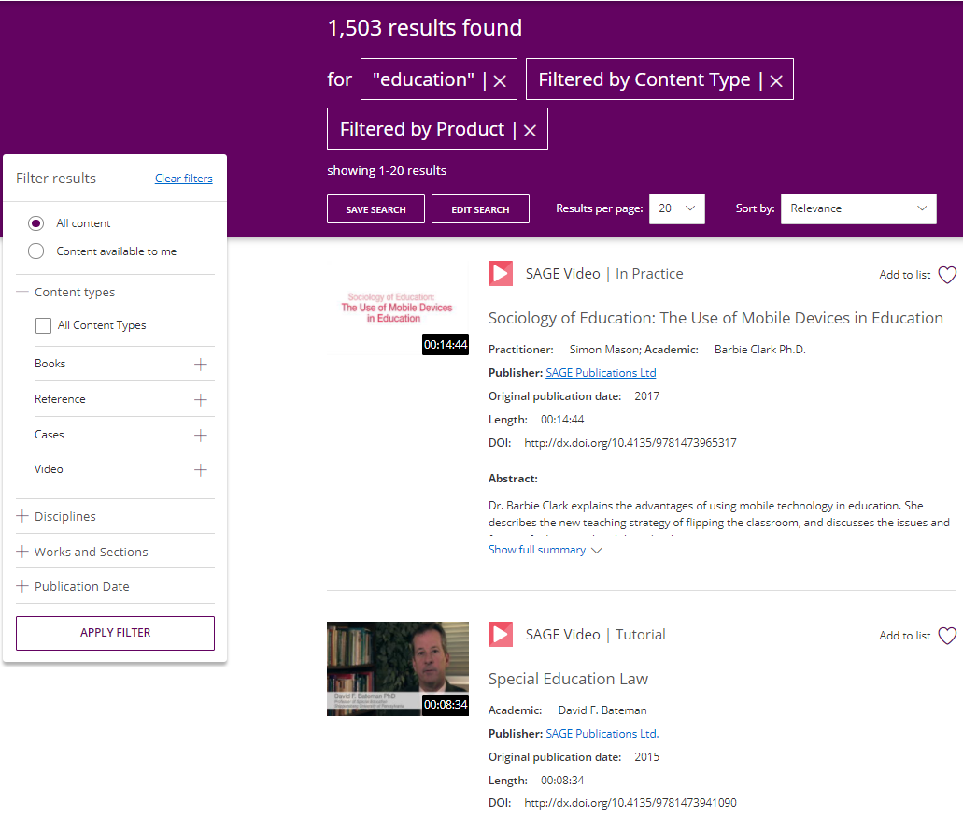
Viewing your results
Use the filters on the left-hand side of the search results page to refine your search; you can filter by content type and discipline, and use the publication date slider to find older or newer content.
Click the image or title to open the video.
You must click the Apply filter button to apply your changes.
Item is not available at your institution

Slide 24

Applying your learning
Visit the SAGE Video homepage at http://sk.sagepub.com/video or find it via your library catalogue
Find a video in your subject area using Browse by Discipline
Run a search based on a current assignment or project you are working on
Use the filters to look at videos from one video type

Slide 25
The Video page
Back to Contents
Video page features and functionality

Slide 26
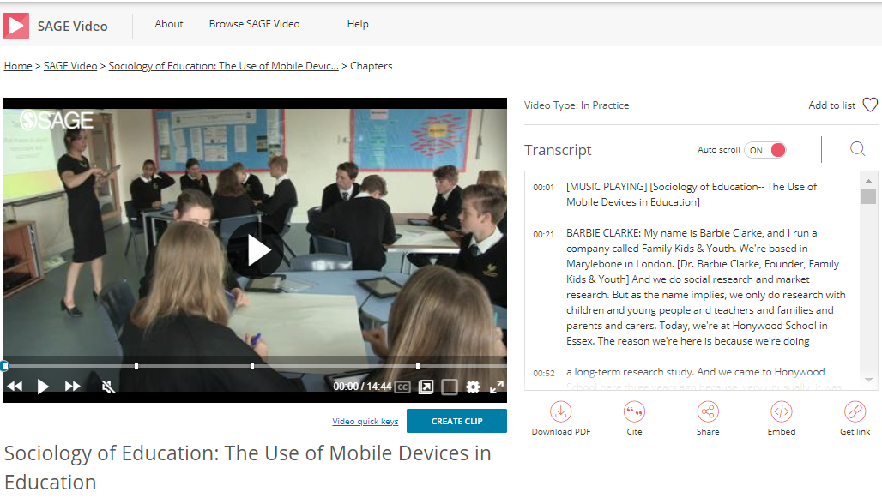
SAGE Video page
Use the functions at the bottom of the video display to adjust the volume, increase and decrease the video quality and playback speed, add subtitles, open in a new tab, or view full-screen.

Slide 27
SAGE Video page
Use the auto-scrolling transcript to follow along with the video as it plays.
Videos are streaming only, but you can download a PDF of the video transcript by clicking the Download PDF icon.

Slide 28
SAGE Video page
Use the icons beneath the video transcript to: to Cite in 4 referencing styles, Share with a friend, student or colleague, Embed a video into a learning management system (LMS) or virtual learning environment (VLE), or Get link to generate a permalink to link to the video page directly.

Slide 29
SAGE Video page
Use Add to list to create lists of your favourite videos.
*You will need to be signed in to your Profile to add videos to a list.*
TIP: To learn how to create your Profile, click here.

Slide 30
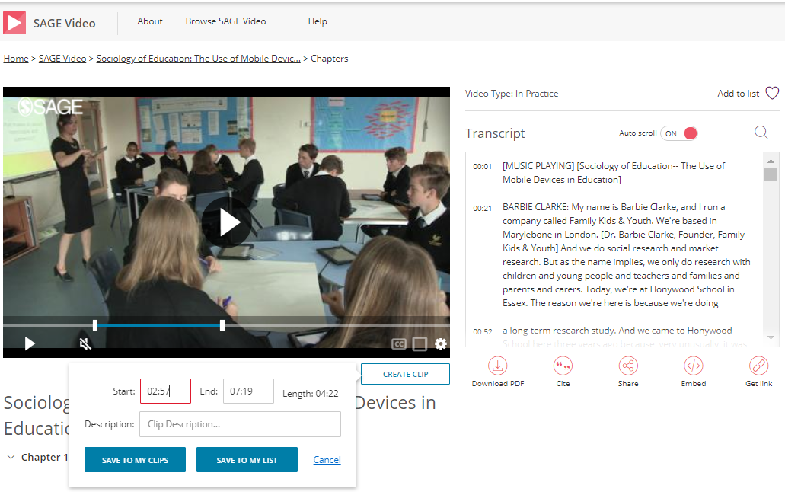
Create video clips
Create video clips
Click on Create Clip beneath the video.
Use the sliders that appear on the video to select the start and end times of your clip.
Click on Save to my clips (a list just for clips) or Save to my list.
If you select, Save to my list, choose the list you’d like to add the video clip to, or create a brand-new list.
*You will need to be signed in to your Profile to save clips.*
TIP: To learn how to create your Profile, click here.
TIP: To learn how to access your lists, click here.

Slide 31
Applying your learning
Open a video and download the PDF transcript
Download the citation for your chosen video
Create a video clip, and Save to my clips

Slide 32
Creating a Profile
Back to Contents
Saving searches, adding videos to lists, and creating video clips

Slide 33
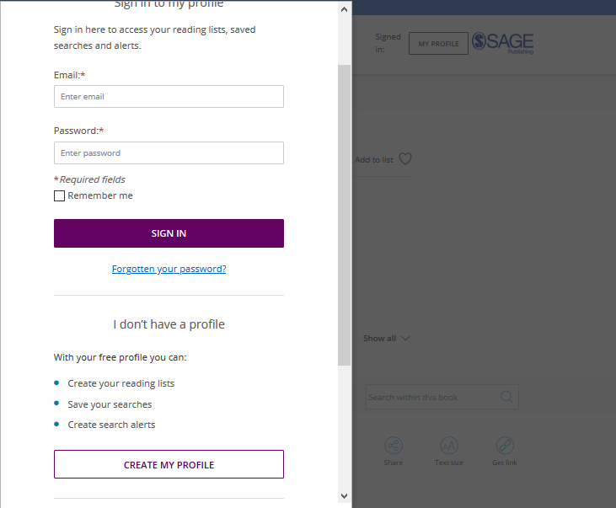
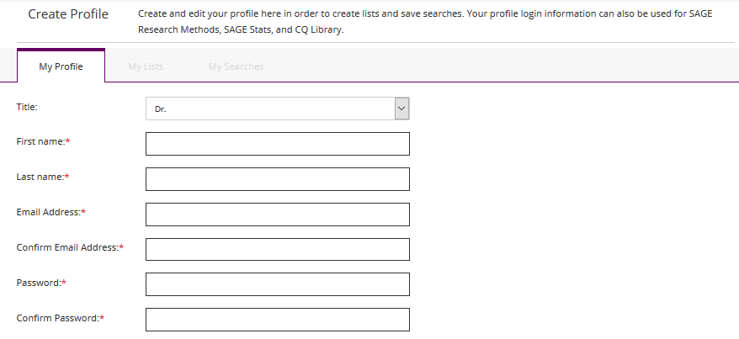
Creating a Profile
Click the My Profile button, then select Create my profile towards the bottom of the pop-up window that appears.
Once you’ve created your free profile, you can sign in here at any time.

Slide 34
Saving searches
When you’re logged into your Profile and you are viewing your search results, click the Save Search button to save your search criteria, so that you can quickly re-run the same search again later.

Slide 35
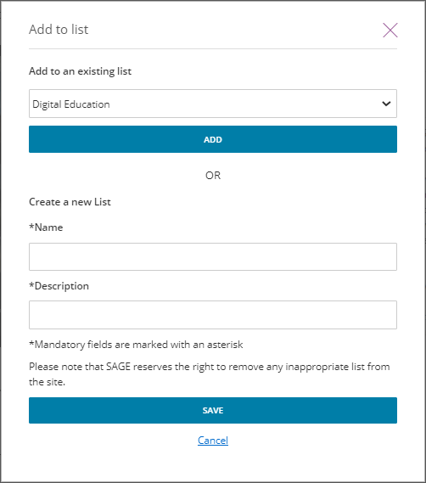
Managing lists
When logged in to your Profile, you can add resources to My Lists in order to save items of interest for later.
On any resource page, click the Add to list button.
When the pop-up window appears, choose an existing list to add your resource to, or create a new list.

Slide 36
Managing lists
When logged in to your Profile, you can add resources to My Lists in order to save items of interest for later.
You can also add an item to a list from your search results page.

Slide 37
Create video clips
Create video clips
Click on Create Clip beneath the video.
Use the sliders that appear on the video to select the start and end times of your clip.
Click on Save to my clips (a list just for clips) or Save to my list.
If you select, Save to my list, choose the list you’d like to add the video clip to, or create a brand-new list.
*You will need to be signed in to your Profile to save clips.*
TIP: To learn how to access your lists, click here.

Slide 38
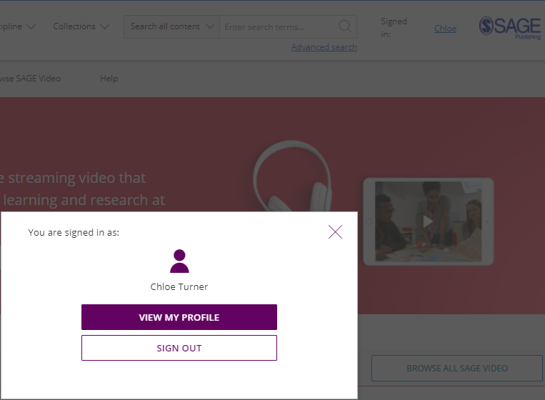
Managing your Profile
When you are signed in, you can access your lists and saved searches by clicking on your name at the top-right of any page.
Select View my profile to edit your profile details, and view and edit your saved searches and lists.

Slide 39
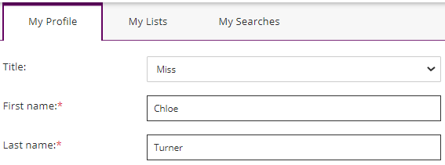
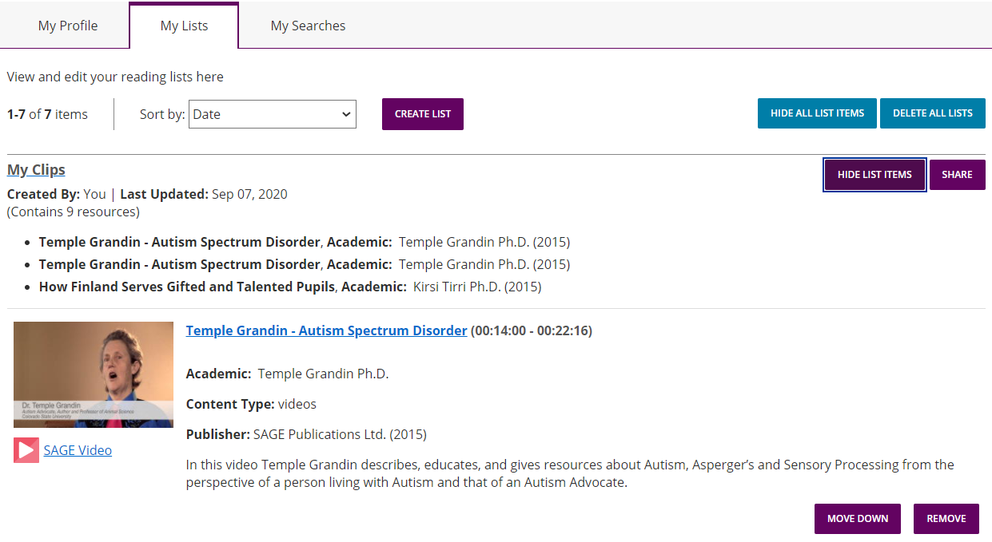
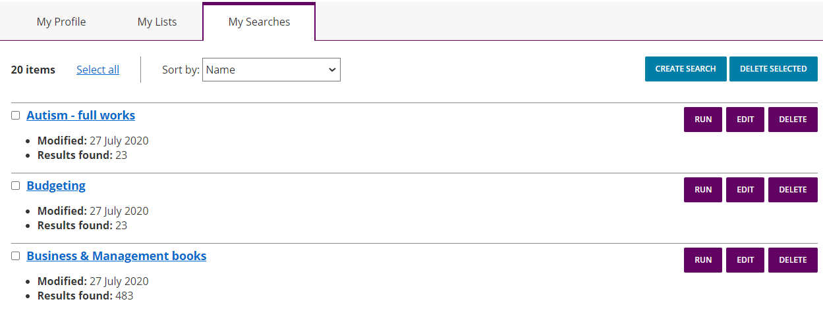
Managing your Profile
Toggle between your profile areas
My Lists
My Searches

Slide 40
Applying your learning
Create a free profile on SAGE Video from any page of the platform
Save a search based upon a current assignment or project
Save one video to Save to my list
Create a video clip, and Save to my clips

Slide 41
Want to learn more?
Explore more of our training resources here.

Slide 42
Thank you for watching!
Back to Contents

