Slide 1

let your training
journey begin

Slide 2
SAGE Business Cases
Workshop for {…}
{Your name}

Slide 3

Session outline
Introduction to SAGE Business Cases
Live platform demonstration
Final questions and session round-up

Slide 4
Session objectives
By the end of this session, participants will be able to:
Describe how SAGE Business Cases can help them in their study and research
Locate relevant cases using browse and search options
Save a case to a list within the platform

Slide 5
Discussion Questions
How familiar are you with SAGE Business Cases?
What projects are you currently working on or interested in?
What do you hope to gain from today’s session?

Slide 6
Introduction to the platform
What is it? What’s in it? Who is it for?
Why a library collection of business cases?

Slide 7
SAGE Business Cases gives you access to a collection of thousands of proprietary, licensed, and commissioned cases that inspire researchers to develop their own best practices and prepare for professional success.
These business cases, tailored to library needs, provide librarians, faculty, and students with cases to support their curriculum and independent research.
You can access the platform at:
http://sk.sagepub.com/cases

Slide 8

What’s in it?
The content you can access through SAGE Business Cases will depend on the subscription at your library
It’s possible your library does not subscribe to all of our content
If you do not have access to particular content, you will see the following icon next to the resource:
If you aren’t sure which content your institution subscribes to, please check with your library staff

Slide 9
What’s in it?
Original cases are exclusive to the platform, and are written by Business & Management faculty who have extensive knowledge of teaching with business cases.
Repurposed SAGE content has been adapted into the case format from resources already published by SAGE, including books and journal articles. Adapting the content in this way can save users time when searching for cases in these formats.
Licensed content from content partners SAGE work with over 20 global content partners (such as Universities, business schools and professional societies), who often produce their own business cases, and then sell them at the library level.

Slide 10
Our Editorial process
An In-house Editorial team dedicated to SAGE Business Cases content development
  Source and develop relationships with prospective content partners
  Identify potential original authors and follow commissioning process
  Curate existing SAGE content
An Editorial Advisory Board oversees the whole collection
  Global Business & Management faculty
  Well known to SAGE
  Highly respected in their fields
  Familiar with teaching with cases
  Suggest top cases we can license
Cases go through full peer-review
  Submissions handled through ManuscriptCentral
  A team of (external) reviewers check each case we publish
    Ensures ‘teachability’ and viability in class
Final publication into the SAGE Business Cases collection
Cases will be updated if they age significantly

Slide 11
Who is it for?
Faculty
    Reduce costs by circumventing the pay-per-case model
    Remove access barriers for students
    Easily access wide variety of cases from a number of different sources
    Publish cases with SAGE
Students
    Access cases whenever, wherever, for course prep, revision, and self-study
    Become more self-sufficient by going beyond assigned cases
    Find related study resources such as books, reference works and journal articles
Researchers
    Examine real-life business decisions and strategies for personal research
Librarians
    Enhance relationships with Business faculty
    Save faculty money
    Inform collection development; obtain data on usage and engagement of case
    content

Slide 12
Getting started on the platform
The homepage, browsing, searching

Slide 13
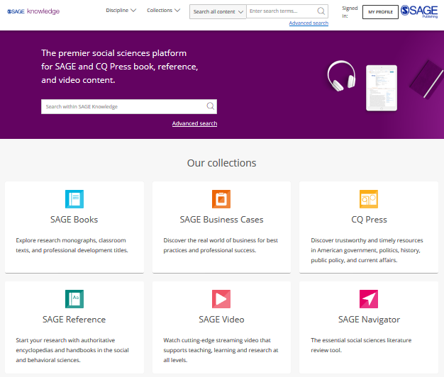
The SAGE Knowledge homepage
SAGE Knowledge hosts a number of SAGE’s digital library products, including SAGE Business Cases.
You can access SAGE Knowledge by going to http://sk.sagepub.com
Please note, it is possible that some of these content options will appear in grey on your screen, if your institution does not subscribe to a particular collection.

Slide 14
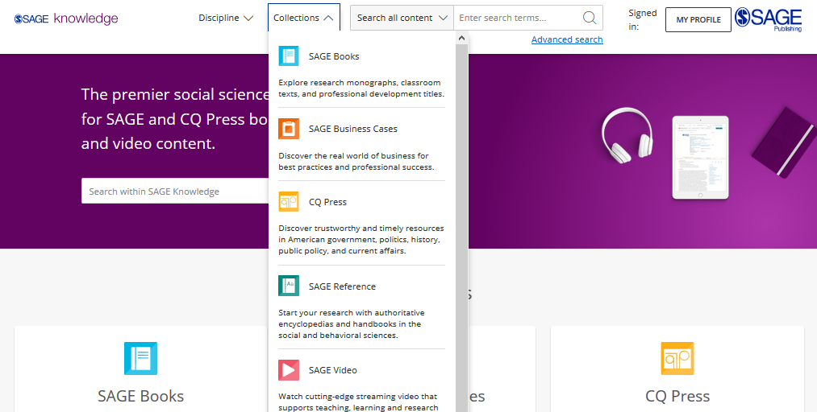
Browsing by
Collection
Click to open the Collections menu to explore all content within a particular collection, for example, if you want to see all of our cases.
You can also Browse by Collection using the tiles on the homepage.
Please note, it is possible that some of these content options will appear in grey on your screen, if your institution does not subscribe to a particular collection.

Slide 15
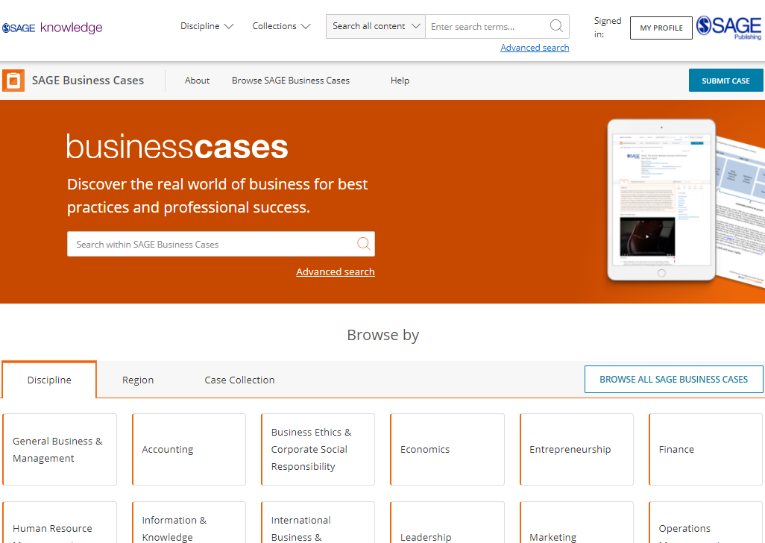
The SAGE Business Cases homepage
You can access SAGE Business Cases directly by going to http://sk.sagepub.com/cases
SAGE Business Cases content will also be available through your library catalogue, and search engines like Google.

Slide 16
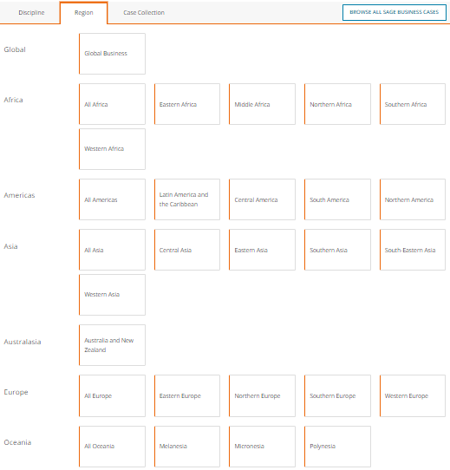
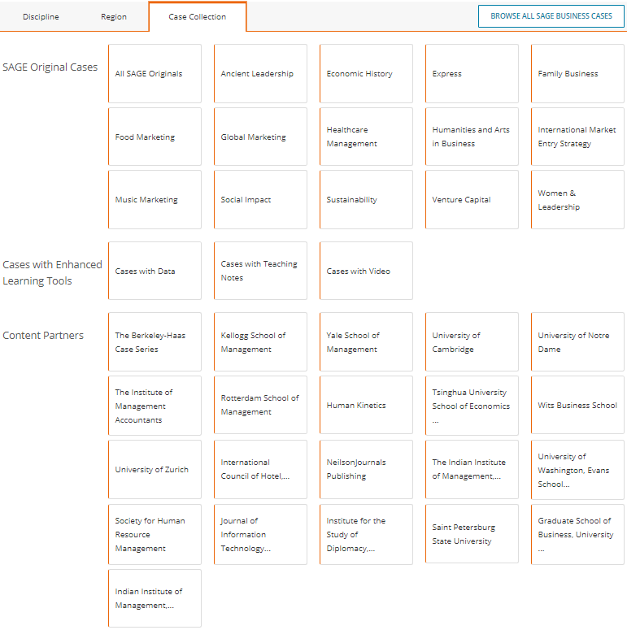
Browsing from the SAGE Business Cases homepage
Browse by Region to see cases related to business in particular regions, or by Case Collection to see cases from SAGE’s original case series, enhanced cases, and cases from a particular content partner.

Slide 17
Browsing from the SAGE Business Cases homepage
Browse by Discipline to access the subject taxonomy to get a more granular breakdown of the Discipline.

Slide 18
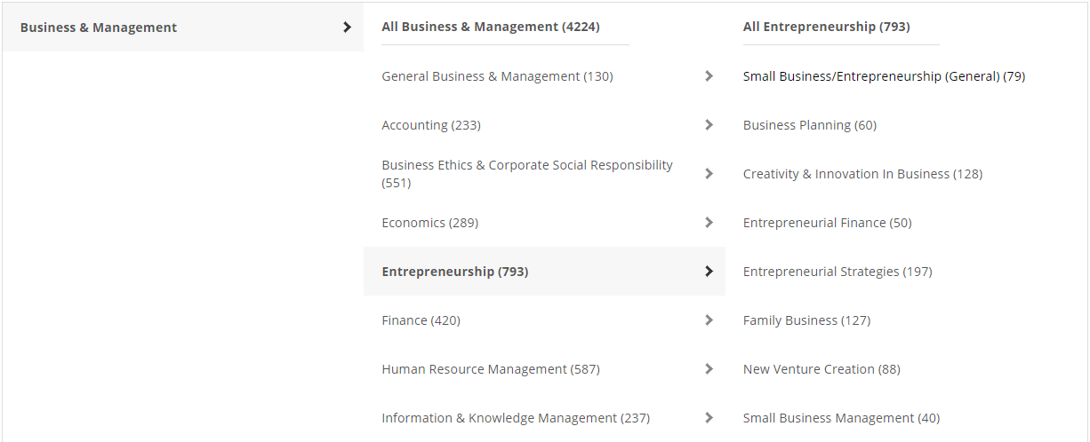
Browsing by Discipline
The subject taxonomy allows you to discover cases on your chosen topic or research area. It is also a great way of seeing what is covered in the case collection, especially if you’re not sure of your key word search terms.
Please note, some discipline or topic areas will show zero results (0) depending on your institution’s collection status.

Slide 19
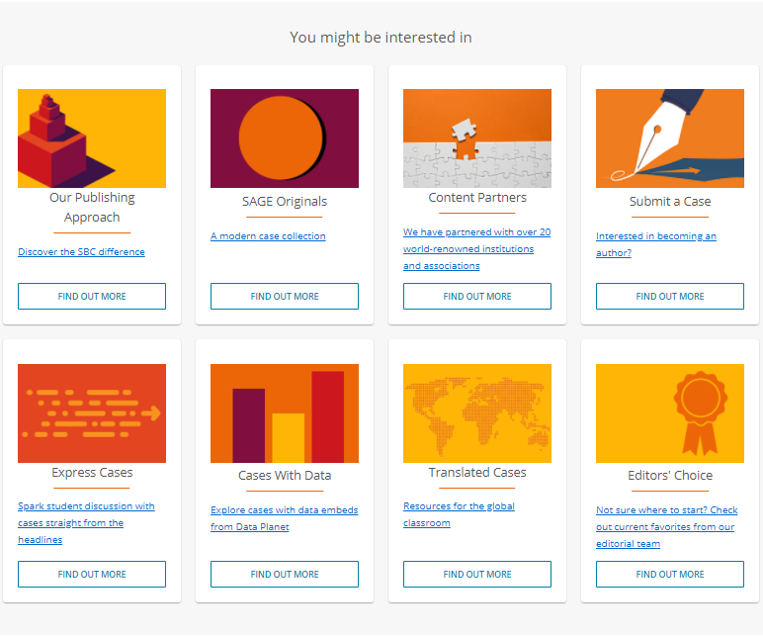
Browsing from the SAGE Business Cases homepage
Explore the You might be interested in links towards the bottom of the SAGE Business Cases homepage to find out more about the case collection.

Slide 20
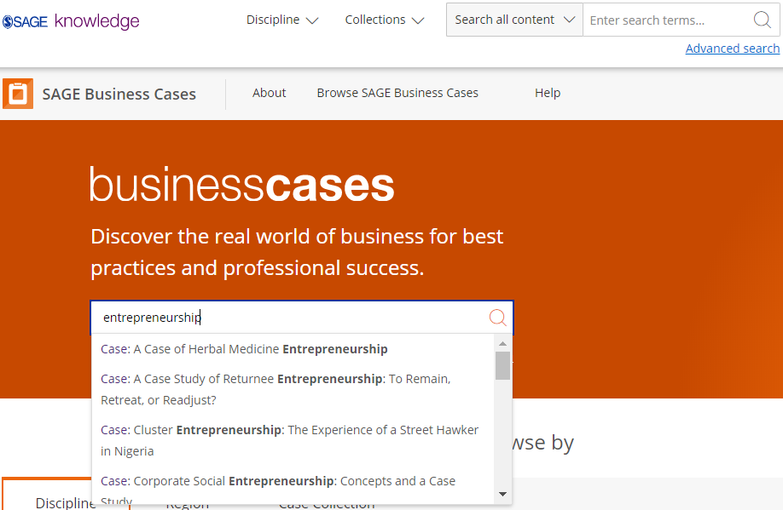
Using the Quick search
You can run a search from any page using the search bar at the top of the screen.
Use the quick search to look for cases related to key words and phrases.
Run the search for your own terms, or click on one of the auto-suggestions to go directly to that case or keyword result.

Slide 21
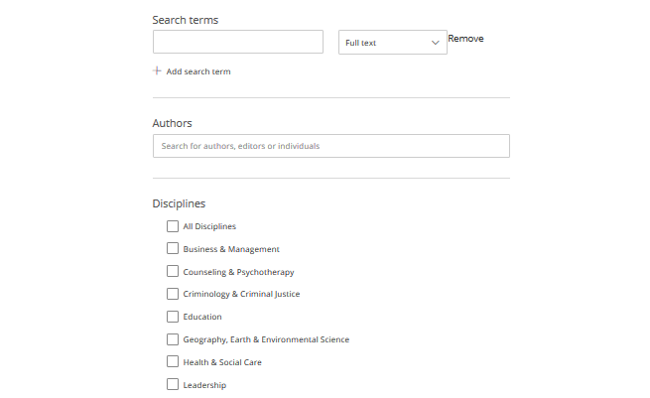
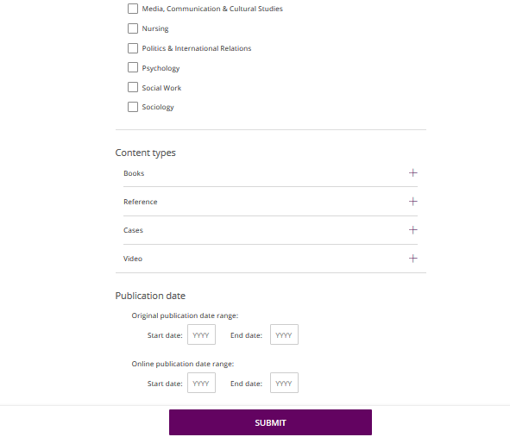
Using the Advanced search
Enter your search criteria
Add new rows for more criteria
Search specifically for people, e.g. authors
Choose the disciplines you want to search across
Choose the collections you want to search across
Select your publication date ranges
Click Submit when you’re ready

Slide 22
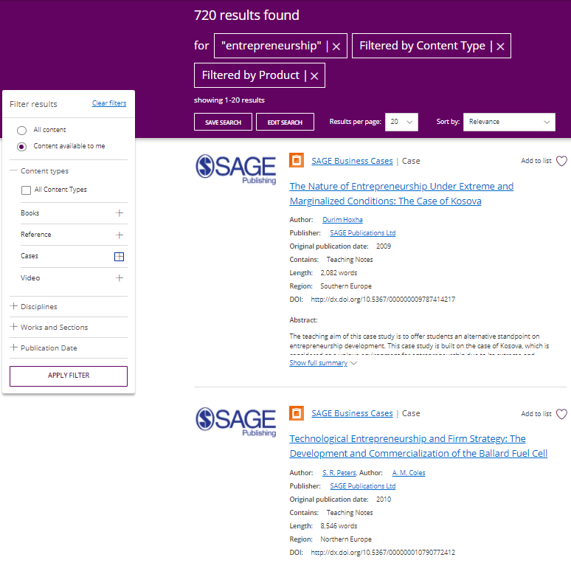
Viewing your results
Use the filters on the left-hand side of the search results page to refine your search; you can filter by content type and discipline, and use the publication date slider to find older or newer content.
Click the image or title to open the case.
You must click the Apply filter button to apply your changes.
Item is not available at your institution

Slide 23
The Case page
Case page features and functionality

Slide 24
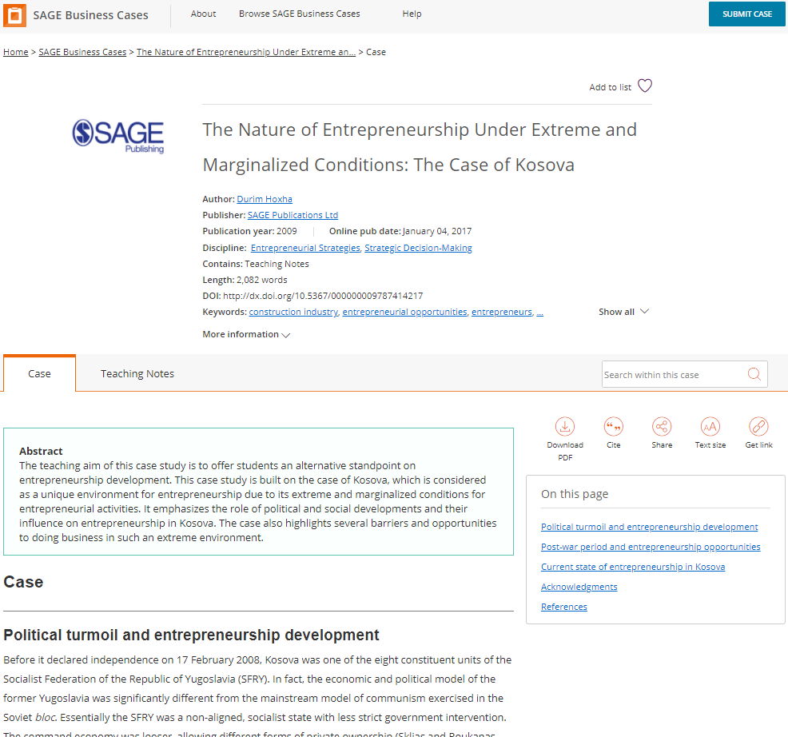
Case page
Add the case to a list using the heart icon
View more publication information about the case
Search for a term or phrase within the case
Switch between different tabs; the main tab you will want to use is the Case view
Download, cite and share the case
Move through different sections in the case
Full text of case continues down the page

Slide 25
Case page
77% of cases contain faculty-only teaching notes, tried and tested by the case authors.
Teaching notes contain discussion questions and suggested activities to use inside and outside of the classroom.
To access these you will need to get a Verification Code from your library staff.

Slide 26
Creating a Profile
Saving searches, and managing lists

Slide 27
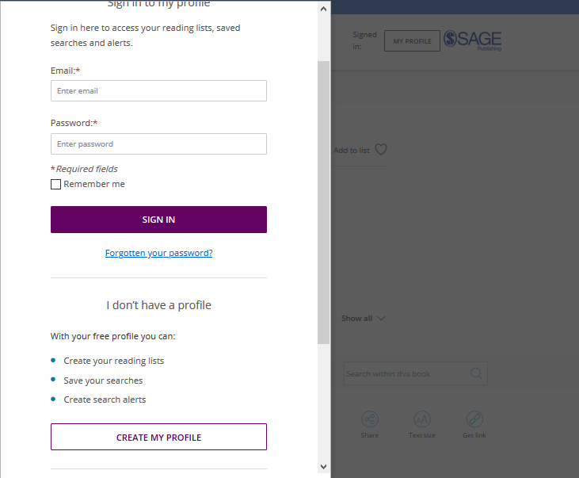
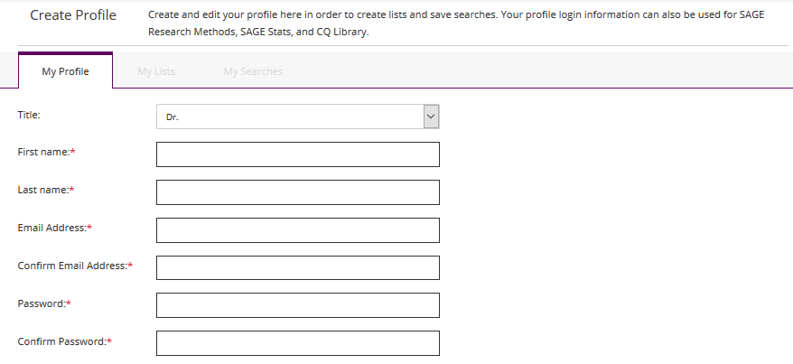
Creating a Profile
Click the My Profile button, then select Create my profile towards the bottom of the pop-up window that appears.
Once you’ve created your free profile, you can sign in here at any time.

Slide 28
Saving searches
When you’re logged into your Profile and you are viewing your search results, click the Save Search button to save your search criteria, so that you can quickly re-run the same search again later.

Slide 29
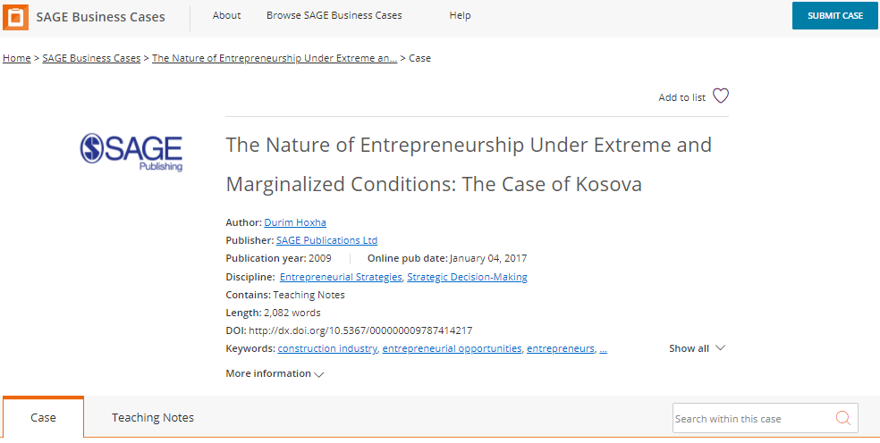
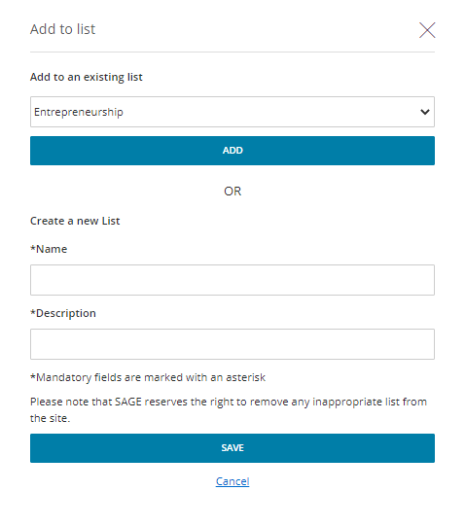
Managing lists
When logged in to your Profile, you can add cases to My Lists in order to save items of interest for later.
On any case page, click the Add to list button.
When the pop-up window appears, choose an existing list to add your case to, or create a new list.

Slide 30
Managing lists
When logged in to your Profile, you can add cases to My Lists in order to save items of interest for later.
You can also add a case to a list from your search results page.

Slide 31
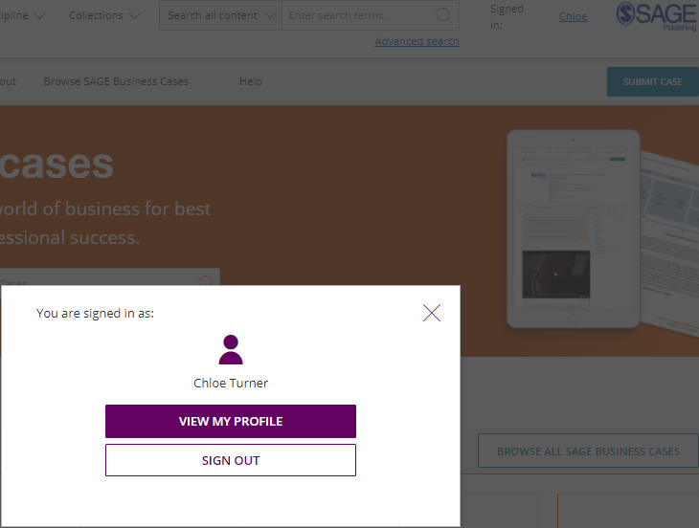
Managing your Profile
When you are signed in, you can access your lists and saved searches by clicking on your name at the top-right of any page.
Select View my profile to edit your profile details, and view and edit your saved searches and lists.

Slide 32
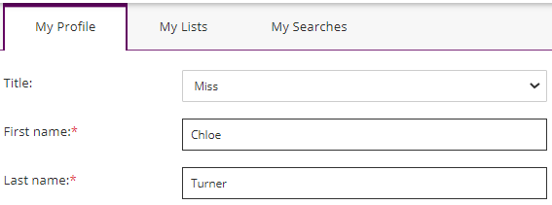
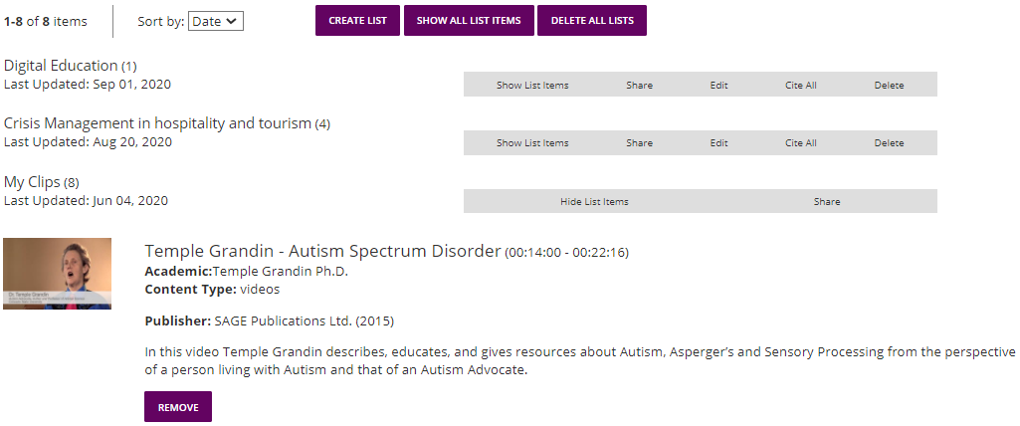
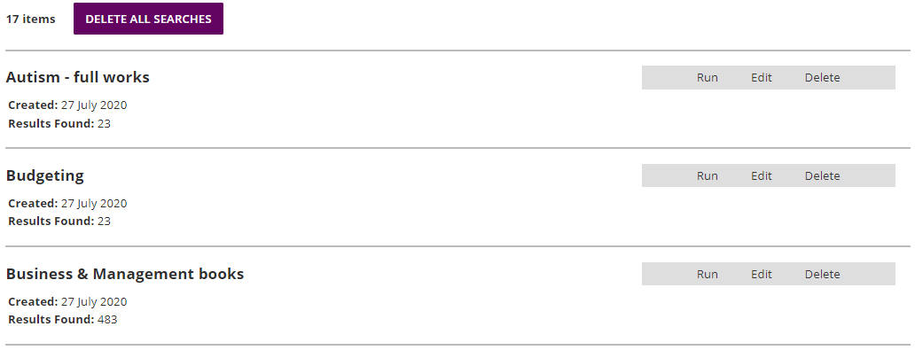
Managing your Profile
Toggle between your profile areas
My Lists
My Searches

Slide 33
Accessing teaching notes

Slide 34
Accessing teaching notes
To access the teaching notes, teachers will need to create a profile, if they haven’t already, on the SAGE Business Cases platform.

Slide 35
Accessing teaching notes
When you are signed in, you can access your profile information by clicking on your name at the top-right of any page.
Select View my profile to edit your profile details

Slide 36
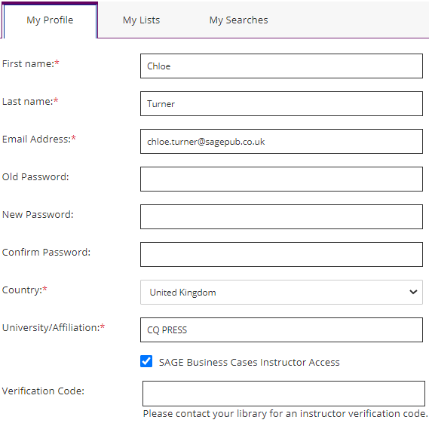
Accessing teaching notes
At the bottom of the My Profile section, tick the box called SAGE Business Cases Instructor Access.
A new box will appear called Verification Code. This Verification Code is a password set up by your library staff, so should be available if you contact them. Enter the code, and click Save.

Slide 37
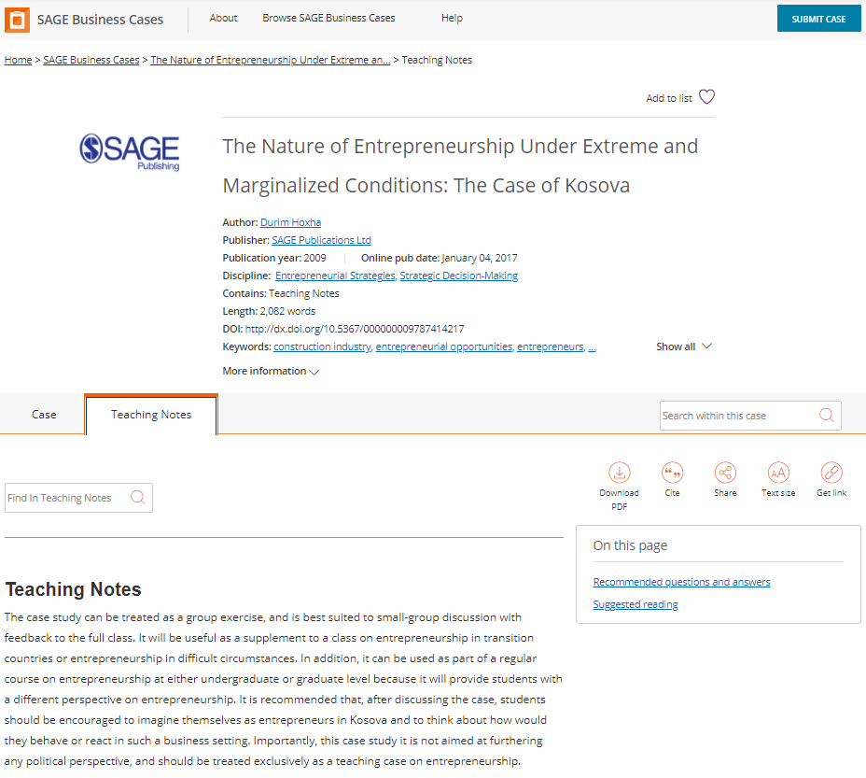
Accessing teaching notes
Go back to the case page, and you will now be able to access the teaching notes for your case by clicking on the Teaching Notes tab.

Slide 38
Do you have any questions?

Slide 39
Thank you for listening!

