Slide 1

let your training
journey begin

Slide 2
SAGE Knowledge
Workshop for {…}
{Your name}

Slide 3

Session outline
Introduction to SAGE Knowledge
Live platform demonstration
Final questions and session round-up

Slide 4
Session objectives
By the end of this session, participants will be able to:
Describe how SAGE Knowledge resources can help them in their study and research
Locate relevant resources using browse and search
Save a resource to a list within the platform

Slide 5
Discussion questions
How familiar are you with SAGE Knowledge?
What projects are you currently working on or interested in?
What do you hope to gain from today’s session?

Slide 6
Introduction to the product
Back to Contents
What is it? What’s in it? Who is it for?

Slide 7
SAGE Knowledge is where we host all our online book and reference content, ideal for learning new theories, concepts, debates and applications in your subject area.
SAGE Knowledge content covers the following subject areas:
http://sk.sagepub.com
Leadership
Media, Communication & Cultural Studies
Nursing
Politics & International Relations
Psychology
Social Work
Sociology
Business & Management
Counseling & Psychotherapy
Criminology & Criminal Justice
Education
Geography, Earth & Environmental Science
Health & Social Care

Slide 8

What’s in it?
Full access to SAGE Knowledge includes over 4,600 books and over 600 reference items
However, the content you can access through SAGE Knowledge will depend on the subscription at your library; it’s possible your library does not subscribe to all the content
If you do not have access to a particular item, you will see the following icon next to it in the search results:
If you aren’t sure which content you have access to at your institution, please check with your library staff

Slide 9
Who is it for?
Students and researchers
    Learn more about key topics in your subject area, at all levels of study
    Get multiple perspectives on topics from SAGE authors all around the world
    Save items to lists to keep track of useful information for your projects
    Download citation information for easy referencing
    Discover new resources with ‘More like this’ recommendations
Faculty
    Introduce students to high-quality content from well-known experts
    Create engaging reading lists for your classes
    Ensure students get easy access to full-text titles on- and off-campus
    Allow all students to access whenever, wherever, with unlimited simultaneous users and a mobile-responsive design

Slide 10
Getting started on the platform
Back to Contents
The homepage, browsing, searching

Slide 11
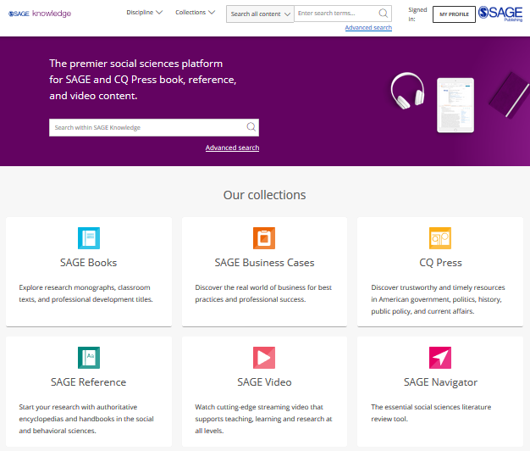
The SAGE Knowledge homepage
You can access SAGE Knowledge by going to https://sk.sagepub.com
SAGE books and reference items will also be available through your library catalogue, and search engines like Google.

Slide 12
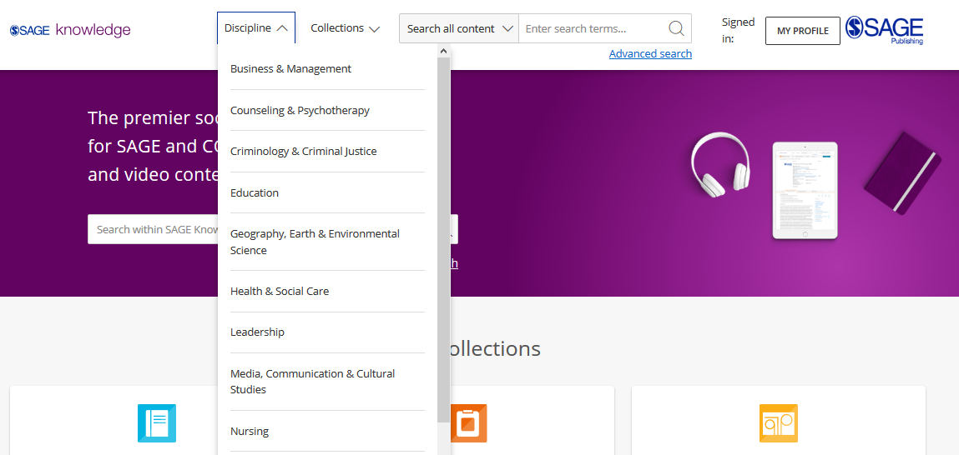
Browsing by Discipline
Click the Discipline menu at the top of the screen on any page to see all content for your subject area.
Please note, it is possible that some of these content options will appear in grey on your screen, if your institution does not subscribe to a particular collection.

Slide 13
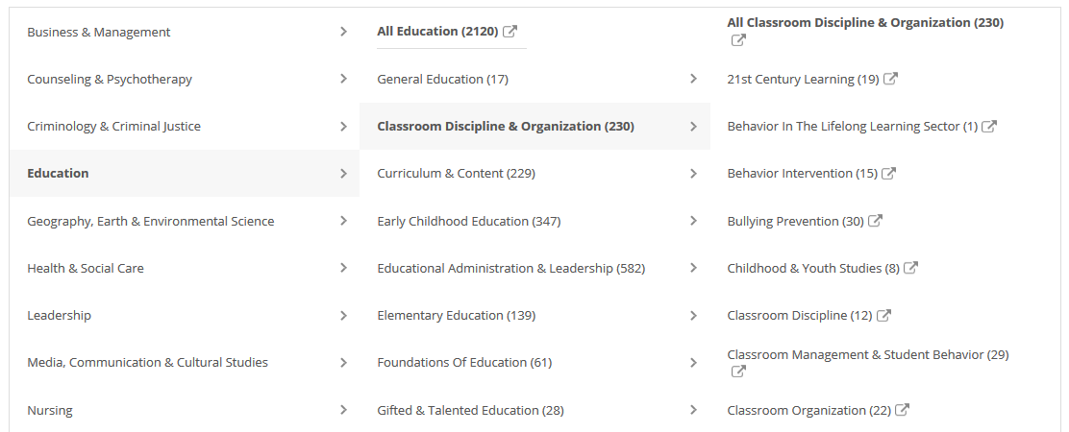
Browsing by Discipline
Browse through the taxonomy for your discipline to explore available subject areas and study themes.
Please note, some discipline or topic areas will show zero results (0) depending on your institution’s collection status.

Slide 14
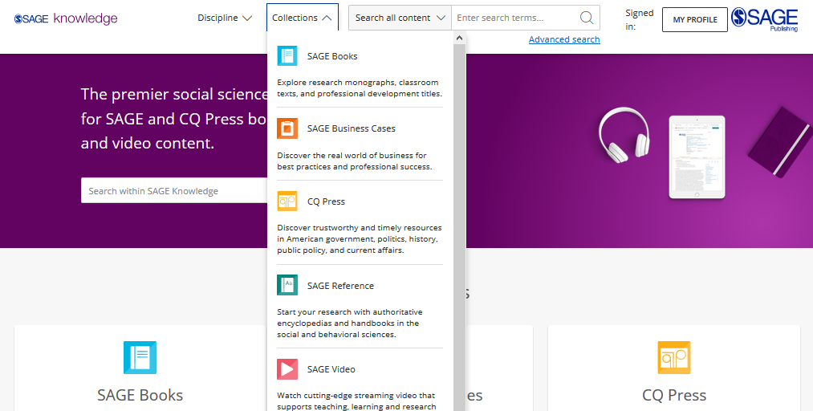
Browsing by
Collection
Click to open the Collections menu to explore all content within a particular collection, for example, if you want to see all of our Books.
You can also Browse by Collection using the tiles on the homepage.
Please note, it is possible that some of these content options will appear in grey on your screen, if your institution does not subscribe to a particular collection.

Slide 15
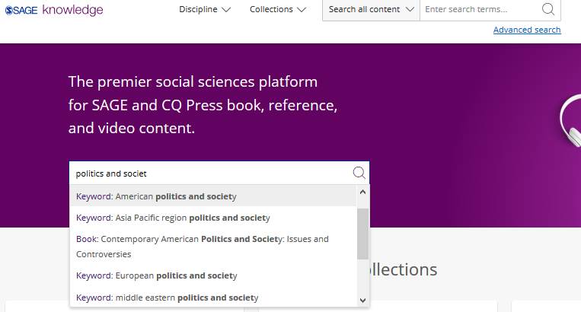
Using the Quick search
You can run a search from any page using the search bar at the top of the screen.
Use the quick search to look for content related to key words and phrases.
Run the search for your own terms, or click on one of the auto-suggestions to go directly to that resource or keyword result.

Slide 16
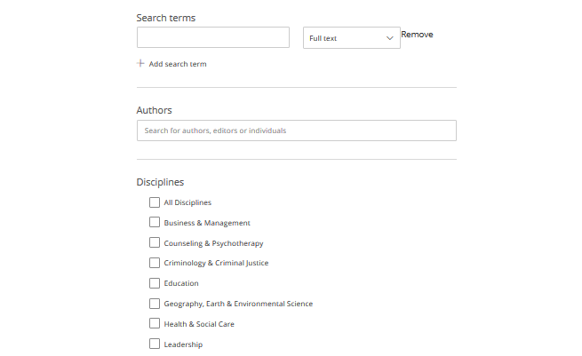
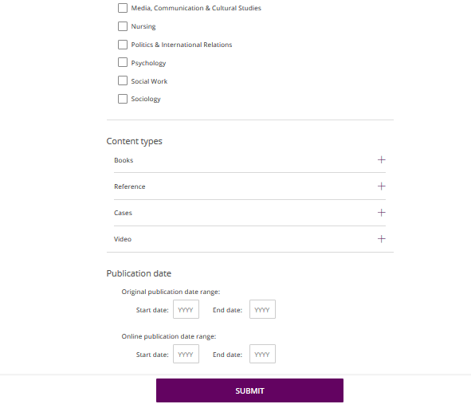
Using the Advanced search
Enter your search criteria
Add new rows for more criteria
Search specifically for people, e.g. authors
Choose the disciplines you want to search across
Choose the collections you want to search across
Select your publication date ranges
Click Submit when you’re ready

Slide 17
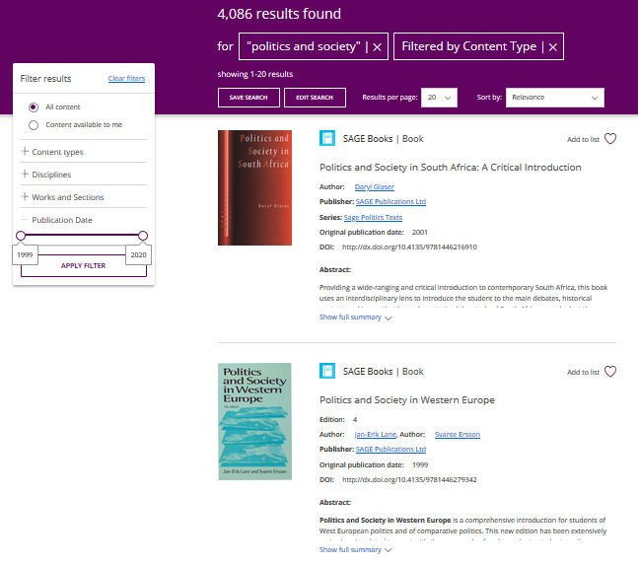
Viewing your results
Use the filters on the left-hand side of the search results page to refine your search; you can search within your results, filter by content type and subject, and use the publication date slider to find older or newer content.
Click the image or title to open the item.
You must click the Apply filter button to apply your changes.
Item is not available at your institution

Slide 18
The resource page
Back to Contents
Entire works and chapters and entries

Slide 19
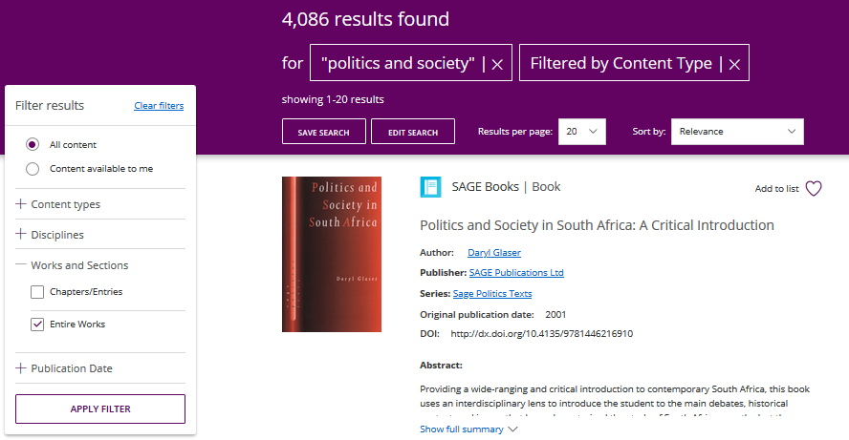
Entire Works
Entire Work refers to the complete version of a text, e.g. a whole Book or a complete Encyclopedia
When you are viewing your search results, if you leave only Entire Works selected, each complete work will only appear in the search results once.

Slide 20
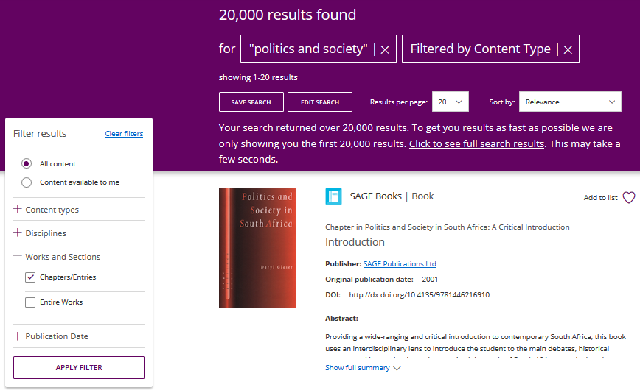
Chapters and Entries
Chapters and Entries refers to the individual component of a text, e.g. a chapter within a Book or an entry in an Encyclopedia
When you are viewing your search results, if you leave only Chapters/Entries selected, you will often see multiple results from the same Entire Work, with a larger number of results returned.

Slide 21
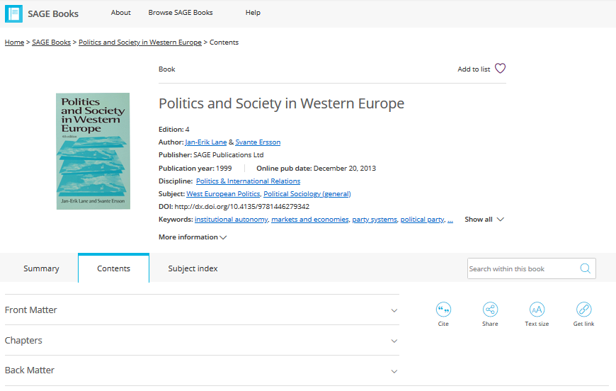
Entire Work page
Add the work to one of your lists
View publication information about the work
Switch between different tabs; the main tab you will want to use is the Contents view
Expand the Chapters view
Download, cite and share the item

Slide 22
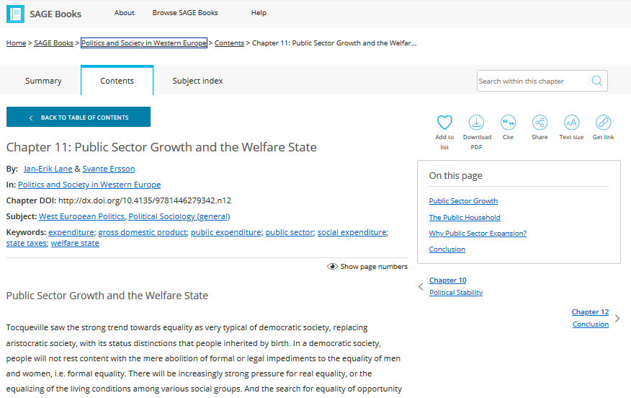
Chapter and Entry page
Search for a term or phrase within the chapter you’re viewing
Return to Entire Work
Download, cite and share the item, or save it to one of your lists using the heart icon
Full text of chapter or entry continues down the page
Browse through other chapters and entries in this work

Slide 23
Creating a Profile
Back to Contents
Saving searches and managing lists

Slide 24
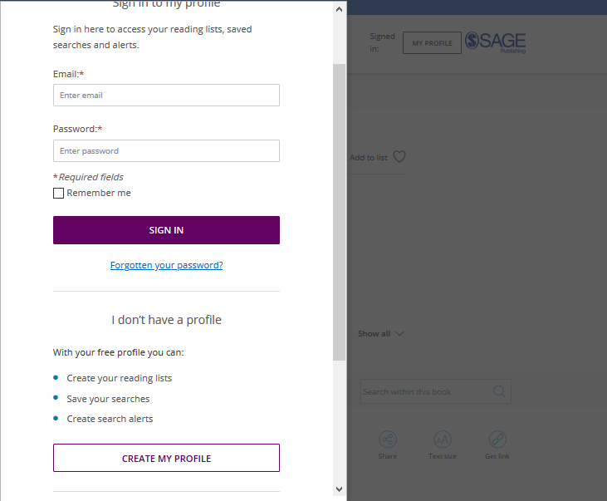
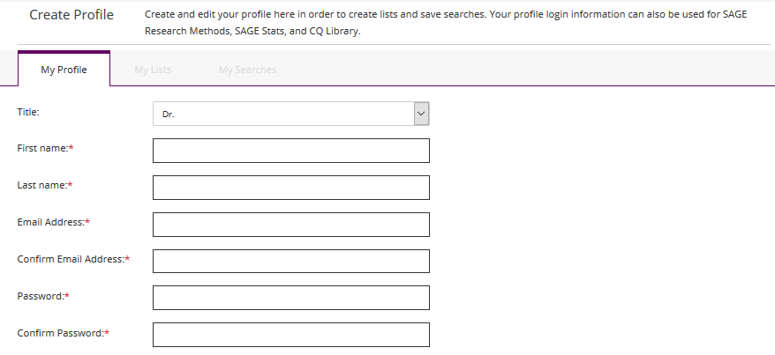
Creating a Profile
Click the My Profile button, then select Create my profile towards the bottom of the pop-up window that appears.
Once you’ve created your free profile, you can sign in here at any time.

Slide 25
Saving searches
When you’re logged into your Profile and you are viewing your search results, click the Save Search button to save your search criteria, so that you can quickly re-run the same search again later.

Slide 26
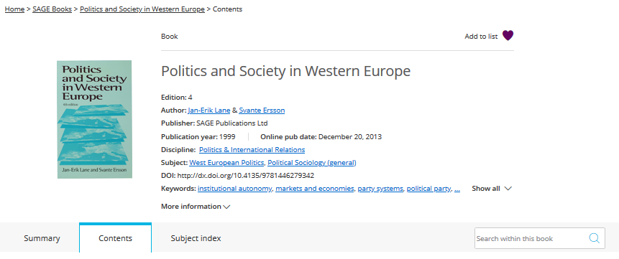
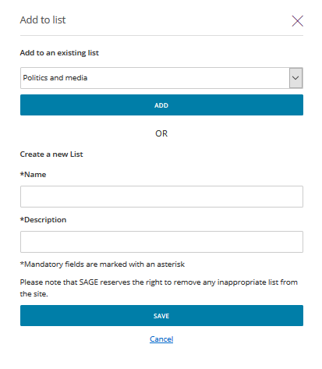
Managing lists
When logged in to your Profile, you can add resources to My Lists in order to save items of interest for later.
On any resource page, click the Add to list button.
When the pop-up window appears, choose an existing list to add your resource to, or create a new list.

Slide 27
Managing lists
When logged in to your Profile, you can add resources to My Lists in order to save items of interest for later.
You can also add an item to a list from your search results page.

Slide 28
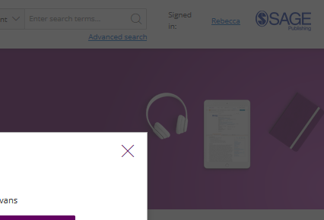
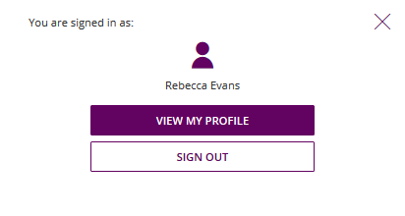
Managing your Profile
When you are signed in, you can access your lists and saved searches by clicking on your name at the top-right of any page.
Select View my profile to edit your profile details, and view and edit your saved searches and lists.

Slide 29
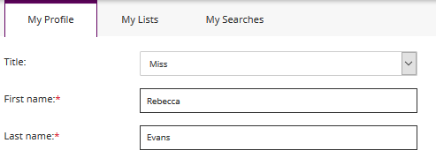
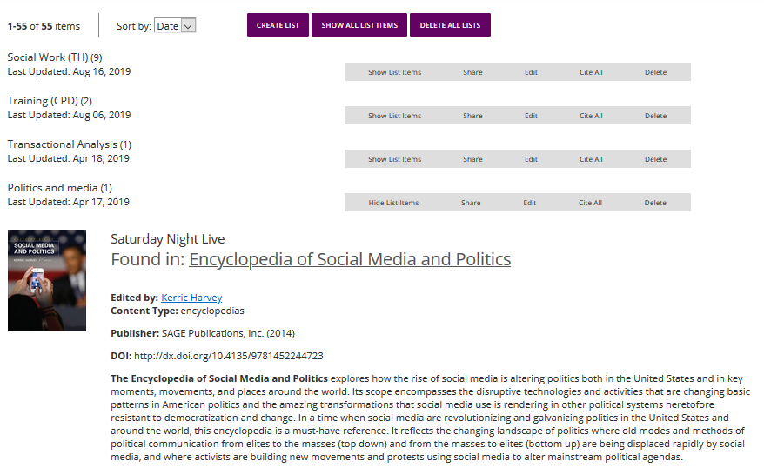
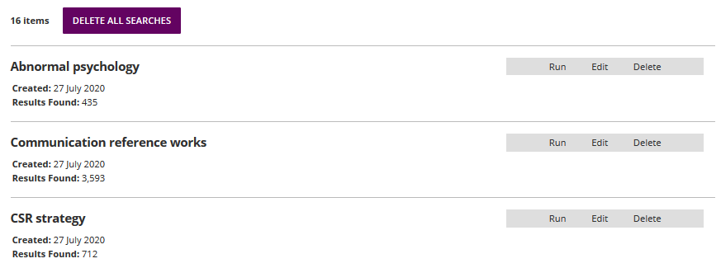
Managing your Profile
Toggle between your profile areas
My Lists
My Searches

Slide 30
Do you have any questions?

Slide 31
Thank you for listening!

