Slide 1

I’d like to teach others about this product…
Notes:
Recommend access via your university to ensure you have access to all of the content associated with your institution.

Slide 2

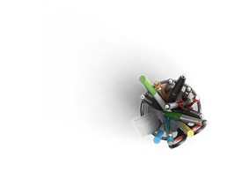
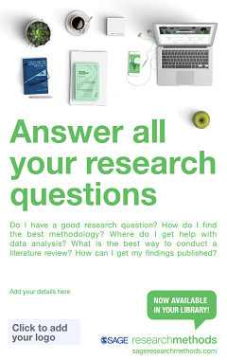

{workshop title}
{your name}
{date}
Notes:
Welcome
Introduction
Housekeeping:
Chat panel
Recording (objections)

Slide 3

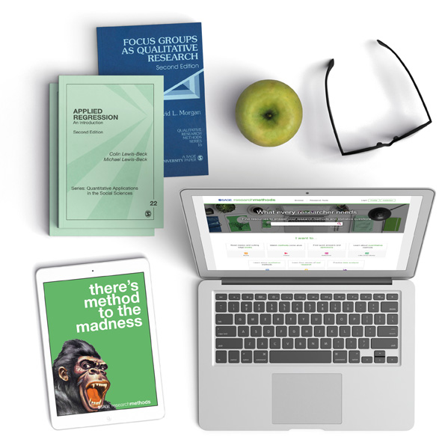
session outline
Introduction to SAGE Research Methods
Live platform demonstration
Final questions and session round-up

Slide 4
session objectives
By the end of this session, participants will be able to:
Describe how SAGE Research Methods can help them in their study or research
Locate relevant resources using browse and search options
Save a resource to a list within the platform

Slide 5
discussion questions
What is your level of experience in using the SAGE Research Methods platform?
What would you most like to gain from attending today?
What is your biggest research methods
challenge, in terms of your own teaching
or learning?

Slide 6

introduction to
What is it? What’s in it? Who is it for?

Slide 7
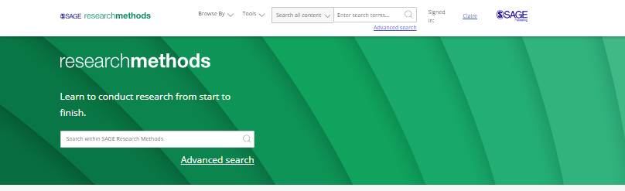
what is it?
A database containing thousands of resources, dedicated to the subject area of Research Methods.
It supports research at all levels, providing materials to guide users through every stage of the research process.
You can access
the platform at: http://methods.
sagepub.com/
Notes:
First of all, let’s introduce you to the platform, get you thinking about what it is and what it’s designed to do:
SAGE Research Methods is a database of engaging and interactive resources and materials solely dedicated to research, research methodology and research skills. The aim is to help users do the best research possible.
The beauty of this database is, it’s essentially a guide to the whole research process. The platform contains thousands of resources, high-quality content available in many different formats to upskill and support you in your research projects step by step: from early planning stages, helping you make those early decisions, deciding how to approach your research, data collection and analysis, through to presentation or publication of that data. The methods you’re using, the different types of data you might be handling. In other words, everything a researcher needs to embark on and complete a successful research project. No matter your level, experience or subject area, you’ll find resources to help you, to support your project and improve your research skills and understanding. It’s a research one-stop shop, for you to do the best research possible whatever your specialism.

Slide 8

what’s in it?
The content you can access through SAGE Research Methods will depend on the subscription at your library
It’s possible your library does not subscribe to all of our content
If you do not have access to particular content, you will see the following icon next to the resource:
If you aren’t sure which content your institution subscribes to, please check with your library staff

Slide 9
what’s in it?
Content is written by researchers, who are largely research methods faculty from a broad range of disciplines.
Content is checked for quality by experts in that field.
Content is commissioned by:
  Utilising pre-existing relationships with authors who have written key research methods text books or journal articles.
  Calls for papers.
  Contacting individuals doing interesting research.
  Meeting researchers at conferences.

Slide 10




who is it for?
Students learning about and doing research for the first time
Faculty teaching Research Methods and supervising projects
Consolidate topics covered in lectures and seminars
Explore options beyond core modules
Practise key skills and see concepts applied in real-life
Engage students with high-quality, reliable resources
Access ready-made items designed with pedagogy in mind (videos, cases, datasets)
Share resources free at the point of access, with no access restrictions
Experienced researchers conducting their own projects
Librarians providing research support or information workshops
Justify methodology with high-quality reference works
Develop their skillset in their own way
Explore new methods not used before
Better understand publishing and dissemination practices
One central resource for a huge range of research resources
Use effective resources in training and outreach
Engage faculty with resources that demystify the research process

Slide 11
getting started on
Homepage, collection tiles and searching

Slide 12

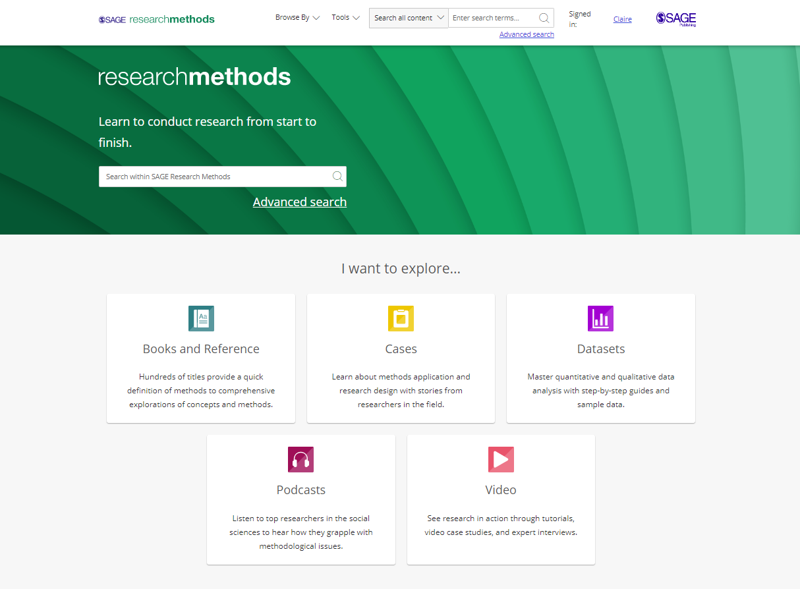
homepage
methods.sagepub.com
SAGE Research Methods content will also be available through your library catalogue, and search engines like Google.
Please note: if your institution does not subscribe to a particular collection, it is possible that some of these content options will appear in grey on your screen.

Slide 13
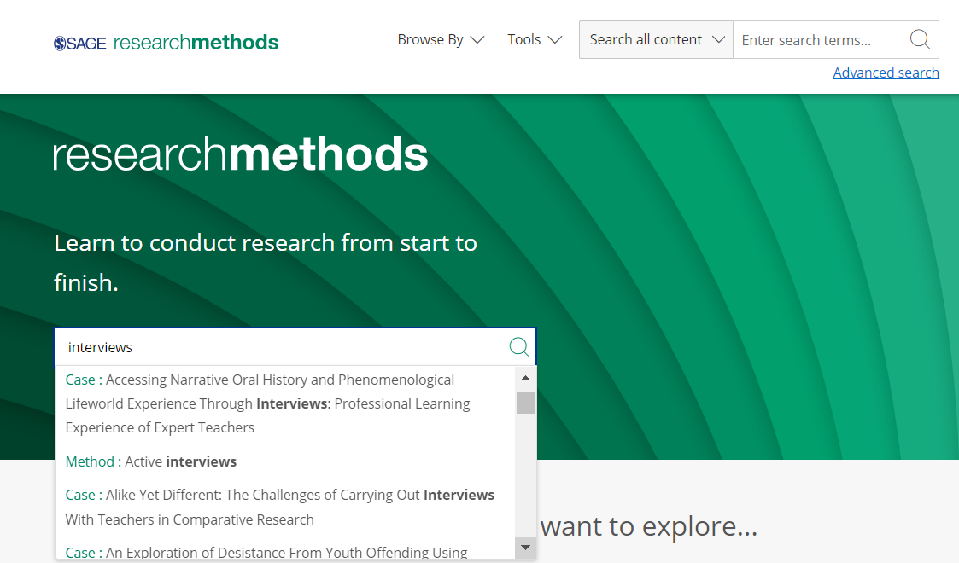
homepage search bar
Use the search bar to find content related to:
the stage you’re at
methods you are using
data you are analysing
keywords and themes
Think about challenges you are facing or research skills you want to develop.
Increase or decrease the complexity of your search by using Boolean operators:
AND, OR and NOT

Slide 14
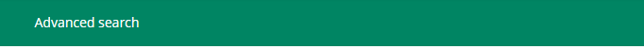
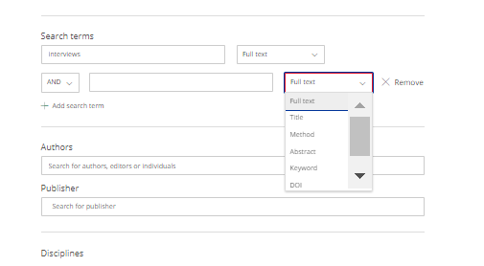
advanced search
Access the Advanced Search from the top toolbar at any time
Enter your search criteria
Search across full text, titles, methods or keywords
Use Boolean operators to enhance your search
Search for a specific author, publisher or discipline
Explore more search options further down the page

Slide 15
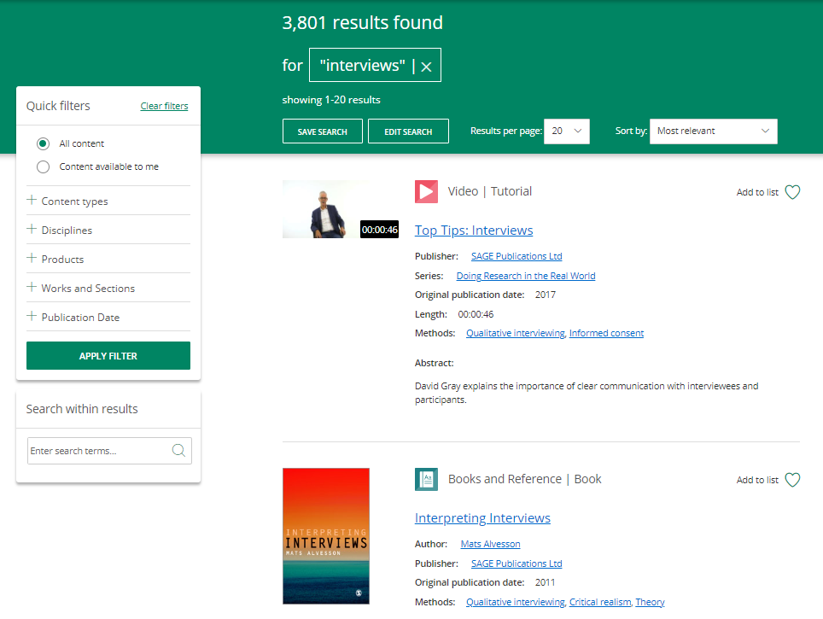
search results
Select Content available to me to only see content available via your library’s subscription
A padlock symbol next to content indicates this resource is not available through your library’s subscription
Use the Quick filters to refine your search by:
Content type
Discipline
Publication date
In your search results, click quick links to methods and keywords to find related content
Click the content title to view the resource
Click Apply Filter to action your changes

Slide 16
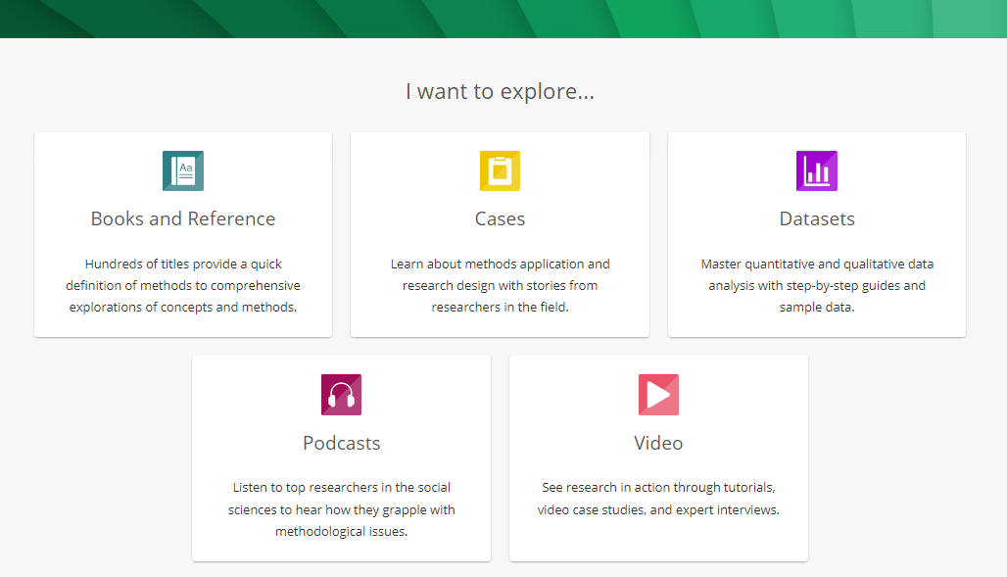
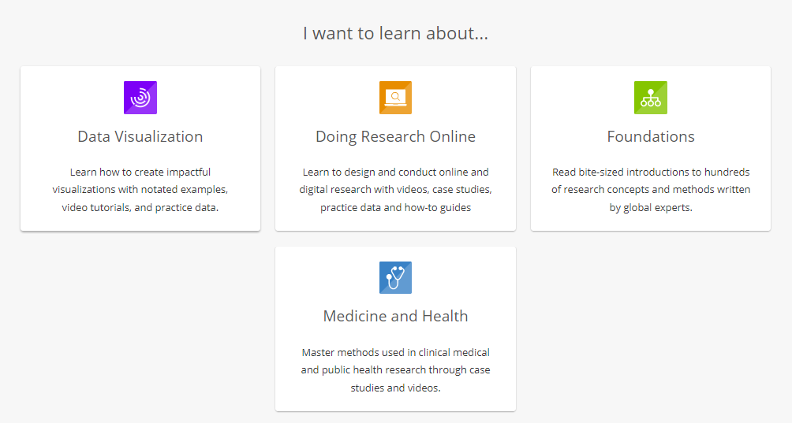
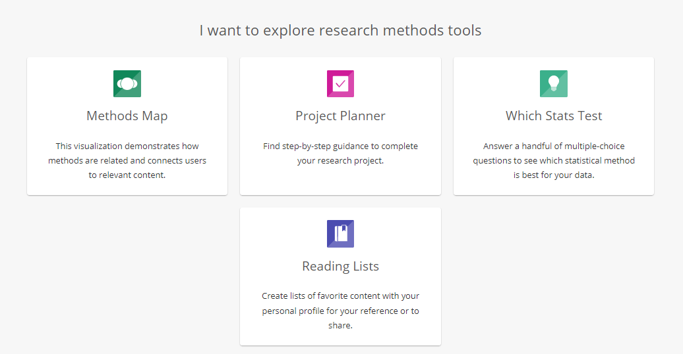
collection tiles
Scroll down the homepage to view the various collection tiles.
Click on tiles to find content in different formats, to support with specific skills or topics, or to explore the platform’s research tools.

Slide 17
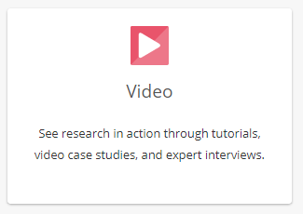
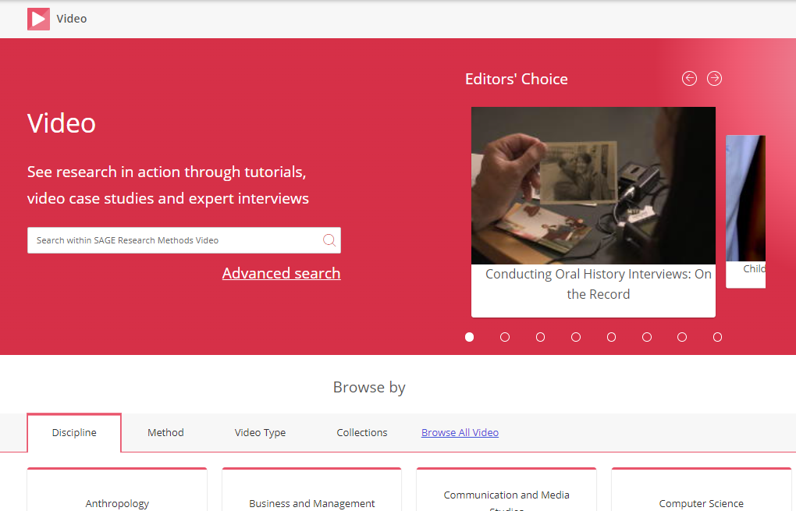
collection landing page
Click a tile on the homepage to be taken to the collection landing page
Check out the Editor’s Choice selection to view recommended content
Enter keywords in the search bar to search across the collection
Use Advanced search options to enhance your search across the collection
Explore the Browse by tabs to find relevant content

Slide 18
platform profile
Creating a profile; saving searches; reading lists

Slide 19
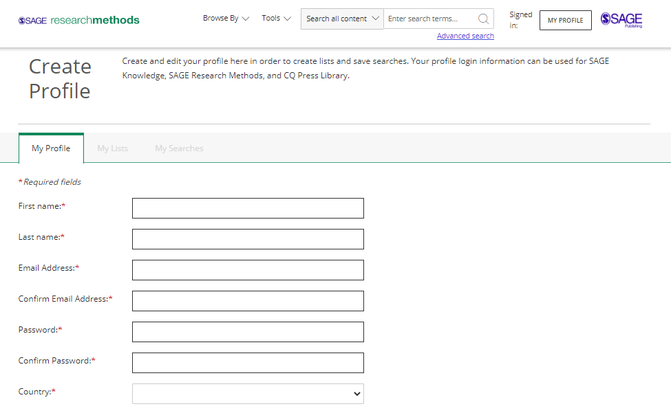
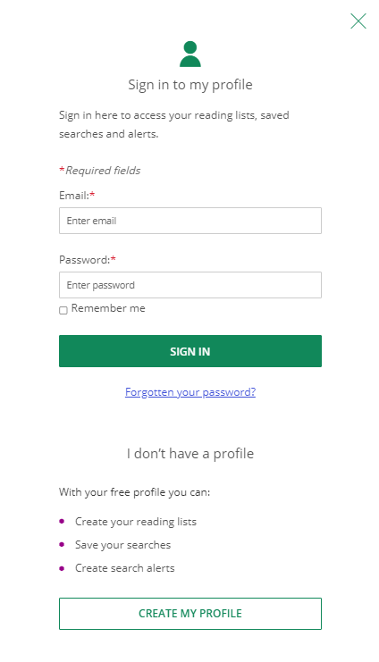
creating a profile
Click My Profile
then Create my profile.
Complete the registration form to set up your free profile. Creating a profile allows you to save searches and add resources to reading lists.
Once you’ve created your profile, you can log in via the My Profile button at any time.

Slide 20
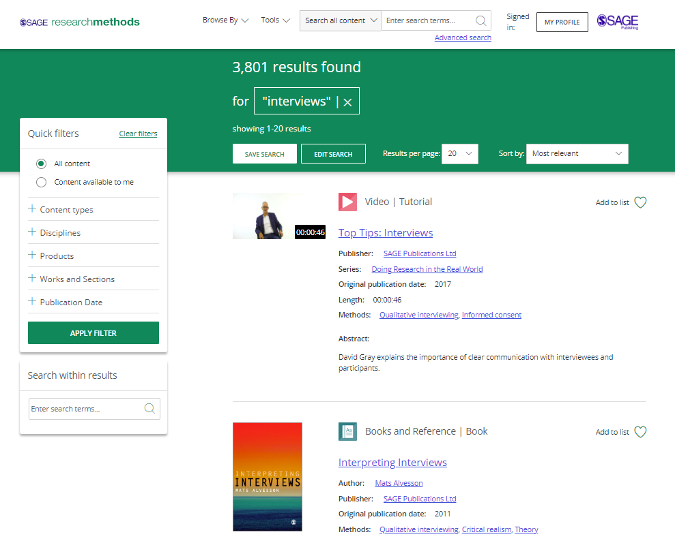
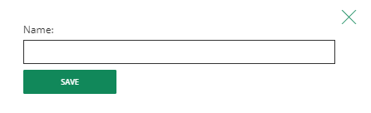
saving searches
When you’re logged into your profile, from your search results page you can click Save search to save your filtered search results.
This allows you to quickly re-run the same search again later.
Once you’ve clicked Save search, give your search a name and click Save.

Slide 21
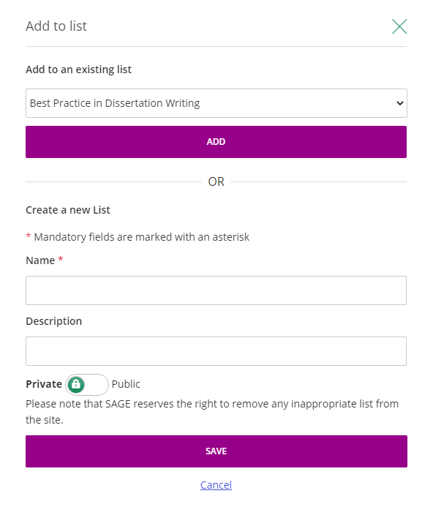

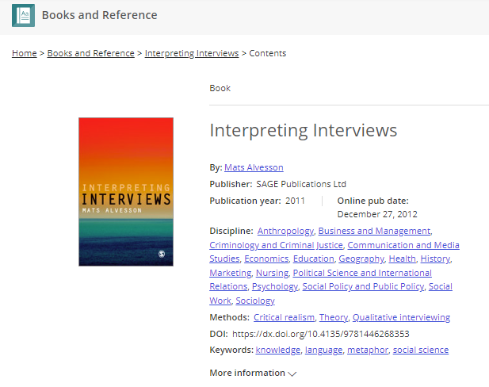


When you’re logged into your profile, you can add resources to reading lists in order to save items of interest for later.
reading lists
Add items to a list by clicking the s symbol, directly from
the search results page…
…or from any content page.
Create a new custom list or add resources to your existing lists.

Slide 22
using reading lists
Librarians
Faculty
Researchers
Support patrons with reading lists linked to their projects, to support research challenges, or to enhance research skills.
Collate materials linked to a particular field or discipline. Embed or link the reading lists in the relevant subject library catalogues for quick, easy access.
Use reading lists as support materials for skills workshops. Share with attendees or embed in course registration pages.
Create lists on various topics or methods to:
share as pre-class reading
supplement course textbooks
engage students and encourage them to explore research methods related to their course or project
Share lists directly with student groups.
Link or embed reading lists in Virtual Learning Environments, your LMS or course pages for quick, easy access.
A quick and easy way to find your materials.
Create multiple reading lists linked to different research methods, different types of data you need to analyse or to support you in the various stages of your research project.
Collaborate with co-researchers by sharing lists related to your topic to ensure consistency across the project.

Slide 23

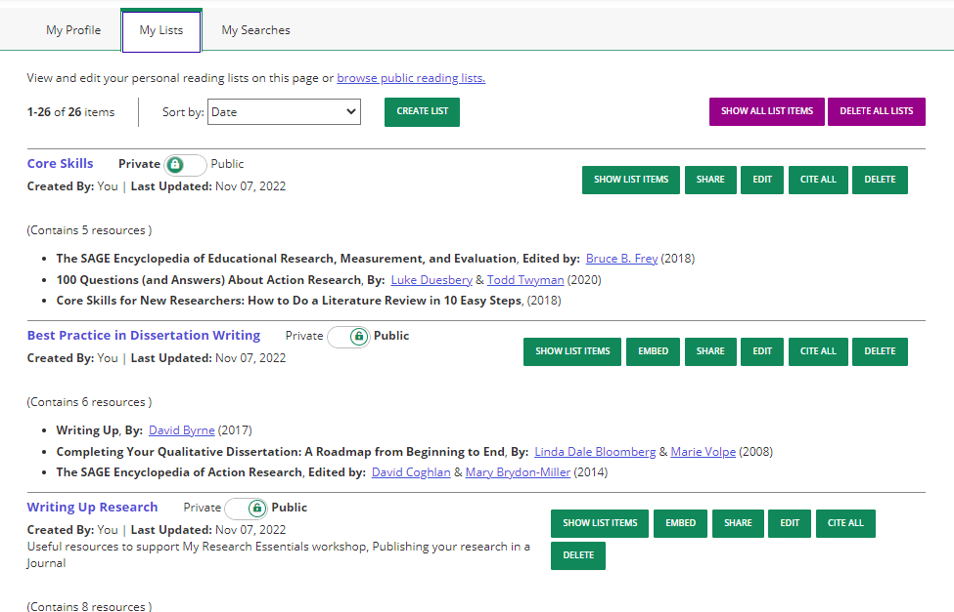
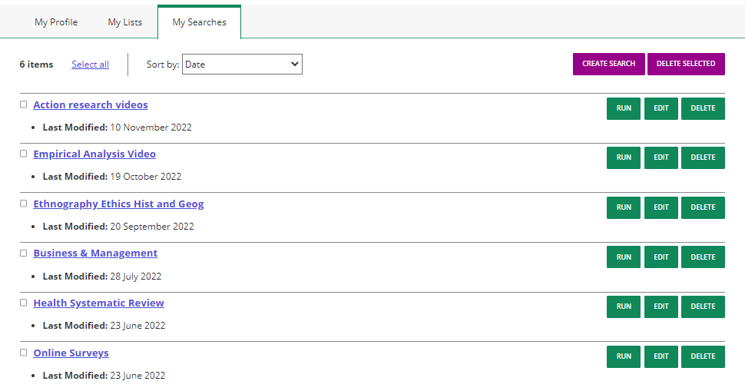
manage your profile
You can access your saved searches and reading lists by clicking on your profile link int the top toolbar, then select View my profile.
My Lists
Your name
My Searches

Slide 24
content types

Slide 25








content types
Books &
Reference
Video
Cases
Datasets
Foundations
Doing Research
Online
Medicine &
Health
Data
Visualization
Notes:
SAGE Research Methods is one platform - made up of lots of different components or “modules”.
It’s designed so that universities can subscribe to the modules according to the needs of the users at their institution. They might ask “what do I need?”, “what am I asked about when it comes to research?”, “what challenges do my researchers tend to come to me with?” and this will help them decide which of these modules they would like to go with as part of their library offering. Important to make you aware of other modules in case you see any of these as we go onto the platform..

Slide 26

function buttons
Use the interactive function buttons in each resource to enhance your research.
Download PDF
Download resources to use off the platform.
Get link
Download resources to use off the platform.
Cite
Create a quick reference.
Choose from a range of formats and reference managers.
Share
Share resources via email or on social media.
Text size
Adjust text settings.
Embed
Add content to your learning management system or webpage by copying the HTML code.
Notes:
Access at Durham University
To start, the kind of “fundamental” packages, useful to all researchers at an institution are the Core and Foundations modules, offer fantastic introductory high-quality content.
CORE is what you might call your main package (our first component – the original):
(CLICK) This includes over 1000 books and reference works (encyclopaedias and dictionaries), all available in full print text online
Includes books, handbooks, Little Green and Little Blue books (in-depth guides which focus on specific qualitative and quantitative methods)
Also reference works - dictionaries: quick definitions of research methods concepts and encyclopaedias: longer definitions with more context. Also journal articles, addressing specific research methods, might be interviews or clinical trials.
(CLICK) Videos – you have access to Core module videos, our videos include tutorials, interviews, documentaries - all of these focused on research methods.
(CLICK) You also have our Foundations module – these are bite-sized introductions to hundreds of research concepts, methods, designed to guide less experienced researchers to the content they need, by providing an introduction to the concept and showing the concept within the larger context of the research methods field, best for those newer to research or wanting to find out more about a new method, broken down into accessible bite-sized entries, a full range of qualitative, quantitative, and mixed methods. Overviews of the methods themselves, covering their history, development and critical debates surrounding them, themes, geographical/social/cultural developments in research, and also the pioneers of the method, the experts in their field.

Slide 27

Books
Books: full digital versions of print text
Handbooks: comprehensive coverage of specific subjects
Little Blue Books: in-depth guide on specific qualitative research methods
Little Green Books: in-depth guide on specific quantitative research methods
Major Works: volumes of curated book and journal content that address particular methods of research
Reference
Dictionary: quick definitions of research methods concepts.
Encyclopaedia: longer definitions with more context
Books
Reference works
Journal articles
Notes:
Access at Durham University
To start, the kind of “fundamental” packages, useful to all researchers at an institution are the Core and Foundations modules, offer fantastic introductory high-quality content.
CORE is what you might call your main package (our first component – the original):
(CLICK) This includes over 1000 books and reference works (encyclopaedias and dictionaries), all available in full print text online
Includes books, handbooks, Little Green and Little Blue books (in-depth guides which focus on specific qualitative and quantitative methods)
Also reference works - dictionaries: quick definitions of research methods concepts and encyclopaedias: longer definitions with more context. Also journal articles, addressing specific research methods, might be interviews or clinical trials.
(CLICK) Videos – you have access to Core module videos, our videos include tutorials, interviews, documentaries - all of these focused on research methods.
(CLICK) You also have our Foundations module – these are bite-sized introductions to hundreds of research concepts, methods, designed to guide less experienced researchers to the content they need, by providing an introduction to the concept and showing the concept within the larger context of the research methods field, best for those newer to research or wanting to find out more about a new method, broken down into accessible bite-sized entries, a full range of qualitative, quantitative, and mixed methods. Overviews of the methods themselves, covering their history, development and critical debates surrounding them, themes, geographical/social/cultural developments in research, and also the pioneers of the method, the experts in their field.

Slide 28
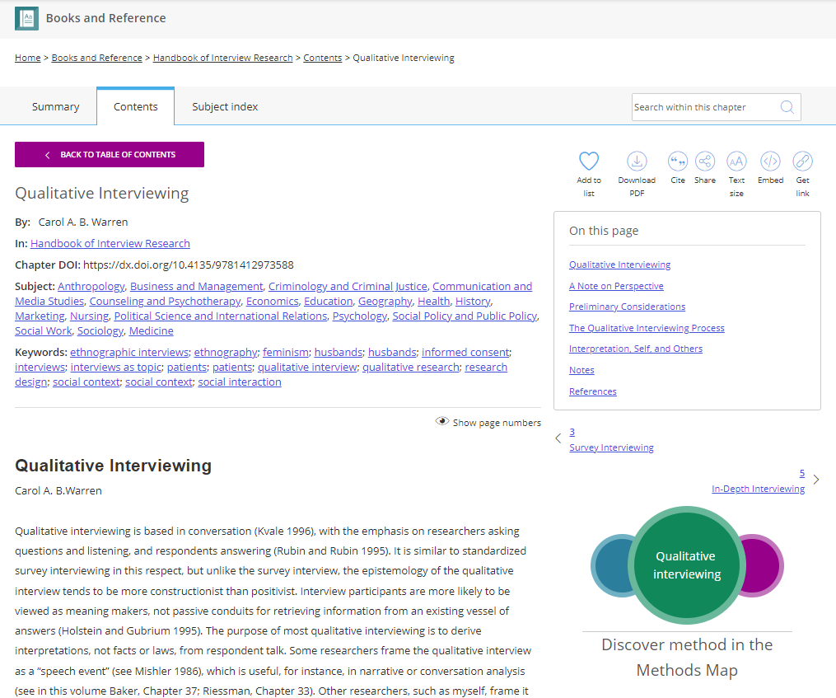
books and reference resource page
Search for a keyword within this resource.
Select a chapter from the book’s title page to be taken to the contents.
Use quick links to jump to relevant sections of the resource.
In the chapter, click linked keywords to explore content related to your topic.
Quickly move between chapters.
Full text of the resource continues down the page.
Resources link to the Methods Map tool.

Slide 29

Video
SAGE Research Methods Video is a streaming video collection created to support teaching and learning by bringing methods to life.
Content covers the entire research methods and statistics curriculum in a variety of formats to guide students through every step of their research project.
The videos can be:
set as pre-class viewing to stimulate in-class discussion
shown in class to provide an alternative viewpoint
embedded into course management pages or websites to increase accessibility and engagement.
Video
Notes:
Access at Durham University
To start, the kind of “fundamental” packages, useful to all researchers at an institution are the Core and Foundations modules, offer fantastic introductory high-quality content.
CORE is what you might call your main package (our first component – the original):
(CLICK) This includes over 1000 books and reference works (encyclopaedias and dictionaries), all available in full print text online
Includes books, handbooks, Little Green and Little Blue books (in-depth guides which focus on specific qualitative and quantitative methods)
Also reference works - dictionaries: quick definitions of research methods concepts and encyclopaedias: longer definitions with more context. Also journal articles, addressing specific research methods, might be interviews or clinical trials.
(CLICK) Videos – you have access to Core module videos, our videos include tutorials, interviews, documentaries - all of these focused on research methods.
(CLICK) You also have our Foundations module – these are bite-sized introductions to hundreds of research concepts, methods, designed to guide less experienced researchers to the content they need, by providing an introduction to the concept and showing the concept within the larger context of the research methods field, best for those newer to research or wanting to find out more about a new method, broken down into accessible bite-sized entries, a full range of qualitative, quantitative, and mixed methods. Overviews of the methods themselves, covering their history, development and critical debates surrounding them, themes, geographical/social/cultural developments in research, and also the pioneers of the method, the experts in their field.

Slide 30
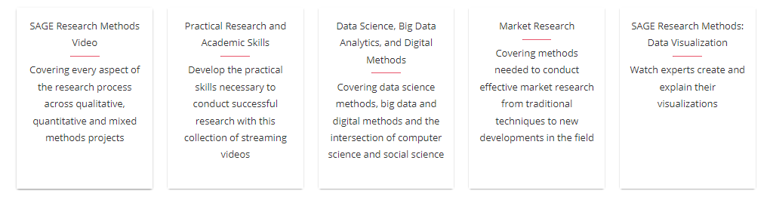

video collections
Each Video collection zones in on specific topic or area of interest.
Tutorials, case study videos, expert interviews and more covering the entire research methods and statistics curriculum.
Covers the practical skills that researchers need to successfully complete their research, including planning, writing, presentation skills and building networks.
Methods, issues and challenges surrounding big data research, covering a huge range of statistical techniques and methodological issues.
A series of videos focused on methods commonly used to conduct market and marketing research, including planning, designing and presenting research.
A series covering the principles of data visualization and expert advice on creating specific visualizations. Part of a mixed media collection.
Videos covering research across all medical specialties, including clinical study design, biostatistics, systematic review and research ethics.
Part of a multimedia collection designed to support novice or experienced social science researchers who are conducting research online.
Helps students and researchers navigate key topics including: informed consent, confidentiality, anonymity, ethical codes, and ethical approval.

Slide 31
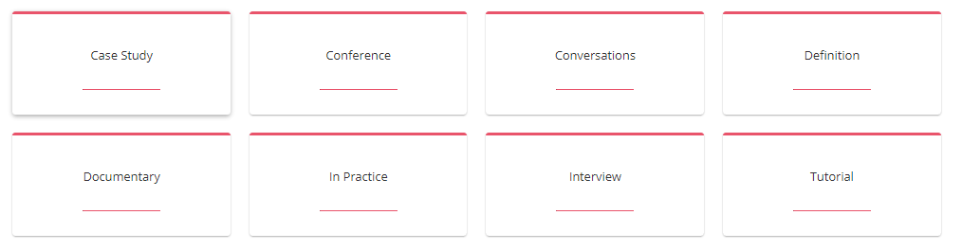
video types
Video are presented in a range of formats.
Explain how a researcher did their research, the methods they chose and why.
Academics discuss a concept or topic, offering interesting insights and perspectives.
Licensed films from various content partners.
Key academics in the field offer their experiences and observations on research methods.
Conference presentations from key experts.
Explanations of research methods and approaches.
Methods applied to real world situations, to make connections between theory and practice.
Key Overview of a key course topic; how to understand it, how to do it, what the key points are.

Slide 32
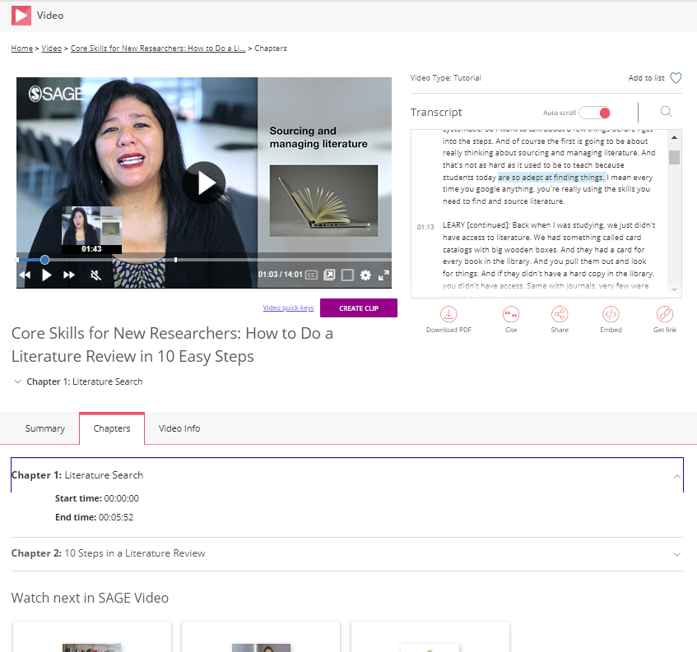
video player
Use the functions at the bottom of the video display to adjust the volume, increase and decrease the video quality and playback speed, add subtitles, open in a new tab, or view full-screen.
Search within the video transcript for your key words.
Use the auto-scrolling transcript to follow along with the video as it plays.
Create a clip with a unique URL.
Download the video transcript as a PDF.
Chapters: move to a different chapter of the video
Video info: detailed metadata linking to related content.

Slide 33

Cases
SAGE Research Methods Cases are detailed records of how real research projects are conducted, written by the researchers themselves.
They explain why the researchers chose the research methods, how they overcame challenges, what went well, and what they might have done differently.
Peer-reviewed and classroom-ready, there are more than 3000 cases available across the platform.
Collections:
Cases Part 1
Cases Part 2
Cases: Medicine & Health
Cases: Doing Research Online
Notes:
Access at Durham University
To start, the kind of “fundamental” packages, useful to all researchers at an institution are the Core and Foundations modules, offer fantastic introductory high-quality content.
CORE is what you might call your main package (our first component – the original):
(CLICK) This includes over 1000 books and reference works (encyclopaedias and dictionaries), all available in full print text online
Includes books, handbooks, Little Green and Little Blue books (in-depth guides which focus on specific qualitative and quantitative methods)
Also reference works - dictionaries: quick definitions of research methods concepts and encyclopaedias: longer definitions with more context. Also journal articles, addressing specific research methods, might be interviews or clinical trials.
(CLICK) Videos – you have access to Core module videos, our videos include tutorials, interviews, documentaries - all of these focused on research methods.
(CLICK) You also have our Foundations module – these are bite-sized introductions to hundreds of research concepts, methods, designed to guide less experienced researchers to the content they need, by providing an introduction to the concept and showing the concept within the larger context of the research methods field, best for those newer to research or wanting to find out more about a new method, broken down into accessible bite-sized entries, a full range of qualitative, quantitative, and mixed methods. Overviews of the methods themselves, covering their history, development and critical debates surrounding them, themes, geographical/social/cultural developments in research, and also the pioneers of the method, the experts in their field.

Slide 34
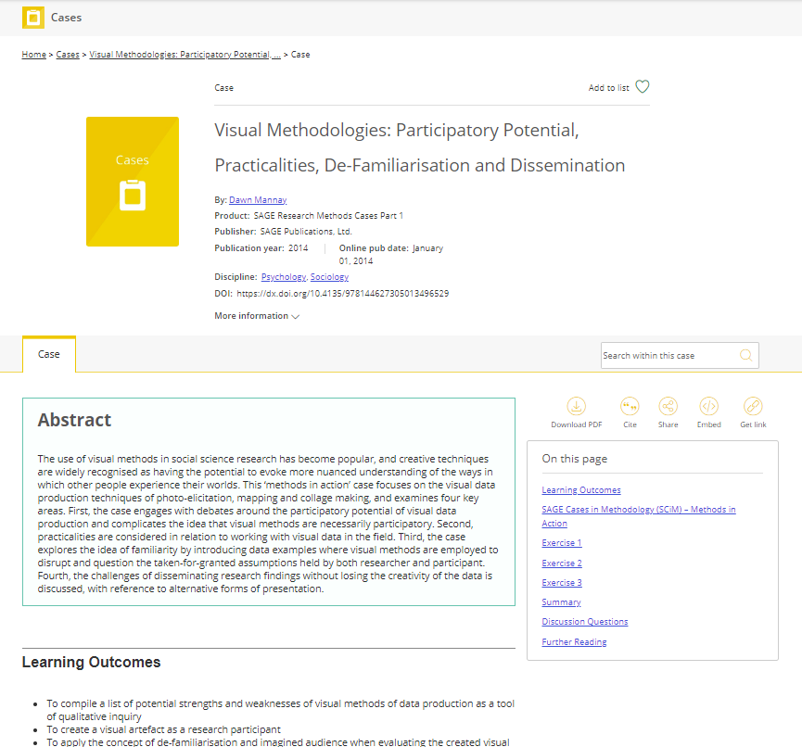
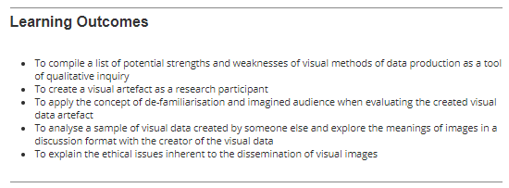
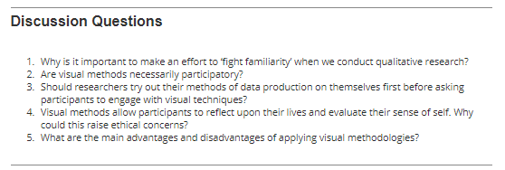
cases resource page
All Cases come with learning outcomes, exercises and discussion questions, which make them great for self-study and as a ready-to-go teaching resource.
Search for a keyword within this resource.
Use quick links to jump to relevant sections of the resource
Full text of the case continues down the page.

Slide 35

Datasets
SAGE Research Methods Datasets is a collection of topical, engaging practice datasets, indexed by method and data type, presented with instructional guides that can be used to support the teaching and independent learning of quantitative and qualitative data analysis techniques.
Use Datasets for:
To support classroom teaching and lab assignments
for independent learning or practice of analytical methods
refresher training of data analysis techniques.
Datasets
Notes:
Access at Durham University
To start, the kind of “fundamental” packages, useful to all researchers at an institution are the Core and Foundations modules, offer fantastic introductory high-quality content.
CORE is what you might call your main package (our first component – the original):
(CLICK) This includes over 1000 books and reference works (encyclopaedias and dictionaries), all available in full print text online
Includes books, handbooks, Little Green and Little Blue books (in-depth guides which focus on specific qualitative and quantitative methods)
Also reference works - dictionaries: quick definitions of research methods concepts and encyclopaedias: longer definitions with more context. Also journal articles, addressing specific research methods, might be interviews or clinical trials.
(CLICK) Videos – you have access to Core module videos, our videos include tutorials, interviews, documentaries - all of these focused on research methods.
(CLICK) You also have our Foundations module – these are bite-sized introductions to hundreds of research concepts, methods, designed to guide less experienced researchers to the content they need, by providing an introduction to the concept and showing the concept within the larger context of the research methods field, best for those newer to research or wanting to find out more about a new method, broken down into accessible bite-sized entries, a full range of qualitative, quantitative, and mixed methods. Overviews of the methods themselves, covering their history, development and critical debates surrounding them, themes, geographical/social/cultural developments in research, and also the pioneers of the method, the experts in their field.

Slide 36
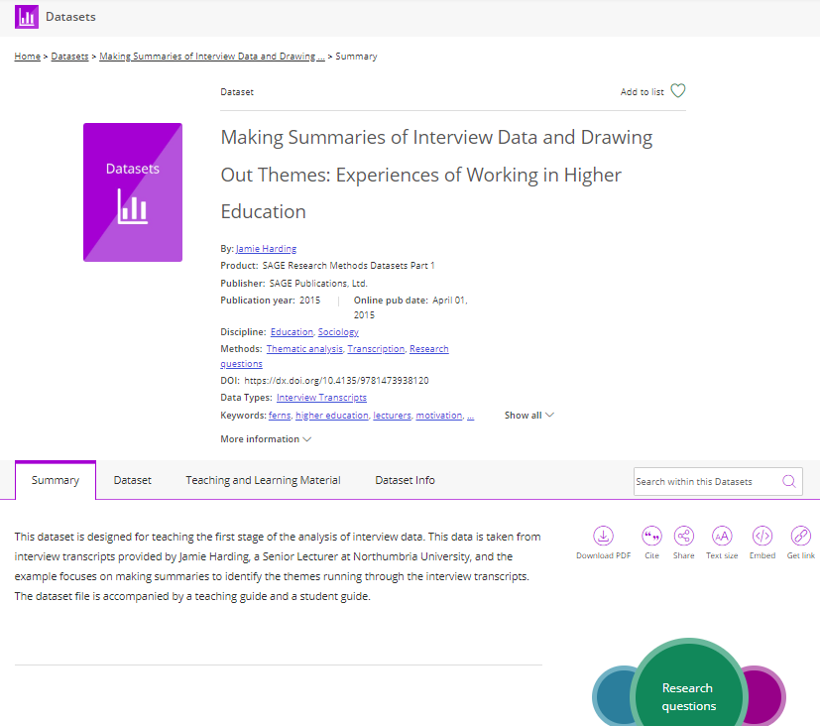
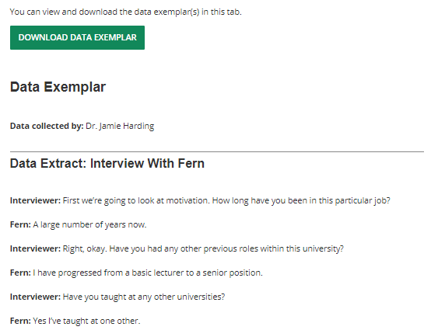
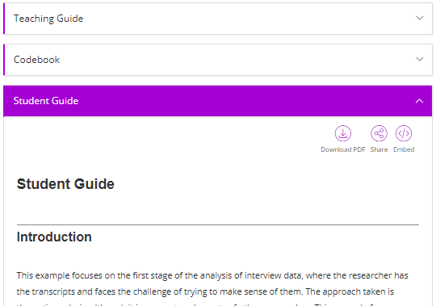
datasets resource page
Click on the Teaching and Learning Material tab to access the Teaching Guide for tips on how to use the dataset, and the Student Guide for step-by-step instructions on how to approach and analyse the dataset.
Access or download the data sample.

Slide 37

Foundations
A starting point for newer researchers to guide them to the content they need, providing an introduction to the concept and showing the concept within the larger context of the research methods field.
Online reference resource presented in series of entries and short essays on key concepts and scholars.
Special emphasis on traditionally under-represented scholars.
Includes content on cutting-edge methodologies, covering qualitative, quantitative and mixed methods.
Foundations
Notes:
Access at Durham University
To start, the kind of “fundamental” packages, useful to all researchers at an institution are the Core and Foundations modules, offer fantastic introductory high-quality content.
CORE is what you might call your main package (our first component – the original):
(CLICK) This includes over 1000 books and reference works (encyclopaedias and dictionaries), all available in full print text online
Includes books, handbooks, Little Green and Little Blue books (in-depth guides which focus on specific qualitative and quantitative methods)
Also reference works - dictionaries: quick definitions of research methods concepts and encyclopaedias: longer definitions with more context. Also journal articles, addressing specific research methods, might be interviews or clinical trials.
(CLICK) Videos – you have access to Core module videos, our videos include tutorials, interviews, documentaries - all of these focused on research methods.
(CLICK) You also have our Foundations module – these are bite-sized introductions to hundreds of research concepts, methods, designed to guide less experienced researchers to the content they need, by providing an introduction to the concept and showing the concept within the larger context of the research methods field, best for those newer to research or wanting to find out more about a new method, broken down into accessible bite-sized entries, a full range of qualitative, quantitative, and mixed methods. Overviews of the methods themselves, covering their history, development and critical debates surrounding them, themes, geographical/social/cultural developments in research, and also the pioneers of the method, the experts in their field.

Slide 38
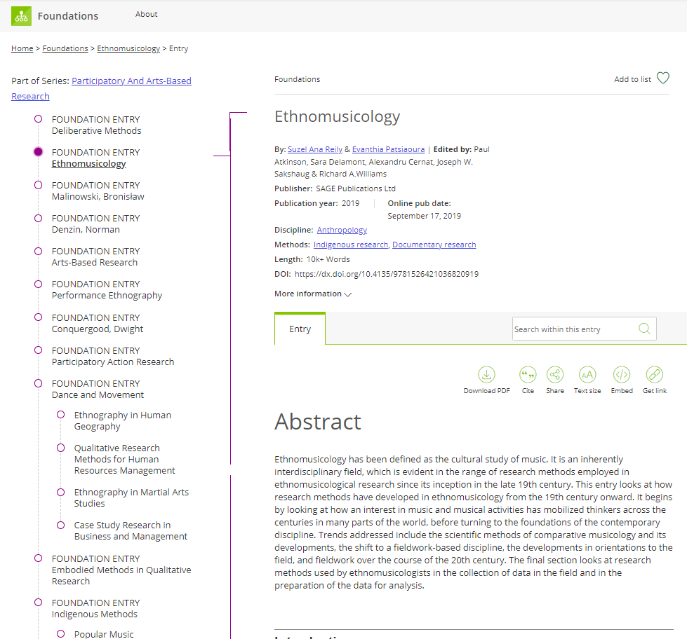
foundations entry
Each Foundation Entry forms part of a Series: a broad research methods topic area.
Each Series is structured in a way which makes it easy for you to get an overview of the topic area, and go straight to the topic, concept or author which interests you the most.
Search for a keyword within this resource.
Full text of the resource continues down the page.

Slide 39

Doing Research Online
A multimedia collection, designed to support novice or experienced social science researchers conducting research online.
Includes:
How to Guides providing practical help with using digital research methods
Videos (including tutorials, expert interviews, video case studies)
Case studies focused on challenges of designing and conducting research online
Teaching sets of data with instructional guides
Doing Research Online
Notes:
Access at Durham University
To start, the kind of “fundamental” packages, useful to all researchers at an institution are the Core and Foundations modules, offer fantastic introductory high-quality content.
CORE is what you might call your main package (our first component – the original):
(CLICK) This includes over 1000 books and reference works (encyclopaedias and dictionaries), all available in full print text online
Includes books, handbooks, Little Green and Little Blue books (in-depth guides which focus on specific qualitative and quantitative methods)
Also reference works - dictionaries: quick definitions of research methods concepts and encyclopaedias: longer definitions with more context. Also journal articles, addressing specific research methods, might be interviews or clinical trials.
(CLICK) Videos – you have access to Core module videos, our videos include tutorials, interviews, documentaries - all of these focused on research methods.
(CLICK) You also have our Foundations module – these are bite-sized introductions to hundreds of research concepts, methods, designed to guide less experienced researchers to the content they need, by providing an introduction to the concept and showing the concept within the larger context of the research methods field, best for those newer to research or wanting to find out more about a new method, broken down into accessible bite-sized entries, a full range of qualitative, quantitative, and mixed methods. Overviews of the methods themselves, covering their history, development and critical debates surrounding them, themes, geographical/social/cultural developments in research, and also the pioneers of the method, the experts in their field.

Slide 40

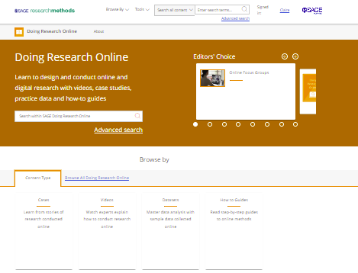

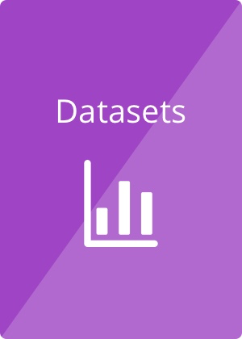


doing research online content
Users will find support to employ a variety of digital methods from online surveys, interviews to digital ethnography, social media, and text analysis, as well as learn how to manage, store and archive digital data. Privacy and other ethical considerations specific to conducting research online are also covered. Researchers can also find support with how to navigate the challenges of being supervised online.
How-to
Guide
Video

Slide 41

Medicine and Health
A set of mixed media modules focused on research methodology resources for clinical medicine and public health.
The SAGE Research Methods Medicine & Health collections cover primary clinical and epidemiological research, both interventional and observational, as well as systematic review and meta-analysis. Examples of studies are drawn from across all major medical specialties, as well as public health, nursing, dentistry, health policy, and services research.
Medicine
and Health
Notes:
Access at Durham University
To start, the kind of “fundamental” packages, useful to all researchers at an institution are the Core and Foundations modules, offer fantastic introductory high-quality content.
CORE is what you might call your main package (our first component – the original):
(CLICK) This includes over 1000 books and reference works (encyclopaedias and dictionaries), all available in full print text online
Includes books, handbooks, Little Green and Little Blue books (in-depth guides which focus on specific qualitative and quantitative methods)
Also reference works - dictionaries: quick definitions of research methods concepts and encyclopaedias: longer definitions with more context. Also journal articles, addressing specific research methods, might be interviews or clinical trials.
(CLICK) Videos – you have access to Core module videos, our videos include tutorials, interviews, documentaries - all of these focused on research methods.
(CLICK) You also have our Foundations module – these are bite-sized introductions to hundreds of research concepts, methods, designed to guide less experienced researchers to the content they need, by providing an introduction to the concept and showing the concept within the larger context of the research methods field, best for those newer to research or wanting to find out more about a new method, broken down into accessible bite-sized entries, a full range of qualitative, quantitative, and mixed methods. Overviews of the methods themselves, covering their history, development and critical debates surrounding them, themes, geographical/social/cultural developments in research, and also the pioneers of the method, the experts in their field.

Slide 42
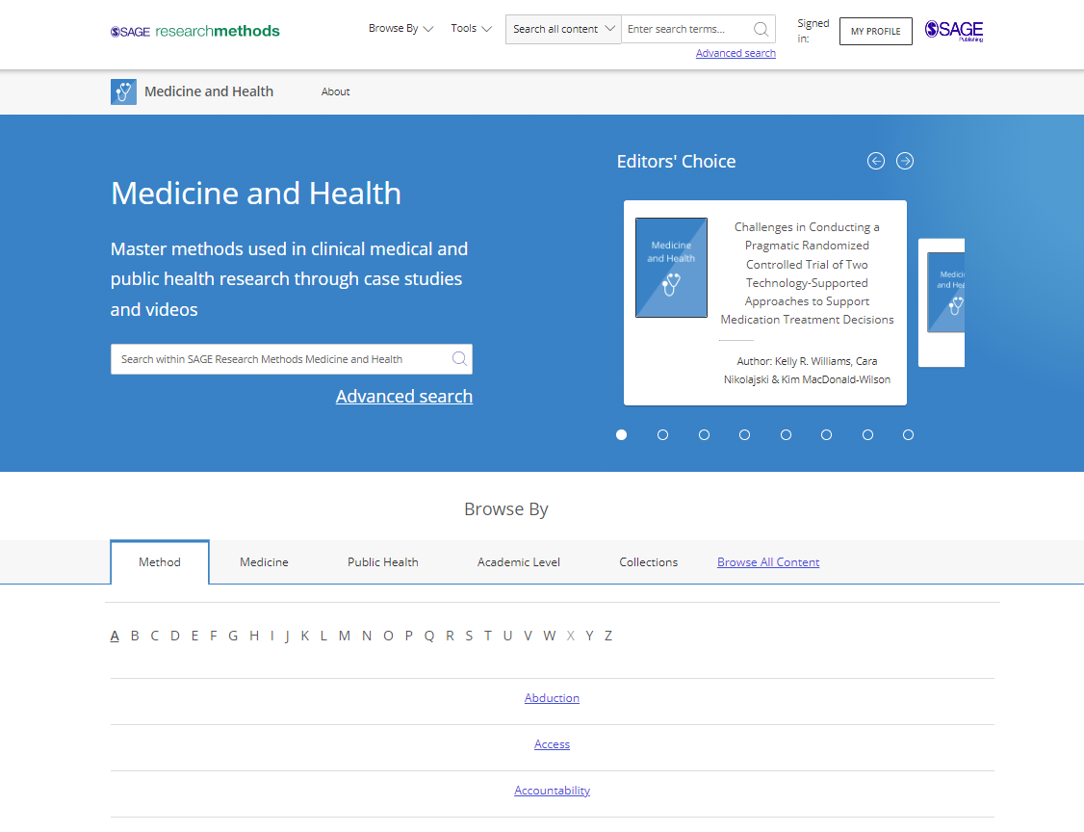

medicine & health content
Case studies, written by researchers in the field, focus on research design, methods selection, and methods application, with an emphasis on the researcher’s experiences and decision-making in designing and conducting a specific study.
Bringing medical and health research to life, videos cover research methods used across medical specialties. They include tutorials, case studies and in-practice films covering clinical study design, conduct and analysis, biostatistics, systematic review and meta-analysis.
Video

Slide 43

Data Visualization
A mixed media collection, combining text, datasets and video content to help understand and create effective data visualizations.
Includes:
A chart gallery introducing chart examples drawn from five categories of visualizations, complete with both presentation tips and alternative versions
Video tutorials with experienced researchers and visualization experts, guiding users though best practices for creating their own visualizations
Datasets, accompanied by step-by-step guides on how to create a particular visualization using a variety of tools, that will let users put their skills into practice
Overviews of visualization tools, from Excel to Python, to help researchers determine the best tool for their needs
Data Visualization
Notes:
Access at Durham University
To start, the kind of “fundamental” packages, useful to all researchers at an institution are the Core and Foundations modules, offer fantastic introductory high-quality content.
CORE is what you might call your main package (our first component – the original):
(CLICK) This includes over 1000 books and reference works (encyclopaedias and dictionaries), all available in full print text online
Includes books, handbooks, Little Green and Little Blue books (in-depth guides which focus on specific qualitative and quantitative methods)
Also reference works - dictionaries: quick definitions of research methods concepts and encyclopaedias: longer definitions with more context. Also journal articles, addressing specific research methods, might be interviews or clinical trials.
(CLICK) Videos – you have access to Core module videos, our videos include tutorials, interviews, documentaries - all of these focused on research methods.
(CLICK) You also have our Foundations module – these are bite-sized introductions to hundreds of research concepts, methods, designed to guide less experienced researchers to the content they need, by providing an introduction to the concept and showing the concept within the larger context of the research methods field, best for those newer to research or wanting to find out more about a new method, broken down into accessible bite-sized entries, a full range of qualitative, quantitative, and mixed methods. Overviews of the methods themselves, covering their history, development and critical debates surrounding them, themes, geographical/social/cultural developments in research, and also the pioneers of the method, the experts in their field.

Slide 44
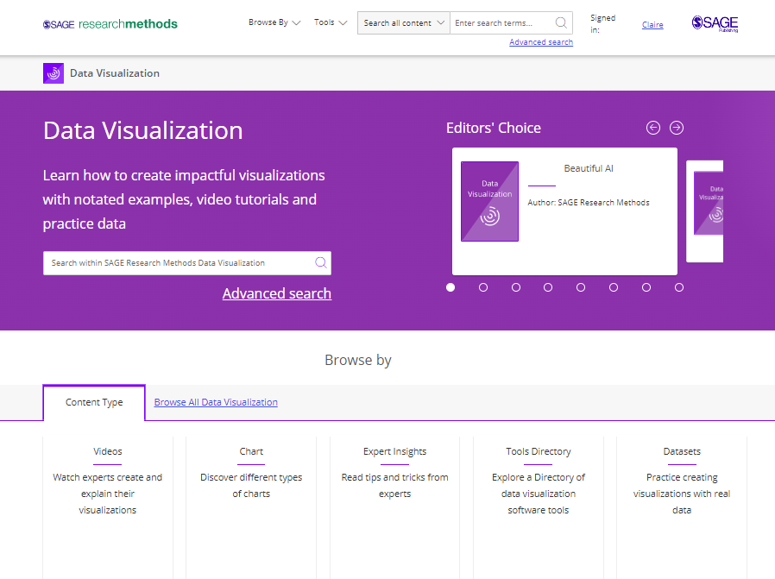
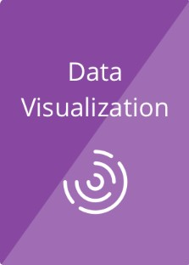



data visualization content
Covers the principles of data visualization, including an overview of chart types, tools, as well as overarching principles such as editorial thinking, and highly detailed how-to guides for creating specific, accurate and impactful visualizations in paper, projects and presentations.
Video
Chart
Gallery
Expert
Insights
Tools Directory

Slide 45
research tools
Methods Map and Project Planner

Slide 46




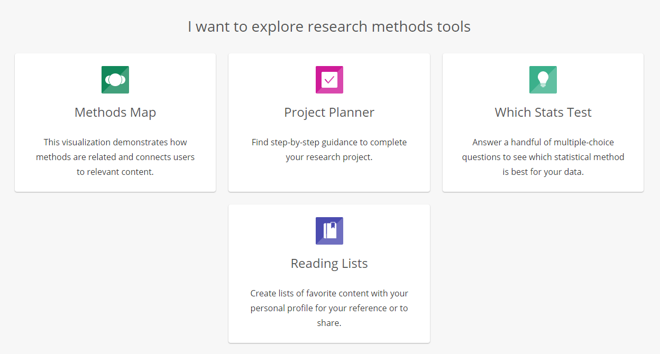
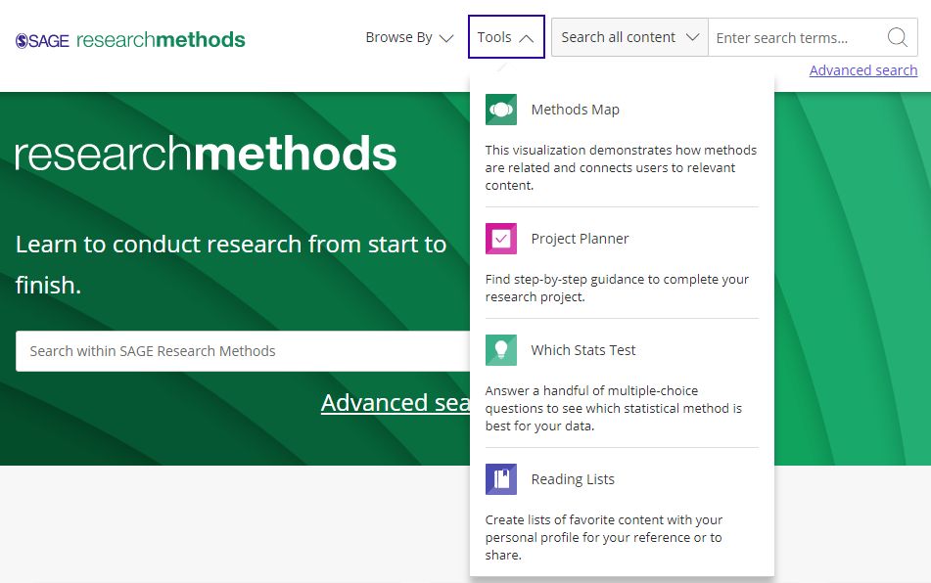
accessing the research tools
Access the Research Tools from anywhere on the platform at the top of the page, in the Tools dropdown menu.
Scroll down the homepage to the I want to explore research methods tools tiles.

Slide 47
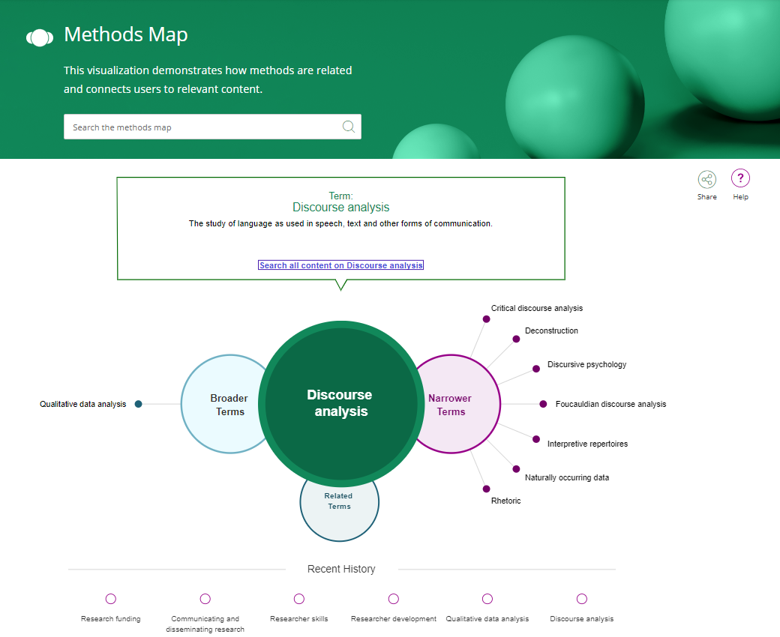
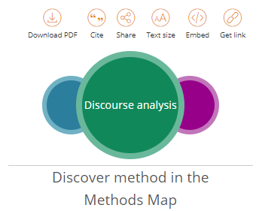
methods map
Methods Map is a visualisation tool to help understand the relationship between different research methods concepts.
A definition of the Methods term
Search the Methods Map to find a research methods concept…
Search all content to find content related to your Methods term
…or click through Broader Terms and Narrower Terms to quickly and easily explore concepts related to your main search term.
The Methods Map tool can also be accessed from the resource pages.
Click on terms in your Recent History to return to previously searched terms.

Slide 48
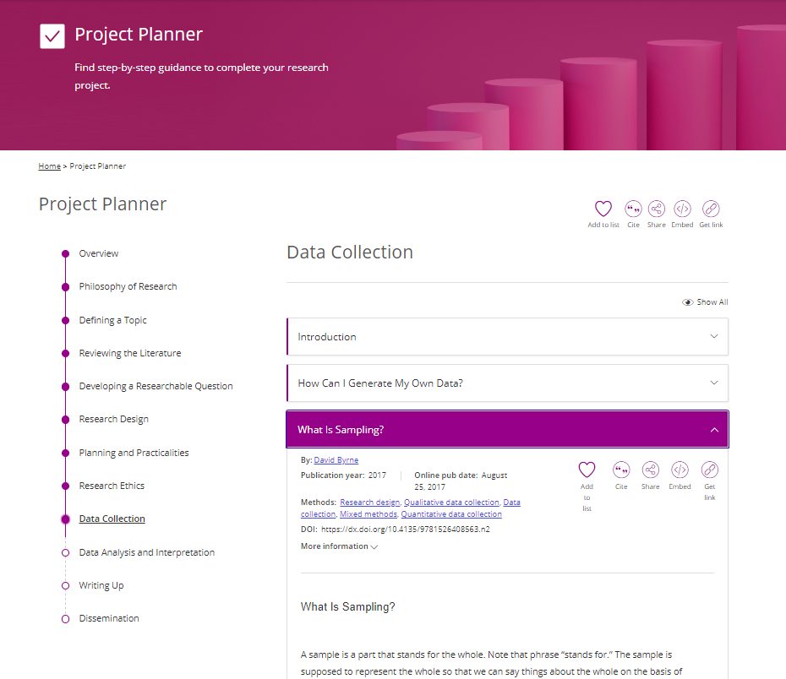
project planner
Project Planner is a framework that walks you through the logical stages of a research project, to help researchers in their planning and organising.
Dip in and out of topics or work through them step-by-step.
Each section is broken down into questions to help you find answers related to the stage of your project and the methods you are using.

Slide 49
Do you have any questions?

Slide 50
Thank you for attending today’s training

