Slide 1
Making Strategy:
Mapping Out Strategic Success
Chapter 12
CLOSURE:
BRINGING IT ALL TOGETHER
Fran Ackermann; Colin Eden

Slide 2
Please note, these slides are designed to be used in addition to the book:
Making Strategy: Mapping Out Strategic Success. by Ackermann & Eden, Sage, 2011
They are not designed to be used in a ‘stand-alone’ manner, or to replicate theory and practice presented in the book.
The assignment design represents one possibility for a 10 credit MBA course.

Slide 3
Strategic Management is about agreeing where to practically focus energy, cash, effort, emotion

Slide 4
Making Strategy in 4x~3hr workshops (2 days)….
Or single half day workshops
Workshop 1 – morning
  Strategy as the Prioritisation and Management of Key Issues
  Statement of Strategic Intent
Workshop 2 – afternoon
  Strategy as Purpose: Agreeing Goals and Aspirations for the Organisation
  Statement of Strategic Intent
Workshop 3 – morning
  Strategy as Competitive advantage
  Statement of Strategic Intent
Workshop 4 – afternoon
  Strategy as Stakeholder Management
  Statement of Strategic Intent
DELIVERABLE OVERALL:
  Statement of strategic intent (SSI) encompassing: issue management, purpose, competitive advantage, stakeholder management

Slide 5
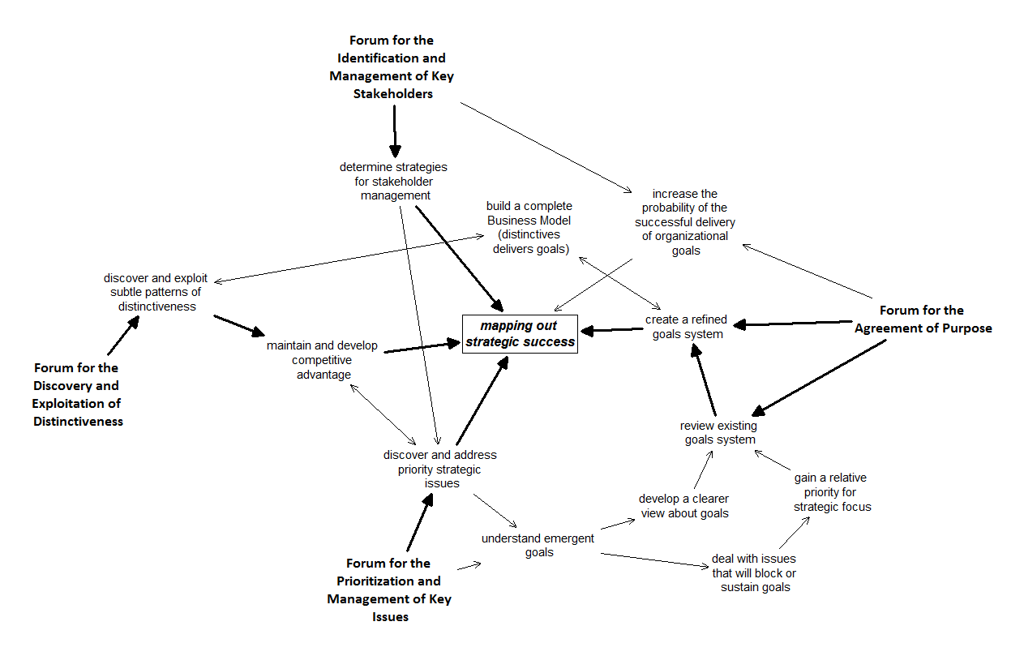
The Logic of the Locking together of the 4 Strategy Forums:
IM, PU, CA, SH

Slide 6
The Steps in the Making Strategy Triangle
Emergent goals system to draft goals system
2
5
Priority implies purpose
The Business Model
4
7
STAKEHOLDERS
Competitive Advantage: through differentiation/ distinctiveness
Issues into priority issues
1
3
Into Strategies
6

Slide 7
The Business Model, or Livelihood Scheme
Expresses how the particular way in which the organisation will deliver shareholder value, or the mandate, through exploitation of distinctive competencies
For the BM:
    Each goal should, ideally, be supported by a distinctive competence, and
    Each distinctive competence should be exploited to support a goal

Slide 8
Profit/Profitability/Shareholder Value or
Mandate
Delivering
Customer Values
Delivering
Cost Management
Distinctive System of Goals/Aspirations
Core Distinctive Competencies
Distinctive Competencies
Competencies
Summarizing the Business Model

Slide 9
Profit/Profitability/Shareholder Value or
Mandate
Delivering
Customer Values
Delivering
Cost Management
Distinctive System of Goals/Aspirations
Core Competencies
Competencies
Summarizing a Weak Business Model

Slide 10
The Structure of the Business Model
Customer Values/
Mandate
Goals/
Objectives
Distinctive Competence Outcome:
tangible & intangible asset [DCO]
Pattern of DC & C’s=DC
Distinctive
Competences [DC]
Competences
Distinctive Assets:
tangible & intangible [DA]

Slide 11
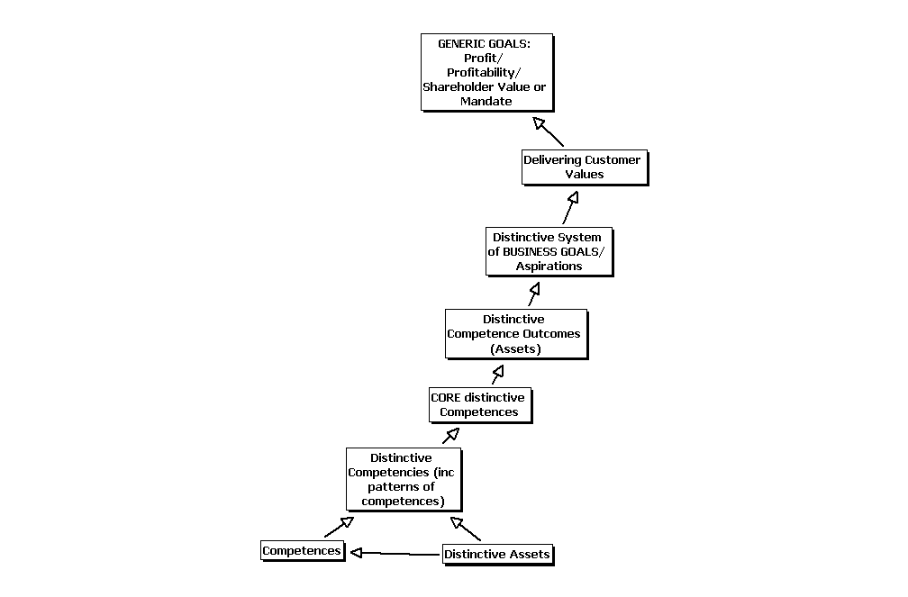
Summarizing
the Business Model
Discovering CORE
Distinctive Competences to
Manage Competitive Advantage

Slide 12
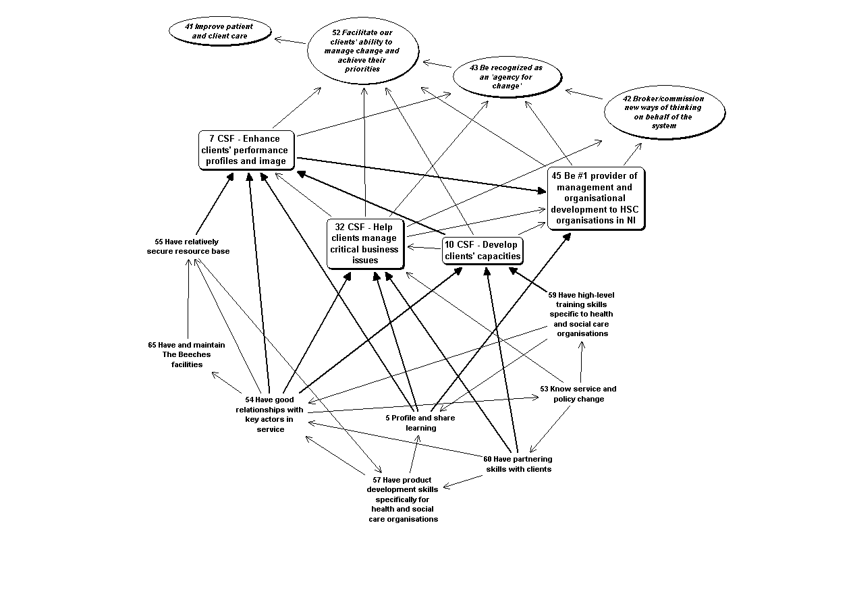
An Example of a Not-for-Profit “Livelihood Scheme”
From: Bryson, J. M.; Ackermann, F., and Eden, C. Putting the Resource-Based View of Strategy and Distinctive Competencies To Work in Public Organizations. Public Administration Review. 2007; 67(4)702-717.

Slide 13
Starting to build the BM
Work with the most distinctive competence (DC)
And the most distinctive competences outcome (DCO)
THESE ARE LIKELY TO BE A PATTERN OR BUNDLE – if a loop then this will likely be the first thing start with

Slide 14
Try it…
Target: link DCO’s and DC’s to Goals (add in linking material if necessary and focus on business goals first – not generic goals)
Work at the appropriate level
Either bring goals onto a repeated view of DC’s map (do NOT use copy and paste EVER)
Or bring DCO’s and DC’s on to a repeated view of the goals system view
To repeat a view: right click on TAB and bring layout

Slide 15
Revise the Goals System if necessary
Make the Goals System realistic and powerful
In the light of the Business Model/Livelihood Scheme development identify:
  Goals that are less realistic because they do not have the sustenance of at least one distinctive competence
  Distinctive competencies that are CORE and might become of Goal status

Slide 16
Goal system check…
Goal system task: to avoid replicating the past and/or creating unhelpful stakeholder responses
  Hold the emerging goal system up (as the image in the ‘mirror’)
    This represents the future as driven by the past (from the current issues map): it may, therefore, be a recipe for recreating the past
    Check that this is a ‘comfortable’ view of the required strategic future
      When it is not, then ‘delete’ the goal (not literally – mark it) AND ensure that the issues that generated it are ‘deleted’, so creating important ‘strategic slack’/resource/energy
    Add new goals that describe the organization as it is required to be
      Make sure of laddering from opportunities not just issues
Problems making the goals system explain the “business we’re in”

Slide 17
Profit/Profitability/Shareholder Value or
Mandate
Delivering
Customer Values
Delivering the Character of the Organization
PURPOSE
Distinctive System of Goals/Aspirations
COMPETITIVE
ADVANTAGE
Strategies
to address priority issues
Core Distinctive Competencies
STRATEGIES
Distinctive Competencies
Strategies
to exploit & sustain
Core DC’s
Competencies
Summarizing the Elements of the Statement of Strategic Intent

Slide 18
Statement of Strategic Intent (SSI)
  Construct a Draft Statement of Strategic Intent in the form of bullet-point statements from the maps - using three sections:
    A statement of purpose that gets across the goals system hierarchy
    The business model logic: the DC’s that provide for the goals
    Draft strategies following from prioritised issues AND strategies to develop the Business Model (sustaining the core DC’s or C’s, implementing new links)
  Attend to Stakeholder Management within each part of the SSI

Slide 19
SSI content…
SSI development
  Tell me what are you are about? What do are you trying achieve? [section one]
  Ok, others says that – so why will you manage that? Because we, uniquely, can deliver – we are special in the following ways… [section two]
  And we recognise that there are some things we have to do to make this happen, not least we will ensure that others can’t grab our uniqueness. [section three]
  And we must pay attention to key stakeholders and their responses to support or sabotage our potential success in delivering goals (1), competitive advantage (2), and resolving our strategic issues (3)

Slide 20

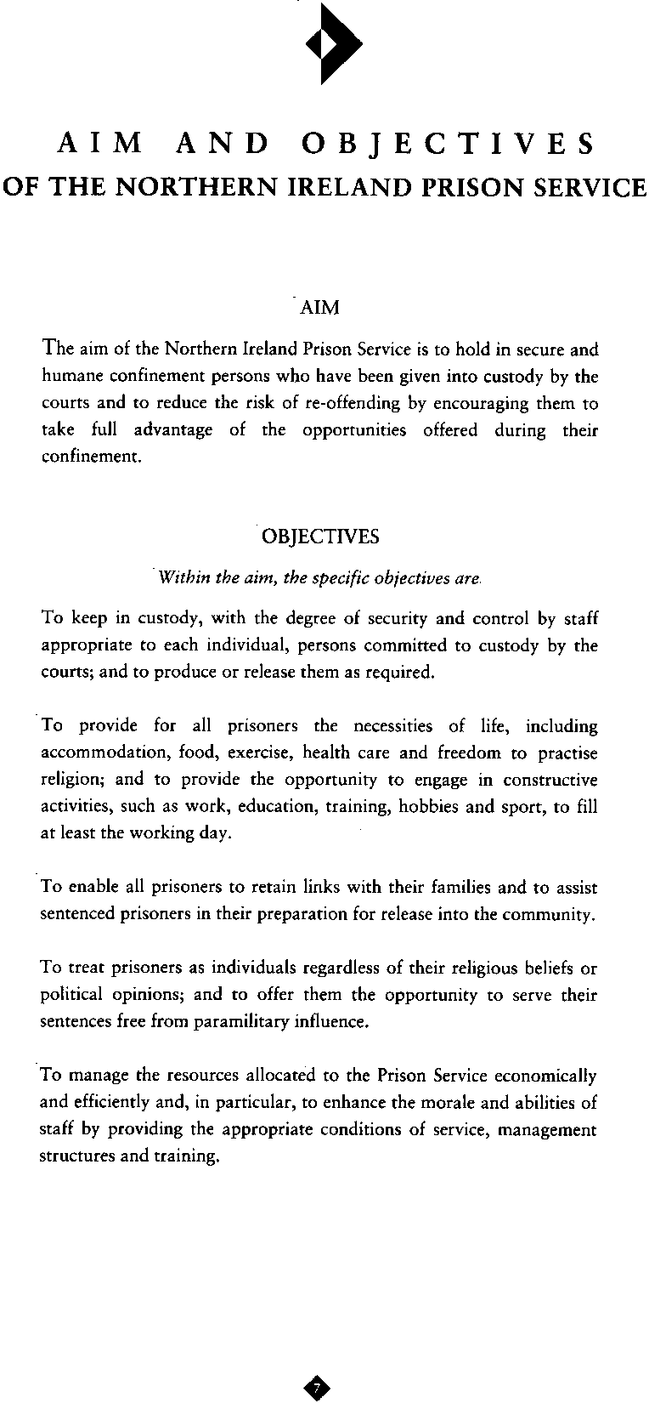
See vignette in: Eden, C and Ackermann, F. Making Strategy The Journey of Strategic Management. London Sage; 1998

Slide 21

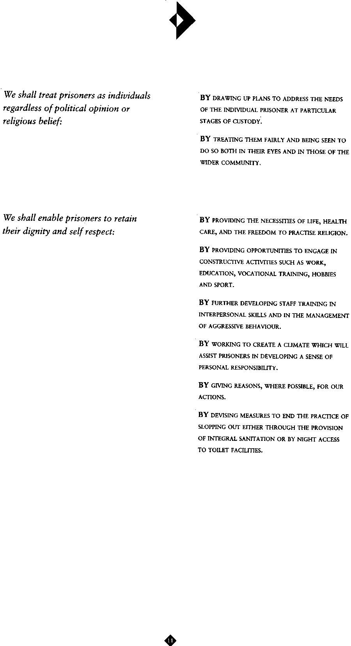
From Map to SSI Document
An example
See vignette in: Eden, C and Ackermann, F. Making Strategy The Journey of Strategic Management. London Sage; 1998

Slide 22
Don’t forget…
Alternative futures/Scenario planning work
Possibly develop KPI’s for goals and strategies
  This also works well for developing options for the delivery of goals and strategies
  But watch for double messages and ‘what can be measured driving out what can’t be measured’
  Steven Kerr article
Roughly test out the numbers
  Rough spreadsheet model developed interactively: XL as a ‘transitional object’
The need for strategic slack to create change effort
  Project planning

Slide 23
KPI’s: REMEMBER
“Everything that can be counted does not necessarily count; everything that counts cannot necessarily be counted”
Albert Einstein (1879-1955)

