Slide 1
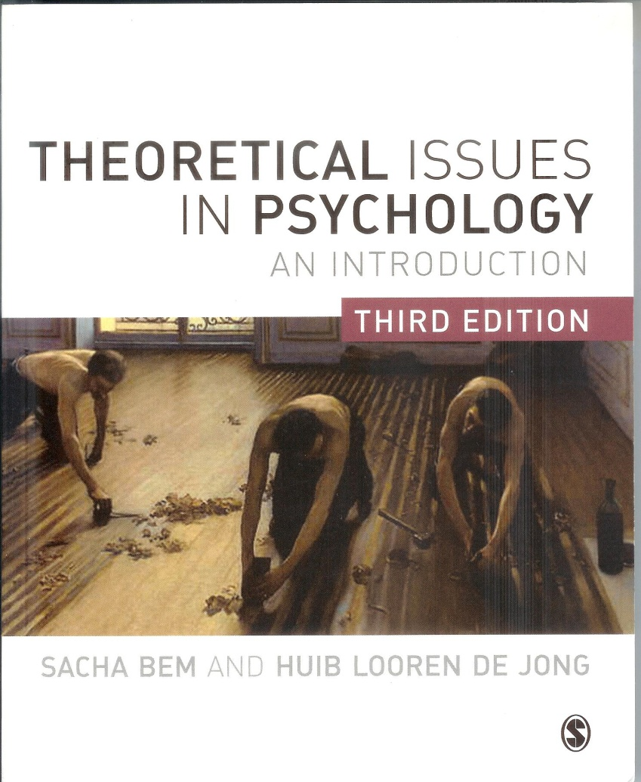
Theoretical Issues in Psychology
Philosophy of science
and
Philosophy of Mind
for
Psychologists
space for cover

Slide 2
Chapter 4
Philosophy of science (2)
Doubts about objectivism
Hermeneutics
Social constructionism
Rhetoric, discursive psychology, psychology as criticism
Realism and relativism
Revisions of realism
Pragmatism
Salvaging objective knowledge

Slide 3
Continental philosophy: anti-positivism
Phenomenology: starts from ‘phenomenal’ (1st person) experience; description of
life-experience
Akt-Psychology:
mental acts, directed to the world: ‘intentionality’
Brentano
1838–1917
Husserl
1859–1938
Hermeneutic:
reconstruction life-experience,
life as (con)text, understanding of meanings
Heidegger
1889–1976
Dilthey 1833–1911
Gadamer
1900–2002

Slide 4
Anti-positivism in historical Germany
German Philosophy 19th Century: idealism, romanticism
Opposing: Enlightenment (British, French) with its cold rationalism, elementarism, positivism/scientism (Comte); idea of progress; individualism.
Promoting: feeling, intuition, not just intellect; holism, historical relativism, back-to-nature and pre-Industrial Revolution; deeper meaning, holistic life experience, not just isolated facts.
Endorsing: phenomenology, hermeneutics.

Slide 5
Troubles with(in)
logical positivism
(Kuhn, Feyerabend)
No independent
a-historic criterion of truth (i.e., no demarcation)
Prejudices inevitable, subject-dependency,
no objectivity
Relativism and
subjectivism
No criterion for progress
Continental anti-positivist
philosophy
No explaining,
but understanding

Slide 6
Positivistic explaining versus
Hermeneutical understanding
Natural sciences
Time-spatial events
Causes
Nomothetic
Explaining
Object/objectivism
Method-centered
Social sciences
Actions
Reasons
Idiographical
Understanding
Subject/subjectivism
Context/meaning-centered

Slide 7
Hermeneutics historically
Originally: method for interpretation of difficult texts (Bible; legal texts).
Dilthey (1900): method for humanities (as opposed to explanation in natural sciences).
Heidegger (1927), Gadamer (1960): general metaphysical/epistemological position.

Slide 8
Analytical Philosophy
Logical Positivism
Wittgenstein
Quine, Sellars
German Hermeneutics
Dilthey
Heidegger
Gadamer
(Post-Positivism)
Taylor
Dreyfus
Rorty
Kuhn
Social-
constructionism
Gergen
Shotter

Slide 9
Hermeneutics
Humans are historical beings.
Dialogue between researcher and object, both change; meaning of text changes through history; interpretator cannot escape his own historical situation (horizon) and prejudices.
Therefore, no fixed object, no objectivitity, no objective meaning (compare art: spectator changes; meaning changes).
Ongoing interpretation, no objective result or final interpretation, no definite truth, but continuing history and tradition.

Slide 10
Modern Hermeneutics
More than method for text interpretation: all knowledge hermeneutical, i.e.:
  situatedness knower, prejudices;
  no objective criteria, no best interpretation;
  language is the medium;
  continuity, tradition.
Converges with post-positivism (Kuhn, Wittgenstein II):
  tradition: paradigm, language game;
  form of life: social and contextual meaning;
  situatedness: staying within the circle.

Slide 11
Convergence hermeneutics and Kuhn
Circularity interpretation (Kuhn: perceptual training).
Subjective contribution inevitable (prejudice, dogmatism).
Social influence (Wittgenstein II: form of life, language game, laboratory).
No neutral observation, no objective foundation.
Knowledge as human product.

Slide 12
Social constructionism
Kenneth Gergen
Relativistic conclusions from post-positivism.
Knowledge and language do not represent
reality, but are social artefacts.
Theory is part of social game (Wittgestein’s language game).
Consensus instead of correspondence theory of truth.
Theory and concepts are social constructions.
Social reality is ‘negotiable’.
No empirical, universal foundations for science.

Slide 13
Gergen on psychology
Psychology not about the psyche (inner states, character, etc), but on social relationships.
Not understanding of the nature of things (mind), but of social processes.
Terms for mental processes reflect social processes: communication, conflict, negotiation.
Topics and concepts are social artefacts, i.e. products of historically situated interactions.
Behaviour is action embedded in context.
There is no one best interpretation.
Psychology’s main task: unmasking and deconstructing ideology and interests, about democratisation and
liberating suppressed ‘voices’.

Slide 14
Gergen: Social constructionism views discourse about the world not as a reflection or map of the world, but as an artefact of communal exchange.
Shotter: The basic function of language is not the
representation of things in the world … It works to create, sustain and transform various patterns of social relations.
Rorty: Truth is not a correspondence between language and reality, but is relative to a given language system, and cannot be elevated out of the linguistic realm …
Conversation is the ultimate context in which knowledge is to be understood.

Slide 15
Billig : science is rhetoric
Science is communication.
Communication is essentially rhetorical.
Science is an intrinsically rhetorical or
persuasive activity.

Slide 16
Discursive psychology
People are discursive subjects, they exchange mea- ningful language.
Explanations not of things and events in the world
but of discourses (conversations, texts).
Priority to ordinary language in defining psycholo-
gical phenomena (emotions, attitudes, perso-
nality, decisions).
These phenomena are not manifestations of hidden
impersonal cognitive states (in the brain, pro-
grams, representations), but are interpersonal
discursive practices (e.g., emotion-talk).

Slide 17
Kinds of relativism
Ontological: there is no mind-independent world.
Epistemological: we cannot know a mind-independent
world even when it existed.
Of truth: there is no truth outside human (social)
Interests.
Of rationality: there is no universal standard of
rationality, or rational discource.
Of morality: there is no universal standard of morality.

Slide 18
Problems for...
Realism
No neutral empirical data, observations theory-laden.
No certain foundations.
Historical fallibility of theories (theories, facts are man-made).
Science more than theories.
Correspondence implausible.
Relativism
Self-defeating.
Relative to what? (nations, cultures, tribes).
Incommensurability not plausible.
Science more than language.
Consensus problematic.

Slide 19
Theory (language) or Action (intervention)
For relativism, and for realism also:
science is mainly theory, representing, couched in language:
realism: correspondence with reality;
relativism: no correspondence with reality.
For pragmatism:
science is not only language, theory,
but also an activity, intervention, experiments, in the world.

Slide 20
American Pragmatism in history
Charles S. Peirce (1878): ‘Thought is essentially an action’. ‘Belief is a rule for action’.
William James (1907): ‘The possession of true thoughts means the possession of instruments of action’.
John Dewey (1929): opposing ‘the spectator theory of knowledge’: ‘Knowing is activity ... one kind of interaction which
goes on in the world’.

Slide 21
Modern pragmatists
Hilary Putnam (1981)
‘The mind and the world jointly
make up the mind and the world’.
Ian Hacking (1983)
‘It is not thinking about the world
but changing it that in the end
must make us scientific realists’.

Slide 22
Realism
correspondence: language↔object
Positivists
Realism modern style:
scientific realism
Boyd
Churchland
Pragmatism
theory & action
Putnam
Hacking
Rouse
Instrumentalism
scientific theories are only tools
Mach
(Dennett)
Relativism
coherence / consensus
language is social medium
Kuhn
Feyerabend
Rorty
Gergen
Social-constructionism

