Slide 1
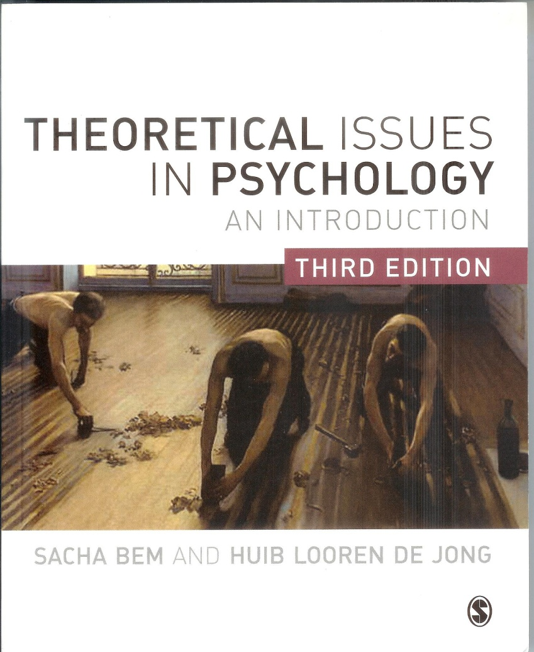
Theoretical Issues in Psychology
Philosophy of science
and
Philosophy of Mind
for
Psychologists

Slide 2
Chapter 10
Consciousness and free will
  Consciousness and qualia
  Mentalistic and naturalistic theories on consciousness
  A tentative definition: the external and internal perspective
  Phenomenal consciousness
  Brainwork organization
  Searching for the neural correlate of consciousness
  Problems for the idea of correlation
  Is consciousness nothing but brainworks?
  To sum up: if consciousness is not an illusion
  Free will, determinism and responsibility
  Dennett’s naturalistic account
  Free will, consciousness and self regulation
  Consciousness, free will, and conscious control

Slide 3
Qualia
Qualia (singular: quale): phenomenal, first-personal, subjective or qualitative features of experiences or feelings, like feeling pain, seeing red, hearing music, tasting chocolate.
By some philosophers they are seen as the hallmark of consciousness.
Materialists however try to naturalize or to eliminate qualia; e.g. by reducing them to brain processes.
Thus the question is: are these first-person phenomenal experiences accessible to objective, third-person scientific means and descriptions; can consciousness be translated in objective scientific descriptions?

Slide 4
Mentalistic views on qualia and consciousness
The bat-story: first-person experiences are irreducible.
Story about Mary, the colour-blind scientist: there is a limit to what science can tell us about our private experiences.
Thomas Nagel
Frank Jackson
The mind-body problem is not cognitively accessible to humans: cognitive closure.
Colin McGinn

Slide 5
Naturalistic views of consciousness
There is no non-physical aspect to conscious states; consciousness is nothing but a special, auto-connected pathway of knowing.
Paul Churchland
The mind is a jumble of parallel information-processing sequences, narratives or multiple drafts competing for dominance and influence over the rest of the brain. The self is a centre of narrative gravity.
Daniel Dennett

Slide 6
A neurobiological view of consciousness and emotions
Consciousness begins deep in organisms’ brain structures, as emotional reactions to the environment, and evolves beyond complex patterns of life-functions into personal selfconsciousness.
Antonio Damasio

Slide 7
A tentative definition of consciousness (Damasio)
The external, behavioral, perspective:
      Wakefulness
      Background emotions
      Attention
      Purposive behavior
The internal, subjective, me-perspective (phenomenal c.)

Slide 8
The theater metaphor of consciousness (Baars)
(condensed)
outer senses
inner senses
ideas
The players:
The spotlight
of attention
shining on the
stage of working
memory:
conscious experience
The unconscious audience:
memory systems
such as:
lexicon; world knowledge
interpreting con-scious contents:
face recognition etc.
automatisms:
skill memory; action control etc.

Slide 9
Some problems for finding correlation
It is not clear what ‘correlation’ is.
How solid is the evidence?
What do the imaging techniques (fMRI) measure?
Registering brain activity: which cognitive operations are involved?
The brain is never at rest: against what do we compare the image?
Empirical neurofacts vs interpretations of cognitive phenomena
The averaging problem: people do not have standard brains
No chain of single causes, but reciprocal causality: elements are interconnected and interdependent and each contributes to changes in the whole system.

Slide 10
Some think that we cannot find consciousness in the brain
‘Being you is not the same as the sum of your brain states’
Consciousness is extra-cranial: embodied and embedded
Wittgensteinian answer: ‘Beware the mereological fallacy’

Slide 11
Free will and determinism
Three conditions for free will:
1. The agent must have been able to do otherwise
(problem: external and/or internal constraints?).
2. The act must originate in the agent, not in external forces (e.g., hypnosis?).
3. The action must be rational, comprehensible
(unpredictable, crazy behavior is not really free).

Slide 12
Free will and determinism
Is free will possible in an causally closed deterministic universe? Two positions:
Incompatibilism: free will is incompatible with determinsm; genuine freedom of will would have to break through the causal chain of natural events.
Compatibilism: free will is freedom from external force, but willings are part of a causal chain, determined by an individual’s history, genes, nervous system, etc.
Freedom is acting in accordance with ‘second order desires’.

Slide 13
Dennett on free will and evolution
Freedom is ‘evitabillity’, flexible sophisticated behavior to avoid harm.
Exploring the environment, invent new strategies, antecipating, planning, self control.
Changing one’s repertoire, changing one’s self – ‘self created self’.
Naturalistic empirical psychological rather than philosophical-metaphysical concept of freedom.
Compatibilism.

Slide 14
Illusion of free will?
‘Willusionists’: conscious free will is epiphenomenon.
Libet: brain makes the decisions, before consciousness.
Wegner: illusion of conscious will and free choice;
unconscious brain processes make decision,
and cause illusion of conscious choice.
Mele: willusionists have a simplistic view of (un)conscious intentions.
Conclusion: free will now empirical studies self-control rather than metaphysics of determinism.

